Slide 1


Net Worth Analysis
An Investigative Approach
OECD – Bribery and Corruption Specialty Programme
October 2024

Slide 2
Trevor McCurry,
Technical Advisor
Criminal Investigations Division, Ontario East Region
Canada Revenue Agency (CRA)

Slide 3

Agenda
PART I: Overview of Net Worth Analysis
PART II: Assets
PART III: Liabilities
PART IV: Calculation of Illicit Income
Expenses and Adjustments
Sources of Income and Adjustments
Calculation of Total Illicit Income
PART V: Presentation of Net Worth Analysis

Slide 4

PART I:
Overview of Net Worth Analysis

Slide 5

What is a Net Worth Analysis?
A Net Worth Analysis is an indirect method of determining an individual’s income earned through illicit means. The Net Worth Analysis quantifies the illicit income by analyzing the following:
Assets
Liabilities
Expenditures
Known Sources of Funds

Slide 6
Why Use a Net Worth Analysis?
A Net Worth Analysis can assist an investigator in quantifying the amount of illicit income earned by an individual over a specified period of time.
A Net Worth Analysis can be utilized when:
Business or financial records are incomplete, unreliable or non-existent;
The accused deals primarily in cash; and
Known sources of income do not support the accused lifestyle.

Slide 7
What Types of Illicit Income Can be Determined
Through a Net Worth?
A Net Worth can be used to quantify income earned from both legitimate business operations as well illicit business operations. These could include, but are not limited to:
Unreported business or personal income (Tax Evasion)
Income earned from drug trafficking
Income earned from bribery or corruption
Income earned through theft or embezzlement
Income earned through human smuggling or trafficking
Income earned through extortion

Slide 8
How Does a Net Worth Work?
A Net Worth looks at the change in assets and liabilities from one year to the next, adjusted for expenditures and known sources of funds to quantify the amount of illicit income.
The Net Worth always starts with a base year amount for assets and liabilities which is generally one day prior to the start of the investigation period.
For example, if your investigation period is from January 1, 2020 to December 31, 2023, a base year balance must be established for assets and liabilities at December 31, 2019.

Slide 9
How to Calculate Illicit Income Using a Net Worth?
Asset
-
Liabilities
=
Net Worth
-
Prior Years Net Worth
=
Increase (Decrease) in Net Worth
+
Expenses and Adjustments
-
Known Sources of Funds and Adjustments
=
Total Illicit Income Earned

Slide 10
Who Gets Included in the Net Worth Analysis?
Who gets included in the Net Worth Analysis is determined on a case by case basis. In most situations the following people are included in the Net Worth Analysis:
  Accused
  Spouse
  Dependent Children
Depending on the case, the Net Worth Analysis could be expanded to include:
  Parents of the accused or spouse
  Adult children
  Other relatives or individuals residing with the accused
Notes:
Determining how each individual is treated on the Net Worth Analysis must be done in a factual way. Items to consider include:
Is the accused married or in a common-law relationship?
Does the accused have dependent children?
Does the accused have adult children that contribute to the household expenses?
Does the accused have other dependent family members?
Who contributes to paying the household expenditures?
Is there co-mingling of funds between the accused and another member of the household?
Are there assets or liabilities in family members names that are paid for by the accused?

Slide 11
What Gets Included in a Net Worth Analysis?
Personal and business assets of the accused, spouse and dependent family members.
Personal and business liabilities of the accused, spouse and dependent family members.
Personal expenditures of the accused, spouse and dependent family members.
Known sources of funds of the accused, spouse and dependent family members.

Slide 12

What Does Not Get Included in a Net Worth Analysis?
Asset and liabilities of a corporation where the accused or their spouse is a shareholder.
Business income and expenses of a corporation where the accused or their spouse is a shareholder.
Notable Exceptions:
  The cost of the shares to the accused;
  Amounts loaned to or from corporation by the accused; and
  Illicit funds and assets flowing through a shell corporation.

Slide 13

Net Worth Case Study Part I: Case Background
In your breakout groups, open your handout to TAB 1.
Review the “CASE INFORMATION” section.
Complete the “FOR YOUR ACTION” section.
Time to Complete: 30 Minutes

Slide 14

PART II:
Assets

Slide 15

Assets
**Assets are recorded on the Net Worth at cost and not fair market value**
Types of Assets for Discussion
Bank Account Balances
Personal Business Assets (Sole Proprietorship)
Cash on Hand
Investment Accounts
Vehicles
Real Property
Accounts and Assets in Foreign Currency
Notes:
Business assets could include buildings, inventory, vehicles, financial accounts, etc.
With each of these types of assets, we are going to discuss where you obtain the information and what amount gets included on the Net Worth.

Slide 16
Bank Account Balances
How Do I Obtain This Information?
Bank statements obtained through the use of a search warrant or other judicial order
What Amount Gets Recorded on the Net Worth?
The balance in the account at December 31st.
Notes:
A date other than December 31st can be used when preparing a net worth; however, December 31st is preferable as most financial records are produced on a calendar year end.

Slide 17
Personal Business Assets
How Do I Obtain This Information?
Personal Income Tax Returns
Accounting records
Regulatory filings
Public databases
What Amount Gets Recorded on the Net Worth?
The cost of the asset. If the accused continues to own the asset throughout the investigation period, the cost of the asset recorded on the Net Worth remains the same.

Slide 18
Cash on Hand
How Do I Obtain This Information?
Unfortunately cash on hand can not be factually determined but is often used by defense to explain a Net Worth discrepancy.
What Amount Gets Recorded on the Net Worth?
Since cash on hand cannot be factually determined, a number of steps can be taken to reasonably determine:
  Was there cash on hand at the start of the investigation period?
  How much cash was available?

Slide 19
Cash on Hand Continued
Steps for Determining Cash on Hand:
  What was the amount of cash found during the execution of search warrants or during arrest?
  Was there interest paid on mortgages, lines of credit and credit cards during the investigation period?
  Were any NSF cheques issued during the investigation period?
  Were any assets paid for in cash during the investigation period? Was the cash used to purchase the asset withdrawn from a bank account or is its origin unknown?
  Have there been any large cash deposits during the investigation period that could have an effect on the Net Worth?
  Was there an interview of the accused, co-accused or other family or friends? If yes, what was said regarding the quantity of cash held outside of the accused bank account at any given time?
  Review the income tax filings of the accused and their spouse prior to the start of the investigation period. Did the accused have the means to accumulate a large amount of cash during that period?

Slide 20
Cash on Hand Continued
If it is determined that there was a reasonable possibility that the accused had cash on hand at the beginning of the investigation period, a determination should be made as to how much cash was available. This can be determined by looking at the following items:
  The amount of cash used to purchase assets.
  The amount of cash deposited into the accused bank and credit accounts that can not be attributed to a known source of income.
  The amount of cash used to reduce outstanding liabilities.
The benefit of the doubt should always be given to the accused when dealing with cash on hand since the amount used in the Net Worth can not be factually verified.
Remember, if the amount of cash on hand remains constant throughout the investigation period, there will be no impact on the Net Worth.

Slide 21
Investments
How Do I Obtain This Information?
Income Tax Returns.
Investment Statements obtained through a search warrant or other judicial order.
What Amount Gets Recorded on the Net Worth?
For tax sheltered investments, the cumulative amount contributed to the investment at December 31st is used.
For all other investments, the adjusted cost base of the investment at December 31st is used.
Notes:
Adjusted cost base accounts for the amount invested by the accused and any earning accumulated in the investment (interest, dividends, sale of investment products)

Slide 22

Investments Continued
Example
Accused purchases 10 shares in XYZ Corp. for $10/share on January 15, 2022.
Accused purchases 15 shares in XYZ Corp. for $20/share on March 17, 2022.
Calculation of Adjusted Cost Base (ACB)
10 shares @ $10/share = $100
15 shares @ $20/share = $300
Total Cost of shares $400 (Recorded as an asset at December 31, 2022)
Total Number of shares 25
ACB per share $16
On April 4, 2023 the accused sells 5 shares in XYZ Corp. for $25/share and deposits the money into their bank account.
5 shares @ $25/share = $125
ACB of $16 x 5 shares = $80
Gain on sale of shares $45

Slide 23
Investments Continued

Slide 24
Vehicles
How Do I Obtain This Information?
Motor vehicle registry.
Vehicle purchase receipts obtained through the use of a search warrant or other judicial order.
Surveillance.
Loan registries.
What Amount Gets Recorded on the Net Worth?
The purchase price of the vehicle gets recorded at December 31st in the year the vehicle is purchased.
The purchase price of the vehicle remains on the Net Worth until the vehicle is sold or disposed of.

Slide 25

Vehicles Continued
Example 1
On December 22, 2023 the accused purchases a new personal vehicle and sells their current vehicle. Information obtained through the investigation shows the following:
New Vehicle
Total purchase price of new vehicle - $45,000
Down payment on new vehicle - $10,000 (from sale of current vehicle)
Amount borrowed to purchase new vehicle - $35,000
Current Vehicle
Total purchase price of current vehicle - $25,000 (purchased prior to the investigation period)
Sale price of current vehicle - $10,000 (put toward purchase of new vehicle)

Slide 26
Vehicles Continued

Slide 27
Real Property
How Do I Obtain This Information?
Land ownership registry.
Property purchase documents obtained through the use of a search warrant or other judicial order.
Surveillance.
Witness interviews.
Loan registries.
What Amount Gets Recorded on the Net Worth?
The purchase price of the property gets recorded at December 31st in the year the property is purchased.
The purchase price of the property remains on the Net Worth until the property is sold.

Slide 28
Real Property Continued
Example
On June 5, 2023, the accused purchases a new principal residence and sells their old principal residence. Information obtained through the investigation shows the following:
Old House
Purchase price - $350,000 (purchased prior to investigation period)
Sale Price - $425,000
Outstanding Mortgage discharged at time of sale - $125,000
New House
Purchase price - $525,000
Down payment - $10,000 (from bank account)
Amount Borrowed - $215,000 [$525,000-($425,000-$125,000)-$10,000]

Slide 29
Real Property Continued
Calculation of Gain on Sale
Sale Price $425,000
Purchase Price $350,000
Gain on Sale $75,000

Slide 30







Cryptocurrency
How Do I Obtain This Information?
Crypto exchange transaction history obtained through a search warrant or other judicial order.
Crypto wallets (cell phone, computer, web based, paper or cold storage) identified during the execution of a search warrant.
Public or private crypto address information identified during the execution of a search warrant.
Seed word list identified during the execution of a search warrant.
Receipts from crypto ATMs identified during the execution of a search warrant.
Transfer of funds to/from bank accounts or credits cards to purchase or sell cryptocurrency.
Notes:
Adjusted cost base accounts for the amount invested by the accused and any earning accumulated in the crypto wallet.

Slide 31
Crypto Currency Continued
What Amount Gets Recorded on the Net Worth?
A blockchain analysis software such as Chainalysis can be used to determine when crypto is purchased, sold, transferred or spent and can be used to determine the adjusted cost base of the cryptocurrency.
The adjusted cost base of the cryptocurrency at December 31st is used.
Notes:
Adjusted cost base accounts for the amount invested by the accused and any earning accumulated in the crypto wallet.

Slide 32
Accounts and Assets in Foreign Currency
How Do I Obtain This Information?
Documents obtained through the use of a search warrant or other judicial order.
Foreign Land Registry databases.
Mutual Legal Assistance Treaty (MLAT).
Treaty Requests for tax information.
Non-treaty requests.
What Amount Gets Recorded on the Net Worth?
If the asset was real property, a vehicle or another asset that is purchased in very few specific transactions, the value should be recorded on the Net Worth in the year it is purchased and at the daily exchange rate used for the transaction. This amount would be carried forward on the Net Worth for each subsequent year the accused owns the asset.
For bank account and credit card account balances, an annual exchange rate can be applied.
Both the daily and annual exchange rate information can be obtained from your country’s central banking authority.

Slide 33
Net Worth Case Study Part II: Assets
In your breakout groups, open your handout to TAB 2.
Review the “CASE INFORMATION” section.
Open the file titled “Net Worth Template.xlsx”.
Complete the “FOR YOUR ACTION” section.
Time to Complete: 30 Minutes

Slide 34

PART III:
Liabilities

Slide 35
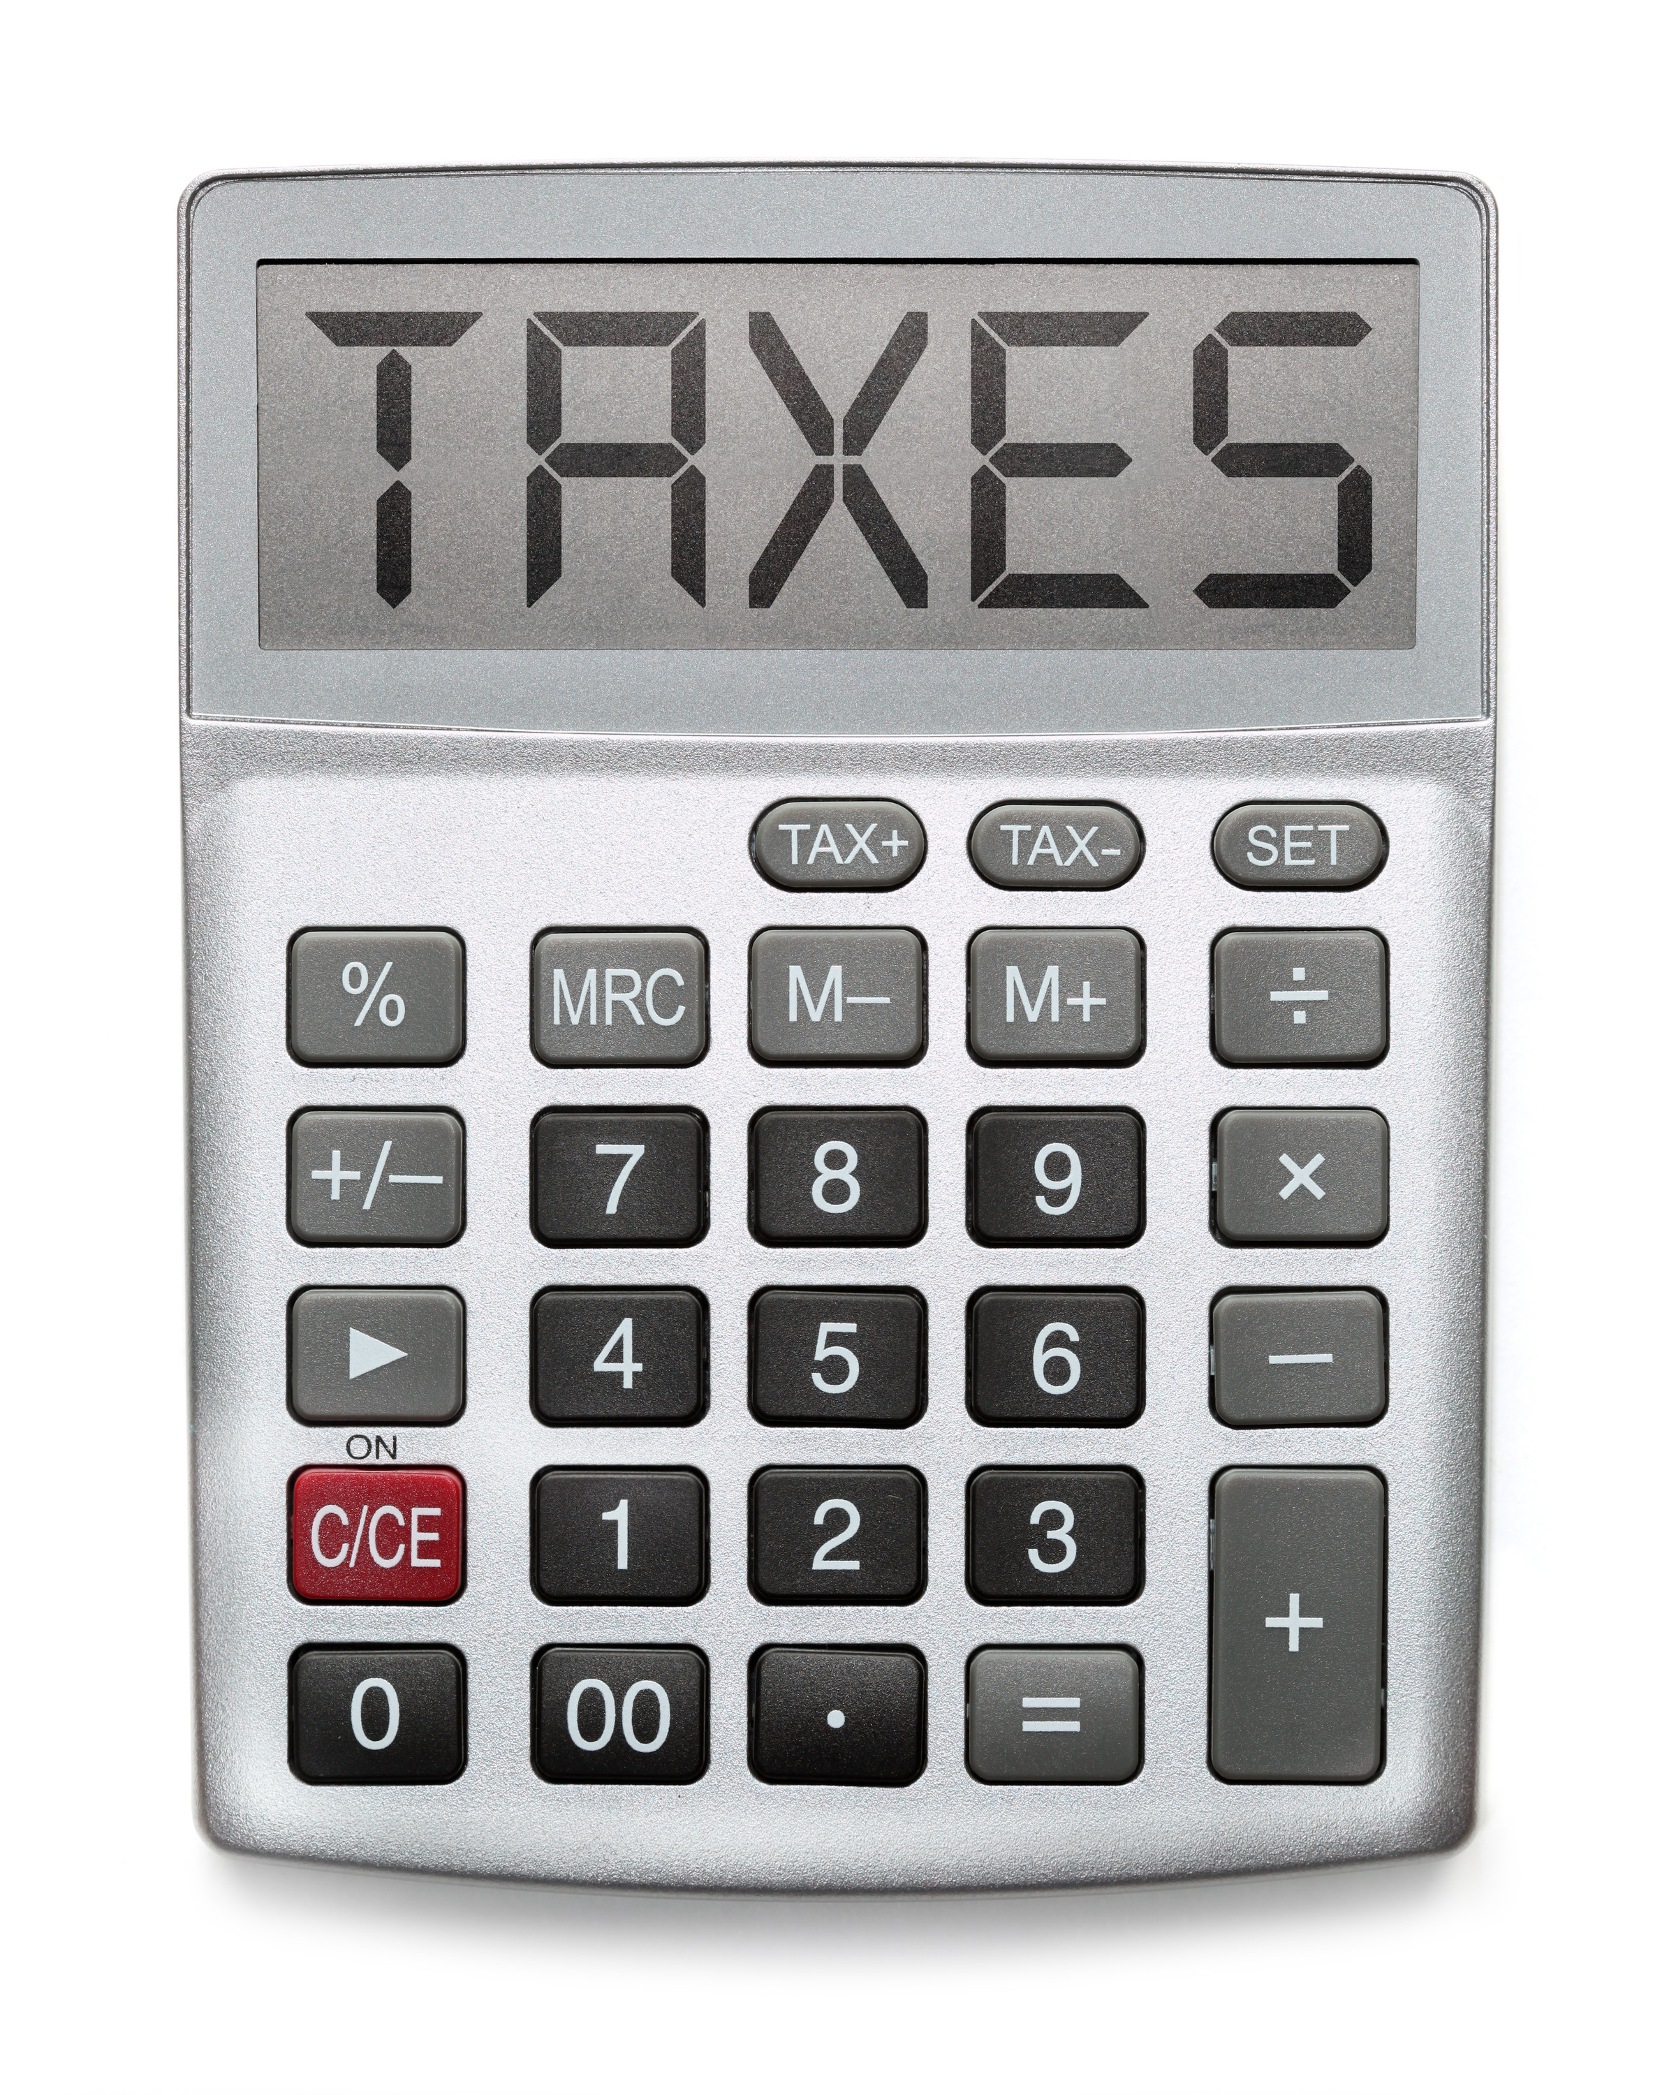



Liabilities
Types of Liabilities for Discussion
Value Added Taxes Payable (VAT)
Credit Cards and Lines of Credit
Personal Loans
Mortgages

Slide 36
Value Added Taxes Payable
How Do I Obtain This Information?
Government tax authority records.
Business and accounting records.
What Amount Gets Recorded on the Net Worth?
The amount owing to government tax authority at December 31st is recorded on the Net Worth. The formula to calculate the balance is as follows:
  December 31 Net VAT Owing (Base Year)
  +
  Net VAT Owing (Receivable) for Current Year
  -
  VAT Remitted (Refunded) for Current Year
  =
  VAT Owing (Current Year End)

Slide 37
Credit Cards and Lines of Credit
How Do I Obtain This Information?
Credit card and line of credit statements obtained through the use of a search warrant or other judicial order.
What Amount Gets Recorded on the Net Worth?
The balance in the account at December 31st.
Items to Remember
  The majority of credit cards do not have their statements issued on the last day of the month.
  The amount included on the Net Worth should be the December 31 balance which could fall in between statement dates.
  Reconcile the transactions on the credit card to December 31 based on their transaction date.

Slide 38
Personal Loans
How Do I Obtain This Information?
Loan and/or banking documents obtained through the use of a search warrant or other judicial order.
Witness interviews.
Loan registries.
What Amount Gets Recorded on the Net Worth?
The balance owing in the account at December 31st
Notes:
Remember to investigate the source of the loan. For example, the accused may take illicit cash, provide it to a third party who then returns the funds structured like a loan. The big question to ask is did that person have the financial means to make a loan to the accused. This could be determined by obtaining the tax records of the person making the loan.

Slide 39
Mortgages
How Do I Obtain This Information?
Land ownership registry.
Property purchase documents obtained through the use of a search warrant or other judicial order.
Loan registries.
What Amount Gets Recorded on the Net Worth?
The balance owing on the mortgage at December 31st.
Items to Remember
Mortgage payments generally contain two components, the principal payment on the mortgage balance and interest on the mortgage balance. Each amount will be dealt with separately in the Net Worth.
Notes:
Land ownership and loan registries can have some or all of the following information:
Date of loan
Frequency of payment
Amount of payment
Interest rate
Term of mortgage
First payment date
Last payment date

Slide 40
Mortgages Continued
Example
On May 29, 2019, the accused purchased their principal residence for $450,000. At December 31, 2023, the accused owed $100,000 on a mortgage related to their personal residence. During 2024, the following payments were made related to the mortgage:
Monthly Interest $500
Monthly Principal $1,000
Total Monthly Payment $1,500
Total Interest Paid in 2024 $6,000
Total Principal Paid in 2024 $12,000
All mortgage payments were made from the accused bank account.

Slide 41
Mortgages Continued

Slide 42
Net Worth Case Study Part III: Liabilities
In your breakout groups, open your handout to TAB 3.
Continue with the file titled “Net Worth Template.xlsx”.
Review the “CASE INFORMATION” section.
Complete the “FOR YOUR ACTION” section.
Time to Complete: 30 Minutes

Slide 43

PART IV:
Calculation of Illicit Income

Slide 44

Expenses and Adjustments
  What type of expenses and adjustments are included?
  Personal Expenses
    Living Expenses
    Household Expenses
    Food
    Travel
    Clothing
    Entertainment and Recreation
    Healthcare
    Interest on personal debt
    Adjustments
      Amounts withheld from employment income
      Loss on sale of assets
      Other items specific to your country’s laws and regulations

Slide 45
Expenses and Adjustments Continued
How Do I Obtain This Information?
Transactions listed in bank and credit card statements
Expense receipts obtained through the use of a search warrant
Income Tax Returns
Witness interviews
Surveillance
Land ownership registry
Loan registries
What Amount Gets Recorded on the Net Worth?
The total expenses incurred by the accused and their household on an annual basis.
Notes:
For example, Income Tax Returns in Canada could contain the following expense information:
Day Care
Property Taxes
Donations
Tuition Fees
Carrying Charges
Adoption Expenses
Medical Expenses
Land ownership registries could contain the following expense information:
Land transfer taxes
Interest paid on mortgages
Loan registries could contain the following expense information:
Interest paid on loans (vehicle loans, other asset loans)

Slide 46
Expenses and Adjustments Continued
Example
An investigation found the following expenses incurred by the accused and their spouse during the year 2023:
Travel $85,000
Restaurants $40,000
Clothing $25,000
Household $30,000
Entertainment $50,000
Total $230,000
The accused had no known sources of income during 2023 except for income earned from their illicit activities. The accused had both a joint bank account and credit card with their spouse. The year end balances are as follows:
Account | 2022 | 2023
Bank Account | $15,000 | $22,000
Credit Card | $2,500 | $4,200

Slide 47
Expenses and Adjustments Continued

Slide 48

Known Sources of Funds and Adjustments
  What Sources of funds and adjustments are included?
  Different types of income
    Employment income
    Net business income
    Investment income
  Gifts from family or friends
  Insurance
  Payments from Government benefit programs
  Income Tax refunds
  Inheritance
  Lottery winnings
    Adjustments
      Gain on sale of assets
      Other items specific to your country’s laws and regulations

Slide 49
Known Sources of Funds and Adjustments Continued
Example
Assume the same facts from the previous example showing the accused personal expenses and bank and credit card balances.
Your investigation has now found the following sources of funds in 2023 related to the accused and their spouse:
Employment Income – Spouse $35,000
Inheritance – Spouse $10,000
Gift in cash from relative – Accused $12,000
Total Known Sources of Funds $57,000

Slide 50
Known Sources of Funds and Adjustments Continued
Previous Example | Revised with Known Sources of Funds

Slide 51
Net Worth Case Study Part IV: Calculation of Illicit Income
In your breakout groups, open your handout to TAB 4.
Continue with the file titled “Net Worth Template.xlsx”.
Review the “CASE INFORMATION” section.
Complete the “FOR YOUR ACTION” section.
Time to Complete: 30 Minutes

Slide 52

PART V:
Presentation of Net Worth Analysis

Slide 53
Net Worth Presentation
The Net Worth Analysis should be accompanied by a written report on your findings. The report would include items such as:
  Information about the author
  Scope of the work
  Summary of findings
  Background
  Methodology
  Detailed findings
  Conclusion
  Schedules and exhibits
Notes:
Information about the author:
Background, experience, education and credentials
Scope of work completed:
What was the purpose of the net worth (quantify illicit income, determine source of funds, determine taxable income)
What were the sources of the information used in the net worth
Limitations of the net worth (missing or unavailable information)
Assumptions made
Summary of findings:
Net worth findings, analysis of banking transactions (deposits and withdrawals), other analysis that feed into the net worth
Background:
Case specifics
Alleged offences
Personal information about the accused
Information about any related businesses
Methodology:
Description of how a net worth works
What procedures were taken to establish the opening net worth balances and amounts entered during the investigation period
Treatment of certain transactions (business vs. personal spending)
Detailed Findings:
A description of the findings for each of the assets, liabilities, expenses and sources of funds.
Conclusion:
A statement on the reports overall findings related to the alleged offences
Schedules and Exhibits:
- Provides supporting documents and analysis completed

Slide 54
Net Worth Presentation Continued
All amounts entered in the Net Worth should have a corresponding source document to reconcile the amount.
  Where the source document is a large PDF, use bookmarks to help the reader find the corresponding information.
Create an electronic folder for each Net Worth schedule (assets, liabilities, expenses and sources of funds) that will contain the source documents. This allows the referencing to stay consistent no matter where the Net Worth is moved to. This also allows for easier disclosure as all the documents pertaining to the Net Worth will be kept together.
For a cleaner looking final product, remove any pre-populated item descriptions that were not used in your analysis.
Assets such as bank accounts should remain as an asset regardless of whether they are in a debit or credit position.
Liabilities such as credit cards and line of credit accounts should remain as a liability regardless of whether they are in a debit or credit position.

Slide 55

Questions?

