Slide 1
Investigative Techniques for the Cash Economy
Uganda: Hilda Bakanansa Walaga

Slide 2
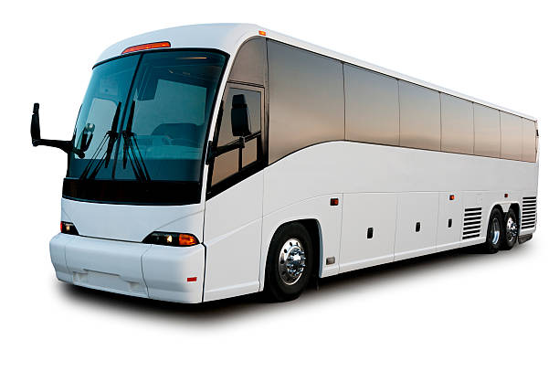
Brief Facts:
Passengers travelling on a bus from the neighboring state into Uganda.
All were subjected to the mandatory CT baggage inspection upon arrival at the boarder entry point into Uganda.
Luggage observation revealed money like
Features.

Slide 3
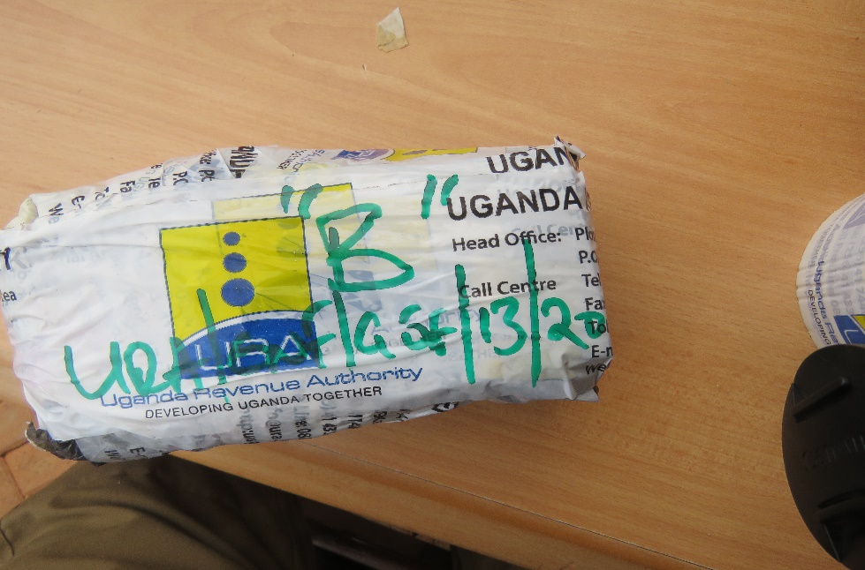
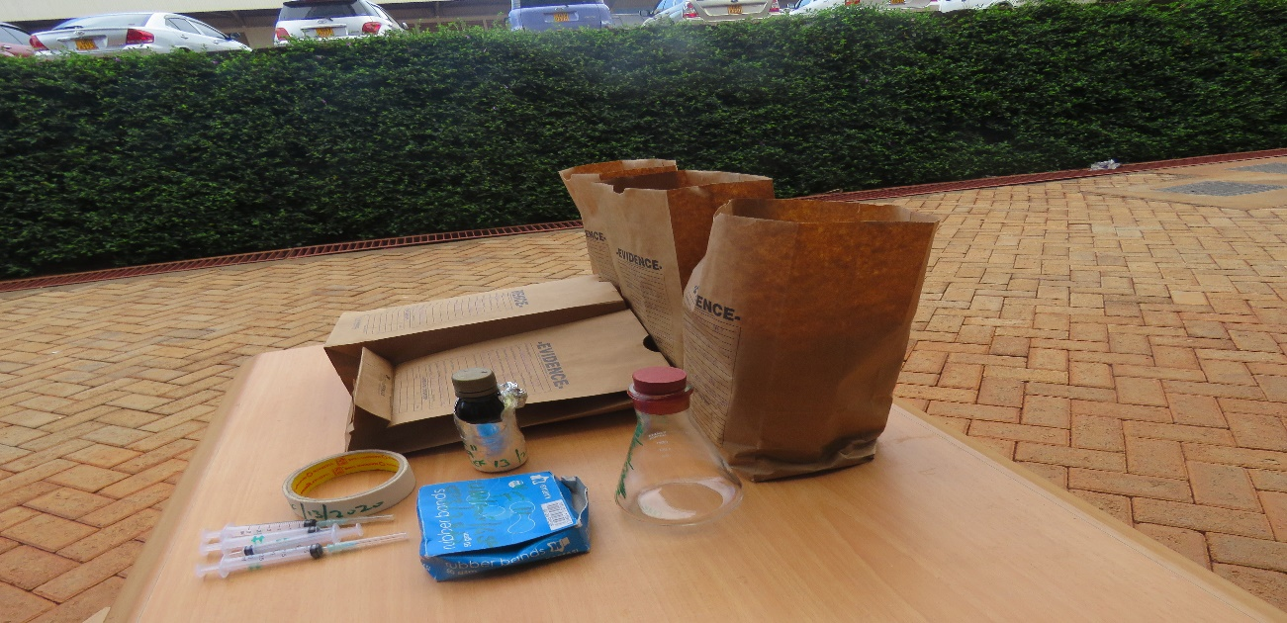
Brief Facts Cont:
Physical inspection of the contents of the baggage

Slide 4
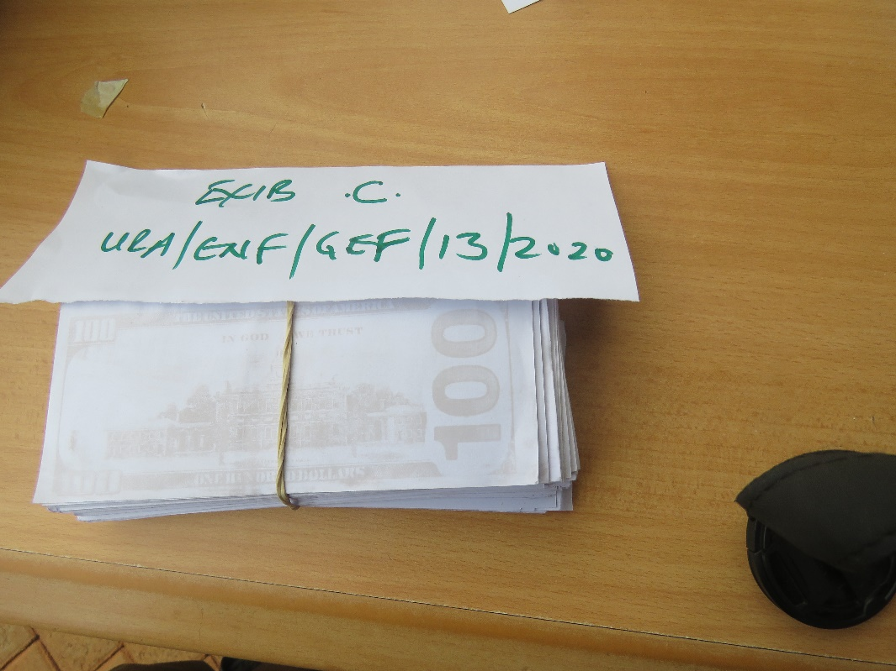
Brief Facts Cont:

Slide 5
Brief Facts Cont:
06 bundles of dollar like papers broken down into 303 pieces of false white US Dollar notes of denominations of 100 (Labelled with US Dollar print), 733 pieces of false Black paper dollars of USD 100 (Labelled with US Dollar print) and 2912 pieces of plain paper notes; a bottle of an unlabeled chemical liquid, 03 syringes and a conical flash.
The baggage owner was identified as Mr. D of Sudanese origin. He was subsequently arrested and charged in court.

Slide 6
Investigations:
Suspect was travelling from Kenya to Uganda as per availed ticket though claimed to final destination to be South Sudan.
Business man who frequently carries on business between Uganda, Kenya and South Sudan. Informal business sector: general trader
Ugandan wife thus roots in Uganda but family resident in South Sudan.
Request to US Secret Service, American Embassy, SA for examination of the suspected counterfeit US Dollar currencies.
No registered business in Uganda or customs entries for exports from Uganda.
Suspect frequents Uganda ie 3 times a month.

Slide 7
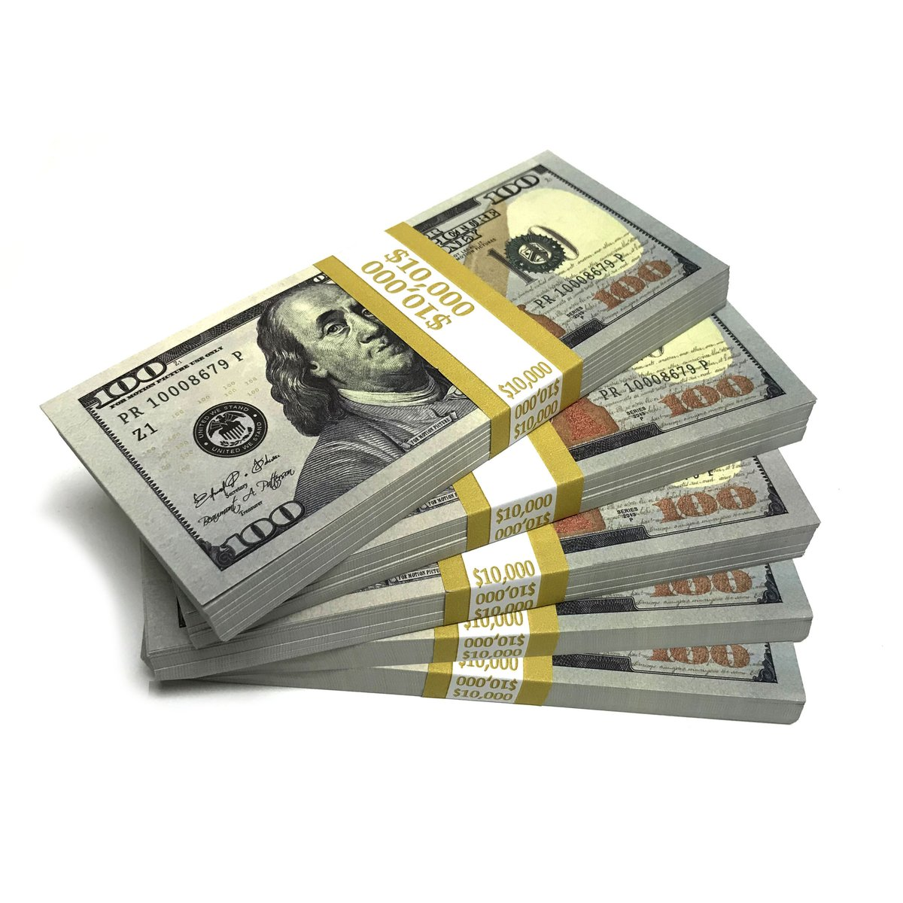
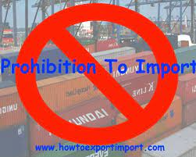
Offence(s) Charged:
Importation of prohibited goods contrary to section 200 (a) (i) of the East African Community Customs Management Act, 2004.

Slide 8
Offence(s) Charged:
Knowingly having in custody or possession any paper intended to resemble and pass as a special paper such as provided and used for making any bank note or currency contrary to section 365(a) of the Penal Code Act Cap 120

Slide 9
Defense case:
Accused claimed to have received a call from his friend requesting him to transport his bag up to Juba South Sudan. Couldn’t identify the friend.
He boarded the Trinity Bus from Nairobi which was to transit through Kampala to Juba.
Instructed to deliver the bag upon arrival in South Sudan and furnished with a contact number.
Received the package already sealed and had no knowledge of the contents.

Slide 10
Relevant case information
Accused released on bail of USD 1,401
Sureties bonded in the sum of USD 2,802
Sureties included his father in law and his friends, a major general attached to Internal Security Organization and liaison to UPDF (Uganda People’s Defense Forces)
Accused’s passport retained by court.
Accused jumped bail/disappeared soon as the case was scheduled for hearing/trial.
Accused arrested and brought to court by the major general in return for his discharge as a surety.

Slide 11
Conviction and Sentence
Accused requested for plea bargain for a conviction with a lesser sentence
A fine of USD 2,000 being 50% of the dutiable value of the prohibited goods. (The dutiable value was derived from the report from the US Department of Homeland Security, United States Secret Service hereto attached which set the value at USD 4,000.)
A further fine of USD 745.34
An Order for destruction of the prohibited items at the cost of the convict in the sum of USD 176.53

Slide 12
THANK YOU

