Slide 1
PROFESSIONAL ethicS AND THE FIGHT AGINST CORRUPTION
OECD CLASS
8TH FEBRUARY 2022
Presented by
Dr Purity Gitonga

Slide 2
Objectives
Situational Analysis:
Overview of corruption
Definition of terms – Ethics, Professionalism
Ethical Theories
Key attributes of Professional Ethics
Resolving Ethical Dilemma

Slide 3
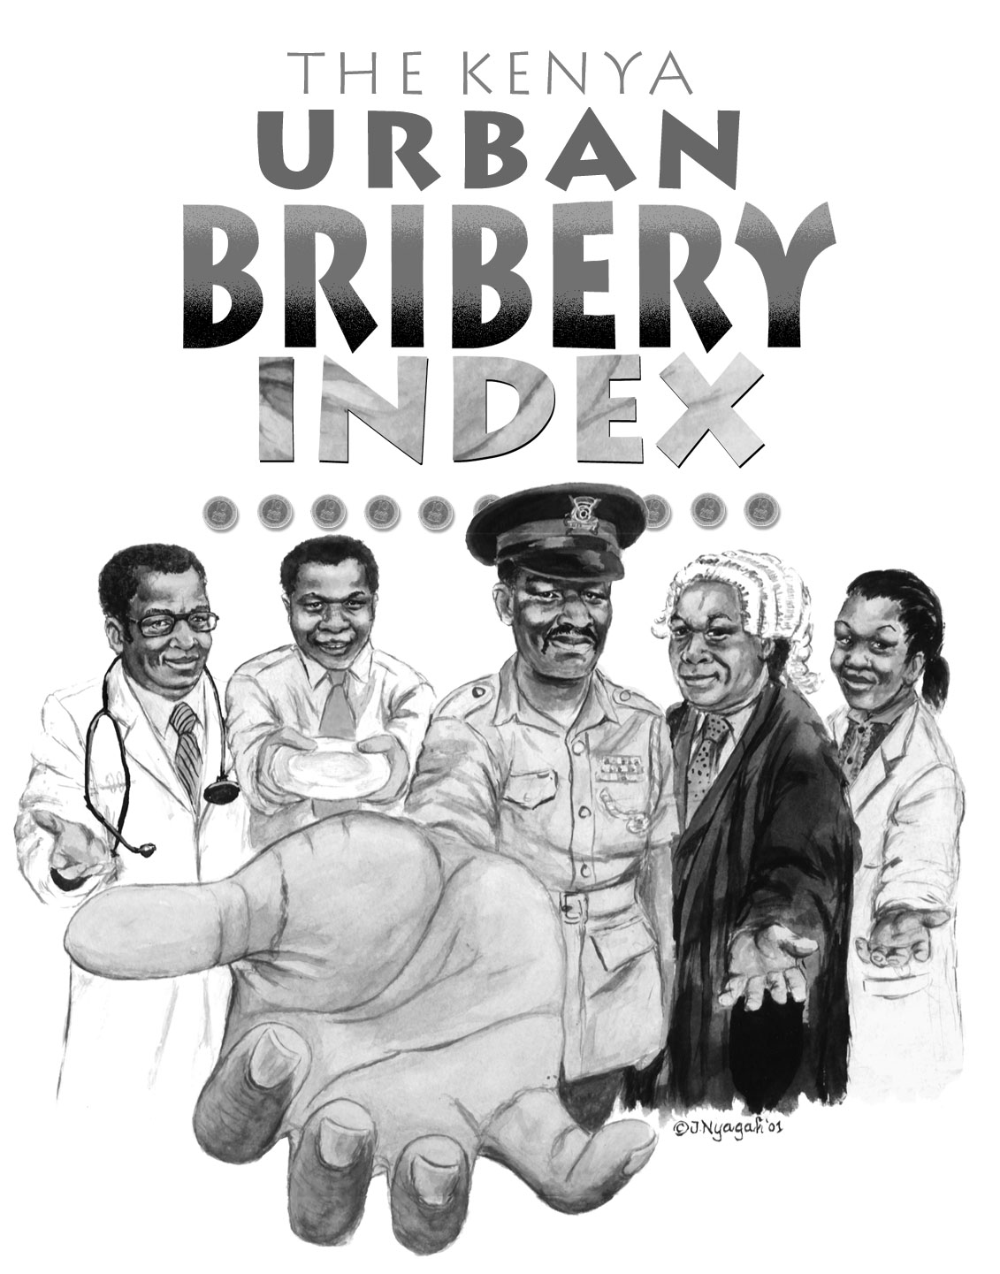
What do you make of this?

Slide 4
Situational Analysis
All countries- big and small, rich and poor engage in corruption
All sectors- public, private, non-governmental, too engage in corruption
International Corporations play a significant role in fuelling corruption in developing countries through foreign bribery and money laundering.
The global cost of corruption is at least $2.6 trillion, or 5 per cent of the global gross domestic product (GDP) (The World Economic Forum) . Businesses and individuals pay more than $1 trillion in bribes every year (World Bank).
The African Union points out that corruption has ‘stolen futures; in Africa with atleast 25million primary school children as its victims.
Trust in governments has waned, yet the public officers occupy that vantage point.
Unethical dilemmas facing employees

Slide 5
The UN, Corruption and Scandals: How Did We Get Here?
OPINIONBY MARTIN JAY: July 26, 2019
It’s not only off-the-scale sexual harassment and corruption at the UN which is worrying for those who believe in the importance of the institution. It’s also racism, which is used as a tool of corruption, even when the UN pretends it’s cleaning up its act
Corruption seems to be a real problem in the UN. Cover ups seem to be more and more being reported at all levels from an institution which seems hell bent on not making itself accountable. Patrick Henningsen, editor of 21st Century Wire, who has seen the UN’s operations around the world with his own eyes, says it’s a cultural problem.

Slide 6
25 Corruption Scandals that shook the World
1. Ukraines missing millions- involving loss of $40billion former president Viktor. Used in a luxury car collection, 345-acre presidential palace, an ostrich farm, and even a loaf of bread made of solid gold. Syphoning off Ukrainian public funds for personal benefit. QN:Why isn’t Ukraine taking action?
2. A McDonald’s pickle: At the end of 2019, McDonald’s CEO Steve Easterbrook was fired for sexting with a subordinate in what the company said was a consensual relationship. "Given the values of the company, I agree with the board that it is time for me to move on," Easterbrook said at the time in an email to employees.

Slide 7
How the Gupta family captured South Africa through bribery
In what’s been described as a “modern coup”, the Gupta family took control of South Africa. Through allegedly bribing politicians, giving lucrative jobs to President Zuma’s children and other ways of buying influence, Ajay, Atul, and Rajesh Gupta captured the state.
The Gupta family took as much as US$7 billion in government funds, including a US$4.4 billion supply contract with South Africa’s rail and port company. The Guptas also hired and fired government ministers, while the president fired tax officials and intelligence chiefs to protect them from investigation. In 2016, when a deputy minister went public about the US$45 million that the Gupta family offered him to fire treasury officials, the Guptas fled the country. President Zuma has since lost government office and faces corruption and money laundering charges. His successor, President Ramaphosa, vowed to clean up the country, however, many officials from the previous administration remain in power. In the meantime, South Africa’s economy struggles and the country continues to face high levels of inequality.

Slide 8
Lebanon’s garbage: the stench of corruption
Sometimes dirty money can lead to filthy cities. Since 2015, Lebanon has had a garbage crisis that’s seen streets and beaches covered in rubbish bags, extreme stench and water contamination. This threat to public health came about when Beirut and Mount Lebanon’s main waste disposal company, Sukleen, stopped collecting garbage.
The company – which had a monopoly since the 1990s – was forced to close an overflowing landfill which was used for 12 years longer than scheduled. Lacking the infrastructure to dispose of the garbage elsewhere, the company let the rubbish bags pile up.
How did a single company monopolise a key public service? It had strong connections with two of Lebanon’s prime ministers. Lebanon also has a culture of patronage, where government contracts are often won through political connections and bribes.
The scandal provoked a popular movement called “You Stink”, which called for the government to clean up its streets and its corruption problems.

Slide 9
Examples from across the globe
False expense reports: Mark Hurd CEO Hewert Packlard – once named CEO of the year in 2007 and by Fortune Magazine in2008 had to resign for his relationship with a contractor. He said, there were instances in which I did not live up to the standards and principlaes of trust, respect, and integrity that I were advocated at HP.
Extramarital affair: John Ensign US Senator resigned after covering up an extramarital affair with monetary payoffs.
Sexual assault: Domique Strauss- Kahn former head of the IMF and a leading French politician was arraigned in court on charges of sexual assault.
Conflict of interest: David Sokol- possible successor of Warren Buffet forced to resign because of trading in Lubrizol stock prior to recommending that Berkshire Hathaway Purchase the company
In 2010 a New Zealand Minister resigned over bottles of wine. He was embroiled in an expense scandal that turned on his purchase of two bottles of wine. He resigned saying “I have absolutely no desire to become the focus of a distraction for this government.”

Slide 10
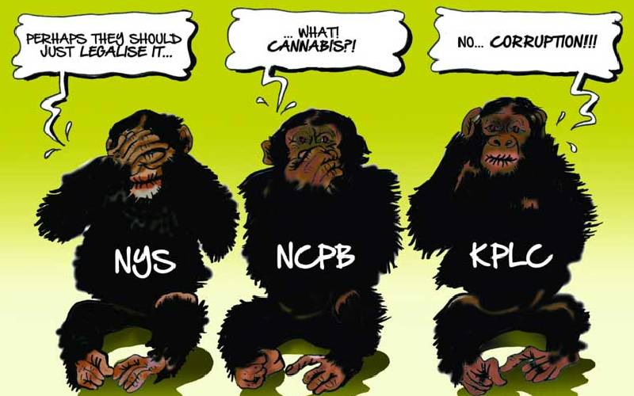
Corruption Scandals in Kenya
State of Corruption in Kenya
Given the scenarios above, what is your comment?
What is the story in your country?

Slide 11
What is Corruption
The term “corruption” is derived from the Latin word “corrupts” meaning “to destroy”. What does it destroy?
The abuse of entrusted power or authority (Public or private) resulting to personal gain or advantage at the expense of public good or collective interest(TI, WB).
Joseph S. Nye (1967: 419) defines corruption as “behavior which deviates from the formal duties of a public role (elective or appointive) because of private-regarding (personal, close family, private clique) wealth or status gains; or violates rules against the exercise of certain types of private- regarding influence.
Legal definition_ What is the legal definition of corruption in your country?
We need to look beyond monetary exchanges when analyzing corruption.

Slide 12
Typology of Corruption
Petty Corruption
Grand Corruption
Political Corruption
Administrative corruption
What’s the difference?

Slide 13
Approaches: UNCAC
Punitive
Preventive
Preventive measures are hard sell to the public, yet it could have better results.
Sends very strong signal.
De-barring companies that are said to be corrupt
Punitive approaches seem to be the choice for the public.
Experience has shown that the costs of corruption in the public service are too great to bear. The public service must work with the highest standards of integrity and conduct to ensure that the trust and confidence of citizens is maintained.

Slide 14
Efforts to institutionalize ethics and integrity
Public Sector Reforms
Stakeholder/Citizen Engagements
Collective Consciousness
Use of technology –
e-Govt
Codes of Conduct & Ethics
Declarations of Income, Assets & Liabilities
Ethics training, Education & Curriculum Intervention
Systems Review
Asset Tracing and Asset Recovery
Policy, Legislative and Institutional framework
To transform the public service and counter the ethical lapses in the public sector, diverse strategies have been employed .
Have these strategies yielded much fruit?

Slide 15
PART TWO: Ethics DEFINED
The term “ethics” derives from the Greek word “ethos” which means character, habit, disposition or custom.
Ethics is creates a framework for determining what is good and bad or right and proper and just versus what is bad, wrong and unjust.
There are three aspects to ethics
Ability to discern:-
  -Right from wrong, Good from evil, Propriety from impropriety
Commitment to do what is right
Doing what is right.

Slide 16
Ethics
ETHICS is concerned with:
Conduct
Decision making
Relationships
Problem solving
What is Unethical behaviour?
The overriding question in ethics is – Will my decision and action injure someone else?
Remember the injury may be physical, emotional psychological or even spiritual.

Slide 17
Levels of Ethical Reflection
Individual
Profession
Organizational
Society
Wenzel, 2004 showed that personal norms of tax honesty were negatively related to people’s engagement in tax evasion

Slide 18

Factors influencing ethical behaviour at individual level
  Personal choices
  Values, Attitudes &perceptions, genetic
Individual attributes
Family School Religion
Professional
What is observable of our parents, teachers, pastors
  Laws
  Rules
  Norms
  Societal expectations, media
Social -Cultural

Slide 19
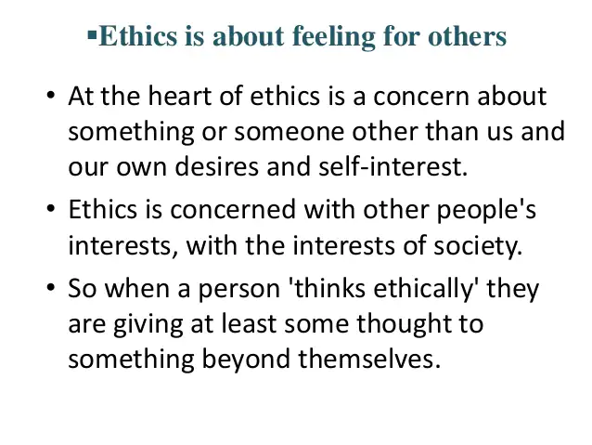

Slide 20
Profession:
Who is a professional?
A profession is an occupation or vocation which requires a high degree of knowledge and expertise in the specific field.
It calls for special skills and qualification,
  Long and specialized preparation in academic and practical training;
  Is governed by a code of ethics, and performs essential service in society;
  Has procedure for certification and validation of membership
  The skill has intellectual base.
A professional is one who has acquired a learned skill and conforms to ethical standards of the profession while displaying knowledge, skill and values required of the profession.
Professional ethics encompasses a code governing the conduct of professionals

Slide 21

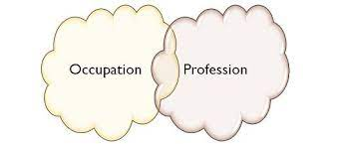
Professionalism

Slide 22
Professionalism
Professionalism is a powerful quality.
It allows you to fulfill your role to the best of your ability. It helps you to impress and inspire others. And it gives you a deep sense of satisfaction and self-worth.
Enables one to consistently achieve high standards, both in the work you do and the way you behave.
Being professional helps you to achieve high-quality results,– and feeling good about yourself.
It is the contribution of Skill and Will that elevates people in any industry or career to the top
Enables you develop three habits : Humility, Patience and Confidence in one’s ability.
Professionalism is not just participating in the right actions at the right time but rather has more to do with the fibre of an individual person.
Enforcement and discipline: Barring of errant professionals

Slide 23
BREAK OUT SESSION
What are the key qualities/characteristics of a professional?
What are some of the examples that may constitute unethical practices in your profession?
2(b)Identify unethical/unprofessional practices among
investigations?
What factors contribute to rising unprofessionalism and unethical practice in the 21st Century?
Importance of professional ethics/codes of conduct in the workplace and in combating corruption

Slide 24
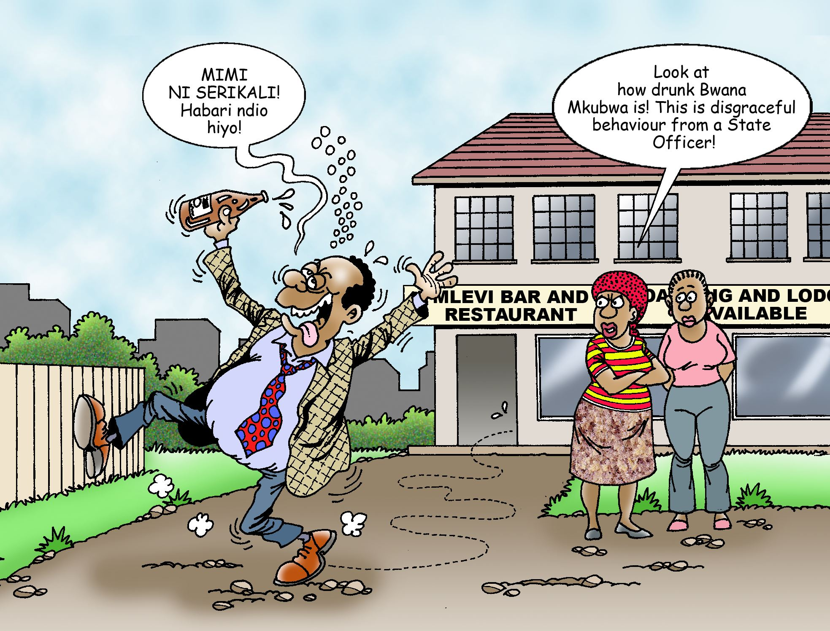
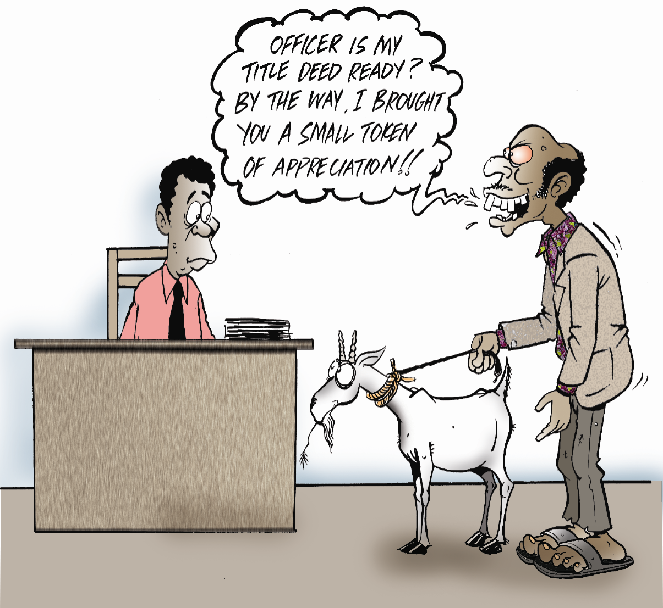
CONDUCTING PRIVATE AFFAIRS
IS THIS FAMILIAR?

Slide 25
Unethical practices
General- Think of the following
In investigations
Receiving of gifts without declaring
Being untidy/unkempt
Rudeness to colleagues & clients..
False expense reports
Inappropriate relations with staff
Drunkenness
Inappropriate dressing…how do you package yourself?
Calling in sick
Forged certificates
Irresponsible use of public facilities
Use of information obtained for personal gain
Manipulation of records
Biases
Presenting reports that have false information and errors
Receiving bribes in return for a favour
Manipulating accounts
Collusions
Lying, destroying evidence
Avoiding difficult cases and opting for the easily solvable
use of demeaning, abusive words

Slide 26
LEGAL and medical
Confidentiality - Lawyers must maintain their clients' confidence at all times.
Competence - Legal professionals must represent their clients with a high level of competence.
Professional Courtesy - Lawyers must treat their colleagues with fairness and courtesy.
Professional Judgement: A lawyer should exercise independent professional judgement on behalf of a client. Also, a lawyer is to refrain from acquiring a financial interest in the legal cases.
Doctors
Trust - Doctors must instill a sense of trust between themselves and their patients.
Do No Harm - Doctors cannot engage in any activity that would cause harm to their patients.
Privacy - Doctors cannot share the details of their patients' medical treatments or histories without permission

Slide 27
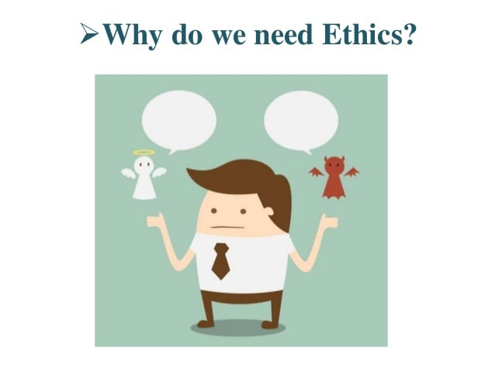

Slide 28
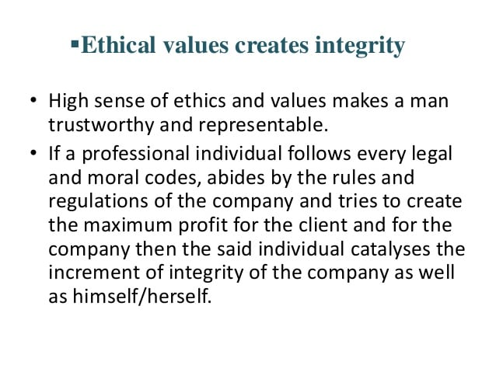

Slide 29
Worth noting
. "Out of all the qualities expected of us, the supremely important values are those of moral integrity and fairness. A conscious attention to a client’s cause and never ending quest for perfection in the exercise of our professional skills and the indomitable courage in the face of improper pressures that conflict with our duties. All these qualities might be unattainable but are very properly expected of us when we are entrusted by our clients often with matters of great consequence in their personal lives for which let us remember we are often handsomely paid.

Slide 30
Five aspects about Integrity
Integrity is a personal choice, actually it’s a lot of choices.
Integrity involves the consistency of a person’s thoughts, words and deeds (Palanski &Yammarino, 2007).
Integrity has a cost. ‘A person of integrity is willing to bear the consequences of his/her convictions’ (Mcfall, 1987, p. 9).
Integrity is not a sometime thing. It is an all time thing. Something is either right or wrong, black and white. There is no in-between.
In big ways and small ways, in visible or invisible situations, employees have the opportunity to demonstrate their integrity—or lack of it—every single day.
Mcfall maintained, ‘A person of integrity is willing to bear the consequences of her convictions’ (Mcfall, 1987, p. 9).
Integrity is important for leaders, managers, workers, and men, women, children and all people.

Slide 31
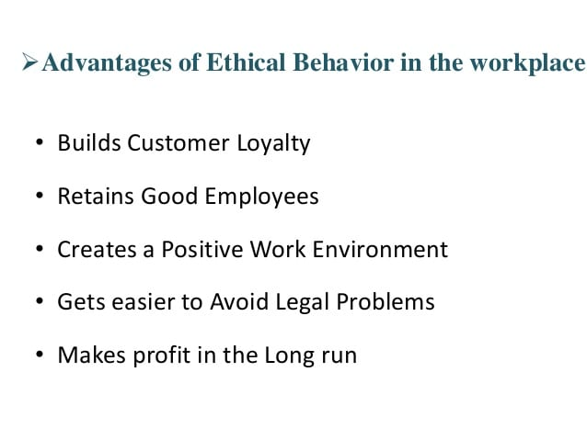
Like a map- Ethics guide our live
Professional Ethics help build confidence
At the heart of ethics is a concern about something or someone other than us and our self interest.

Slide 32
RIG OF GYGES
A story is told of a young shepherd from the city of Lydia. The young boy found a golden ring and he discovered that when he turned the ring on his finger, it made him invisible.
The shepherd boy then decided to use the ring to seduce the king’s wife, attack the king and even take over the kingdom.
Glaucon – who was Platos student argued that the only reason people are just is because they lack the power (opportunity) to be unjust.
As an investigator, what you would do if you had such powers, no fear of detection?
The ring of Gyges is literally and figuratively a story about professionalism, transparency and accountability when no one is seeing you.
Socrates ultimately argues that justice does not derive from this social construct: the man who abused the power of the Ring of Gyges has in fact enslaved himself to his appetites, while the man who chose not to use it remains rationally in control of himself and is therefore happy (Republic 10:612b).

Slide 33
PART THREE
ETHICAL DILEMMAS

Slide 34
Ethical Dilemma
An ethical dilemma (ethical paradox or moral dilemma) is a problem in the decision-making process between two possible options, neither of which is absolutely acceptable from an ethical perspective. There is always a difficult choice to be made
A situation where two or more important values, rights and responsibilities are in conflict and a choice has to be made between equally unpleasant alternatives
Doing what is morally right that results in a bad outcome or bad effects,; and doing what is morally wrong but results in good or at least better effects or outcome.
An ethical dilemma mostly presents when one has to make choices between two conflicting options both of which are right.

Slide 35

We all encounter an ethical dilemma in almost every aspect of our life, including personal, social, and professional.
When your boss wants you to do something unethical-
What should you do as a professional?

Slide 36
ETHICAL THEORIES for ethical decision making
ETHICAL THEORIES
DEONTOLOGICAL
(Duty)
UTILITARIAN
(Consequences)
VIRTUE THEORY
(Character traits)
Communitarian Theory
Others first
The four major ethical theories are:

Slide 37
ETHICAL THEORIES that guide in the decision making process
Utilitarian Theory: “what is ethical is what advances the common good” or the lesser evil. ‘This is an Ends based approach’ looks at the consequences of ones actions to an ethical dilemma.
Deontological Theory: What is important is the duty or obligation regardless of the consequence. Everyone must follow the rule. (rule based approach)
The Care Based Principle or the Golden Rule: The Golden rule is also known as the Care Based Principle. Doing unto others what you would have done unto you. It takes into consideration compassion and personal feelings.
Rights Theory: people make decisions based on the rights that their society agrees to. What the majority of people in that society believes is important will drive decisions.
Virtue Theory: Says that we ought to focus not on what rules to follow but on what kind of people/orgs we want to be. ‘What makes a good person

Slide 38
Principles of Professional Ethics
These include:
Principle of non-maleficence – DO NO HARM obligation. Omit acts that may cause harm to others
Principle of Beneficence – Duty to do good - what is advantageous to your clients, customers
Principle of Autonomy – Respect for others, for their self-determination and making of decisions. sense of self reliance, self rule
Principle of Justice – commitment to dispense fairness, equity.
Solid ethical decision making start with an attitude of authentic care for clients

Slide 39
Checkpoints: How to Resolve Ethical Dilemmas
Identify the Issue
Identify the key person facing the dilemma
Identify the relevant facts -Analyze the situation
Identify possible solutions
Evaluate each possible solution -Choose the alternative that offers the greater good or the lesser evil.
Compare and assess the consequences
Make a decision based on the best identified solution
Take action

Slide 40
Ethical dilemma
A woman is diagnosed with an abdominal aortic aneurysm, a bulge in the wall of the aorta, which will likely cause her death if it should burst. Doctors advise an immediate surgical procedure that will require making an small incision. However, the woman is an exotic dancer and fears that a scar will negatively impact her means of making a living. She refuses to give her consent for the surgery but those in authority insist that the life-threatening risk is non-negotiable. Declaring that the woman is not in her right mind, surgeons order that she be anesthetized. They proceed with the operation and successfully repair the aneurysm. As a result, the patient files a lawsuit against the hospital for millions of dollars.
In view of the 4 principles givenm was it right for the surgeons to proceed? WAS IT RIGHT FOR THE WOMAN TO SUE THEM WHEN THE DOCTORS MEANT THE BEST FOR HER?
Patient autonomy issues are often daunting ethical gauntlets for health care administrators, who must weigh economic factors and dwindling financial resources when making decisions concerning patient care.

Slide 41
Group 3: scenarios
A hotel has requested an accounting officer to give them business to host seminars and workshops in return for one-week complementary accommodation for him and family during the December holidays.
A board secretary is asked to alter minutes to allow for irregular inclusion of agenda items and board decisions outside the board meetings.
“A record clerk has been asked to ‘doctor’ file folios to allow for fake requisition letters for delivery of goods and services.
Group3
What is unprofessional in these scenarios assuming that all three officials have agreed to the requests? How damaging is their unprofessional behaviour to public service delivery?
When your boss wants you to do something unethical- what should you do?

Slide 42
Right Versus Wrong: Is it a Moral Temptation or an Ethical
Dilemma?
Five tests distinguish wrongdoing from an ethical dilemma.
The legal test. Does the choice or action violate any laws?
The front page test. How will the actor feel if the choice or action becomes common knowledge in the community?
The gut feeling test. Does the choice or action intuitively feel "wrong?“
The role model test. Would a respected mentor approve of the choice or action?
The professional standards test. Does the choice or action violate any part of the Professional Code of Ethics?

Slide 43
Article 232: Principles of Public Service in kenya
Prescribes the desired behavior and standards of public officers
Place public interest above personal interest;
Act professionally with honesty, consistency and impartiality;
Uphold economic, efficient, effective and prudent use of public resources
Uphold transparency, accountability and be responsive;
Uphold the rule of law and respect of institutions of Government;
Avoid conflict of interest in performance of duties
Involvement of people in the process of policy making
Maintain oneself in a morally upright manner

Slide 44
KEY TENETS OF PROFESSIONALS shared by Fortune 500 companies
Integrity (Ethics, Honesty)
Respect (Trust, Dignity)
Excellence (Quality, Performance)
Responsibility (Accountability, Commitment)
Teamwork (Collaboration, Cooperation)
Innovation (Creativity, Ingenuity)
Fairness (Diversity, Inclusive)
Care (Service, Compassion)
Passion (Enthusiasm, Fun)
Leadership (Influence, Competitive Advantage)
Life long learning - (Continuous Improvement, Knowledge)
These 17 common values are a way of defining acceptable behavior. They are guiding principles,

Slide 45
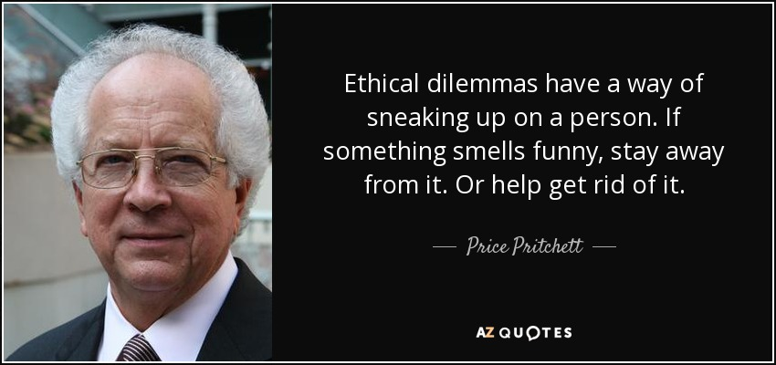
‘An ounce of Prevention is worth a pound of Cure’- Benjamin Franklin

Slide 46
THANK YOU

