Slide 1

Cryptocurrency Challenges
Superintendence of the Financial System
CLAUDIA Argueta
El Salvador

Slide 2
Agenda
Main Characteristics
Advantages and Disadvantages
Used for good and for bad
Challenges
Regulatory framework El Salvador

Slide 3
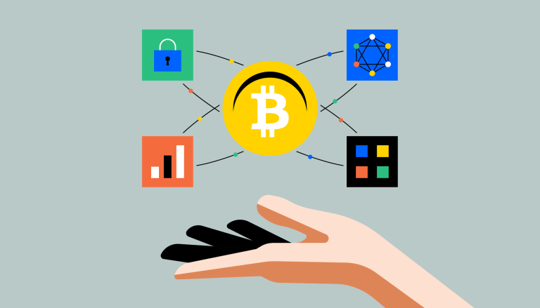
Main Characteristics
Criptocurrency
Virtual representation of value
Digitally traded or transferred.
Used for payment or investment.
Just a fiat currency.
Transactions are made by means of a key pair used to access funds.
Original blockchain-based cryptographic currency, created by the publication of Satoshi Nakamoto´s Whitepaper on October 31st, 2008

Slide 4

Advantages and Disadvantages
Advantanges
Payments easier, faster and cheaper
Provide alternative methods for those without access to regular financial products.
Disadvantages
Without proper regulation, they risk becoming a virtual safe haven for the financial transactions of criminals and terrorists.
Regulated in some countries
Crypto Regulation
Most countries have taken no action.
Prohibited in some countries

Slide 5



Used for good and for bad
Crypto are borderless
Universal
No subject to any centralized authority
Not easily traced by law enforcement
For good
Hedge against inflation
Inexpensive option for cross-border transactions.
For bad
Used for terrorism financiang
Used for money Laundering activities
Acces to global financial services in underserved áreas
Transactions on the dark web
Blockchain forensic tools make it posible to track movement of criptocurrencies.
Crypto are seldom used for money laundering activities compared to fiat or national currencie.
SWIFT Report, September 2020

Slide 6
Challenges
Decrease virtual illegal activity through law enforcement and regulation.
Blockchain decentralized nature poses a challenge when it comes to regulation.
Guidance over virtual assets and virtual asset service provider. (FATF)
Impose a baseline of regulation across the World.
Control something virtual, universal and borderless
Shutting down the blockchain on a global scale is an impossible task.

Slide 7
Challenges
Regulation becomes increasingly relevant as crypto use grows
User protection
A primary factor in the “mainstreaming” of crypto
The volatility of prices also puts a question mark on the potential of bitcoins as a currency.
Countries that have been the target of economic sanctions levied against them
Crypto as a means to diminish the impact of these sanctions in their national economies.
Creation of their own virtual assets as an alternative to SWIFT

Slide 8
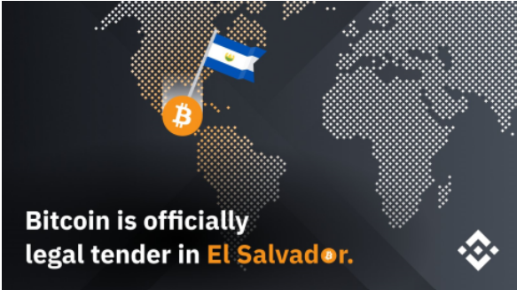
Regulatory framework El Salvador
June 9th, 2021
The Legislative Assembly approved the Bitcoin Law. Valid 90 days after being published: September 7th, 2021.
August 27th, 2021
The Legislative Assembly approved the Regulation of the Bitcoin Law, effective on September 8th, 2021.
September 7th, 2021
The BCR approved:
Guidelines for the Authorization of the Operation of the Technological Platform of Services with Bitcoin and Dollars.
Technical Standards to Facilitate The Participation of Financial Institutions in the Bitcoin Ecosystem (NRP-29)
September 7th, 2021,
The first Bitcoin Service was authorized.

Slide 9

Regulatory Framework El Salvador
Superintendence of the Financial System
The Superintendence is responsible for supervising the individual and consolidated activity of the institutions that make up the system.
Intendancy of Digital Financial Services
The Intendancy is responsable for supervising the digital financial services of the members of the financial system and of the Bitcoin Service Providers.
Bitcoin Service Providers
Natural or legal person that provides for itself or for third parties services related to bitcoin such as, but not limited to, custodians, exchange houses or "exchanges" and payment processors or wallets.
Service Managers with Bitcoin and Dollars
Banks, Cooperative Banks, Savings and Credit Societies and Electronic Money Providers of the country, who wish to provide services with Bitcoin and Dollars.

Slide 10
Regulatory Framework El Salvador
Requirements for Bitcoin Service Providers
Must submit to the BCR
Maintain an anti-money laundering program
Requirements for Service Managers with Bitcoin and Dollars
Description of the risks such as: risk of money and asset laundering and financing of terrorism, as well as the policies adopted for its management
Authorization of the technology platform
Maintain a policy of limits on transactions within its platforms
Traceability of transactions
Customer account records
The Superintendence of the Financial System has all the supervisory powers

Slide 11
Thank You!
Questions and Answers

