Slide 1

CONDUCTING FINANCIAL INVESTIGATIONS
(FOUNDATION PROGRAMME), 2022 oecd international academy for tax crime investigations
Professional Enablers
R Ismail (South Africa)
14 February 2022

Slide 2
LEARNING OBJECTIVES
How to identify professional enablers from the roles they play
Developing risk indicators
Developing responses to deter and disrupt their participation in tax and other financial crimes

Slide 3
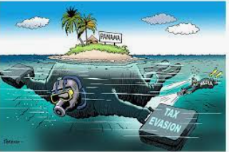
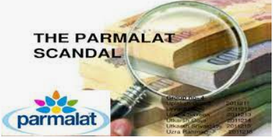

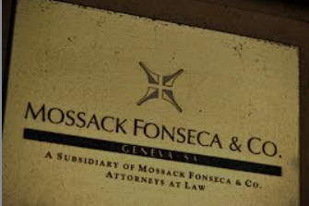
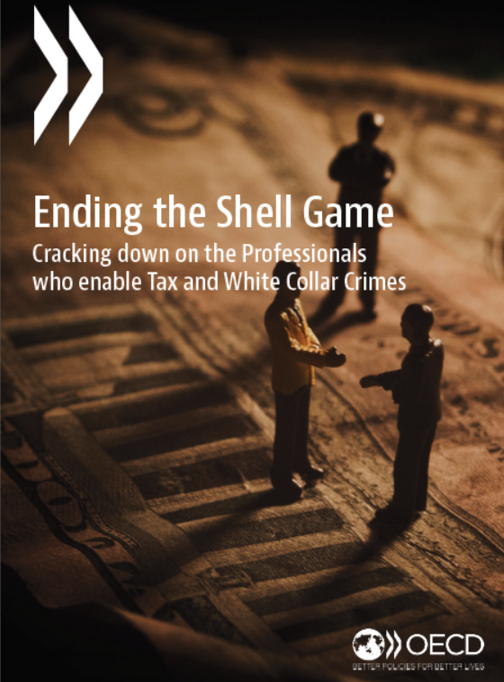





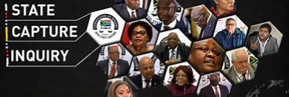
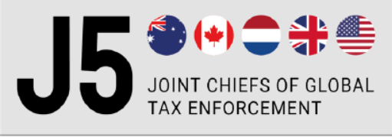


Relevance?

Slide 4
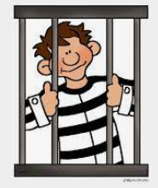
RELEVANT
Fighting Tax Crime – The Ten Global Principles

Slide 5

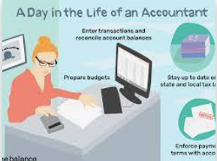


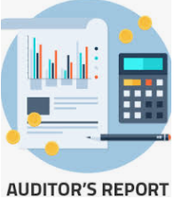

professional VERSUS professional enabler
Professional enablers
help tax evaders and criminal enterprises engineer legal and financial structures intended to facilitate the commission and/or concealment of tax and other crimes
assist in planning the crimes
intent on facilitating wrong-doing by their clients
actively devise, promote, market and facilitate tax evasion schemes
serve criminal clients
or are complacent in their actions

Slide 6
Impacts of tax and other financial crimes
the rule of law
fairness of the tax system
public confidence
codes of conduct
instability and inequality
development
collection of taxes

Slide 7

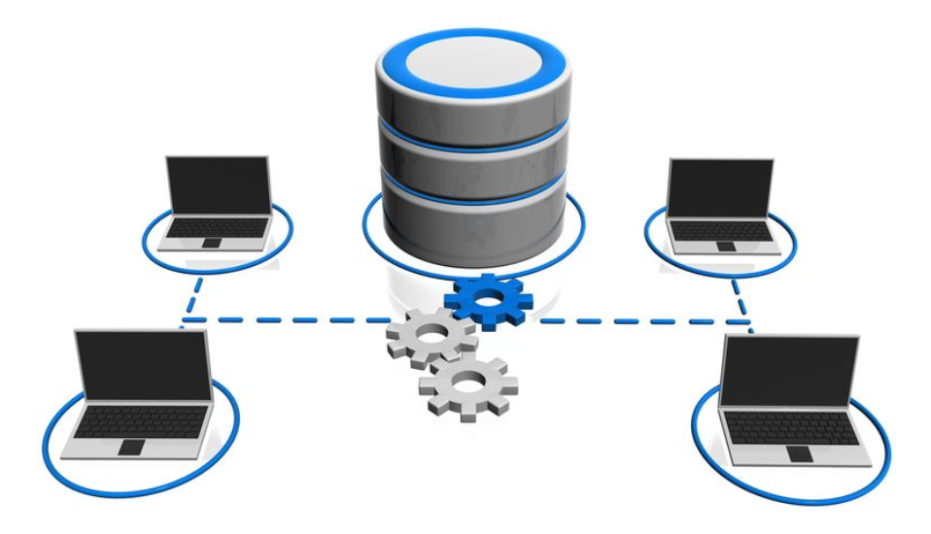



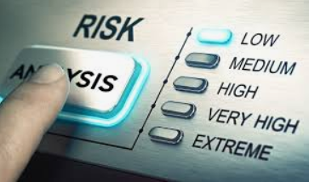





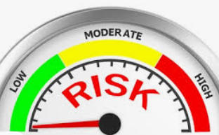






How to identify professional enablers

Slide 8
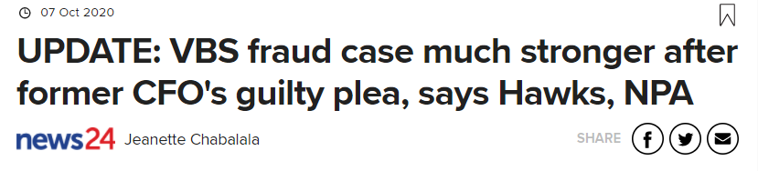
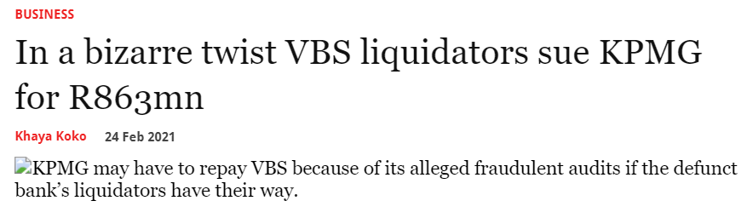
Case study

Slide 9
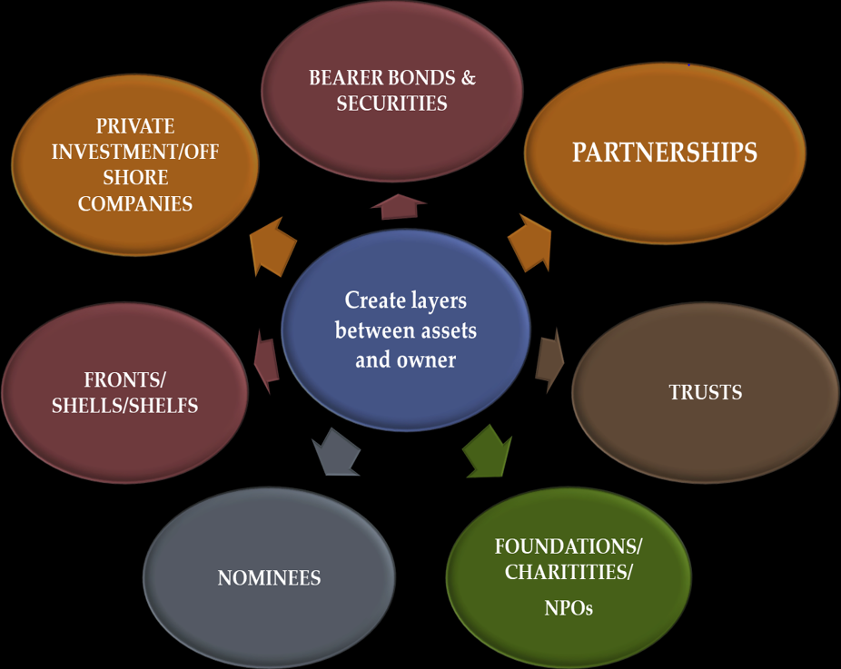
break-OUT session
Discuss, capture and provide feedback on:
  Groups 1 and 2
  what are the top 3 risk indicators that could be put in place to red-flag professional enablers for risk assessment and potential investigation?
  Example: Structures having multiple shell companies
  Groups 3 and 4
  which has been the most successful risk indicators put in place in your jurisdictions in revealing the culpability of the professional enabler?
    Example: Structures that obscure beneficial ownership

Slide 10
Risk indicators
multiple shell companies
multiple shell companies that “operate” from the same address
separate legal and beneficial ownership of entities and/or assets, i.e. trusts
obscure beneficial ownership structures
unnecessary complexity in a structure
structures that lack commercial and business sense
use of offshore service providers; i.e. connection to company formation agents
use of offshore jurisdictions that are known tax havens or hotspots of activity for specific evasion structures
multiple companies with directors in common
use of nominee directorships
one individual is a director multiple times, the extent to which the provision of substantial and meaningful directorship services could not be feasible

Slide 11
Risk indicators
addresses of entities or key actors which are not traceable
addresses registered at P.O. Boxes
schemes based on premium or contingent fees if the structure is deemed successful; which have claw-back clauses/protection from liability for the risk in a structure;
consultants who are “deeply” involved in directing the business of their clients
liquidation of entities to frustrate investigations
abuse of certain types of legal persons e.g. religious organisations
use of the reputations of banks/consultants/”big business” to add a veneer of legitimacy to the criminal enterprise

Slide 12





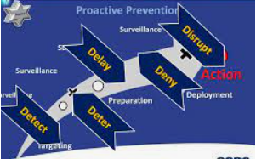
Proposing solutions in response to the risks posed

Slide 13





Remedy: raise awareness

Slide 14
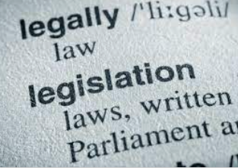
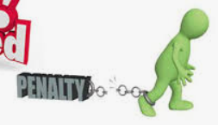



Remedy: legislation

Slide 15
SANCTIONS (PUNITIVE)
De-bar/dis-association by recognised professional bodies
Declare as delinquent
Cancel licences/accreditation/certificates of good standing
Deregister as a recognised practitioner
Name & shame
Financial sanctions, e.g. fines, penalties, asset forfeiture
Withhold government business, on a whole of government basis
MEASURES (PROACTIVE)
Screening, vetting & declaration of interest checks
Ethics & integrity watchdogs
Training, including of & through professional & recognised bodies
Limit the types of services that is causing conflicts of interest
Mandatory rotation of professional service providers
Sharing information between LEA and making those collaborations known
Change legislation – bank secrecy, legal professional privilege, protection of whistle-blowers, unexplained wealth orders
Civil claims for damages – joint & several liability of legal persons and financial & controlling minds

Slide 16
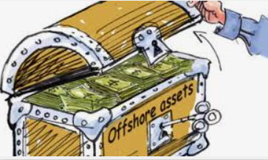




Remedy: to deter and disrupt

Slide 17

Remedy: co-operation

Slide 18

Remedy: implement plans of action

Slide 19
Thank you
Questions and feedback
OECD (2021), Ending the Shell Game: Cracking down on the Professionals who enable Tax and White Collar Crimes,OECD Publishing, Paris.
http://www.oecd.org/tax/crime/ending-the-shell-game-cracking-down-on-the-professionals-who-enable-tax-and-white-collarcrimes.htm

Slide 20
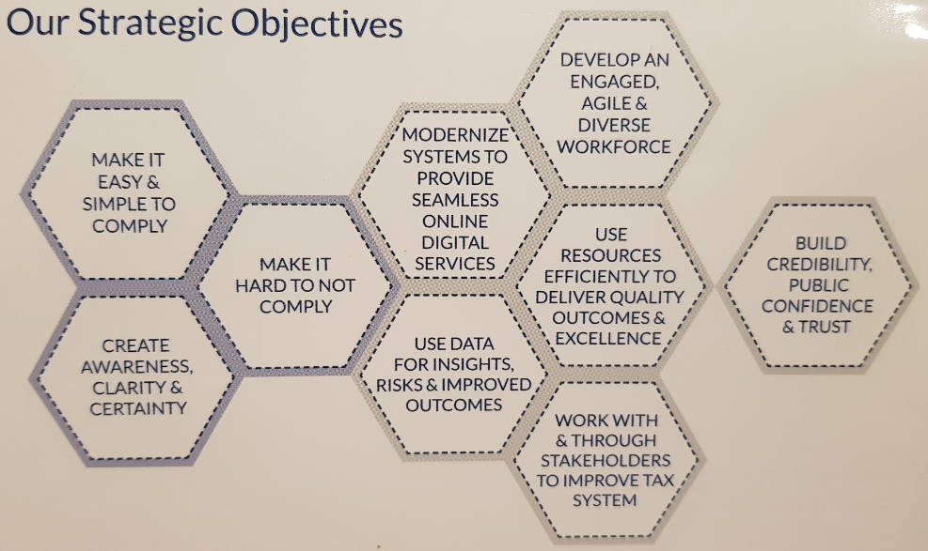
At SARS,
Invited to peruse our website at www.sars.gov.za

