Slide 1
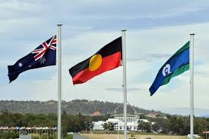
CRYPTO CURRENCY CHALLENGES

Slide 2
Evolution of Payment Systems
Fiat Money
Evolving mediums of tender
Blockchain technology
Virtual assets
  Crypto Currency - Bitcoin, DeFi, Litecoin, Ethereum
  Crypto Asset - Non-fungible token (NFT)
  Crypto-mining

Slide 3


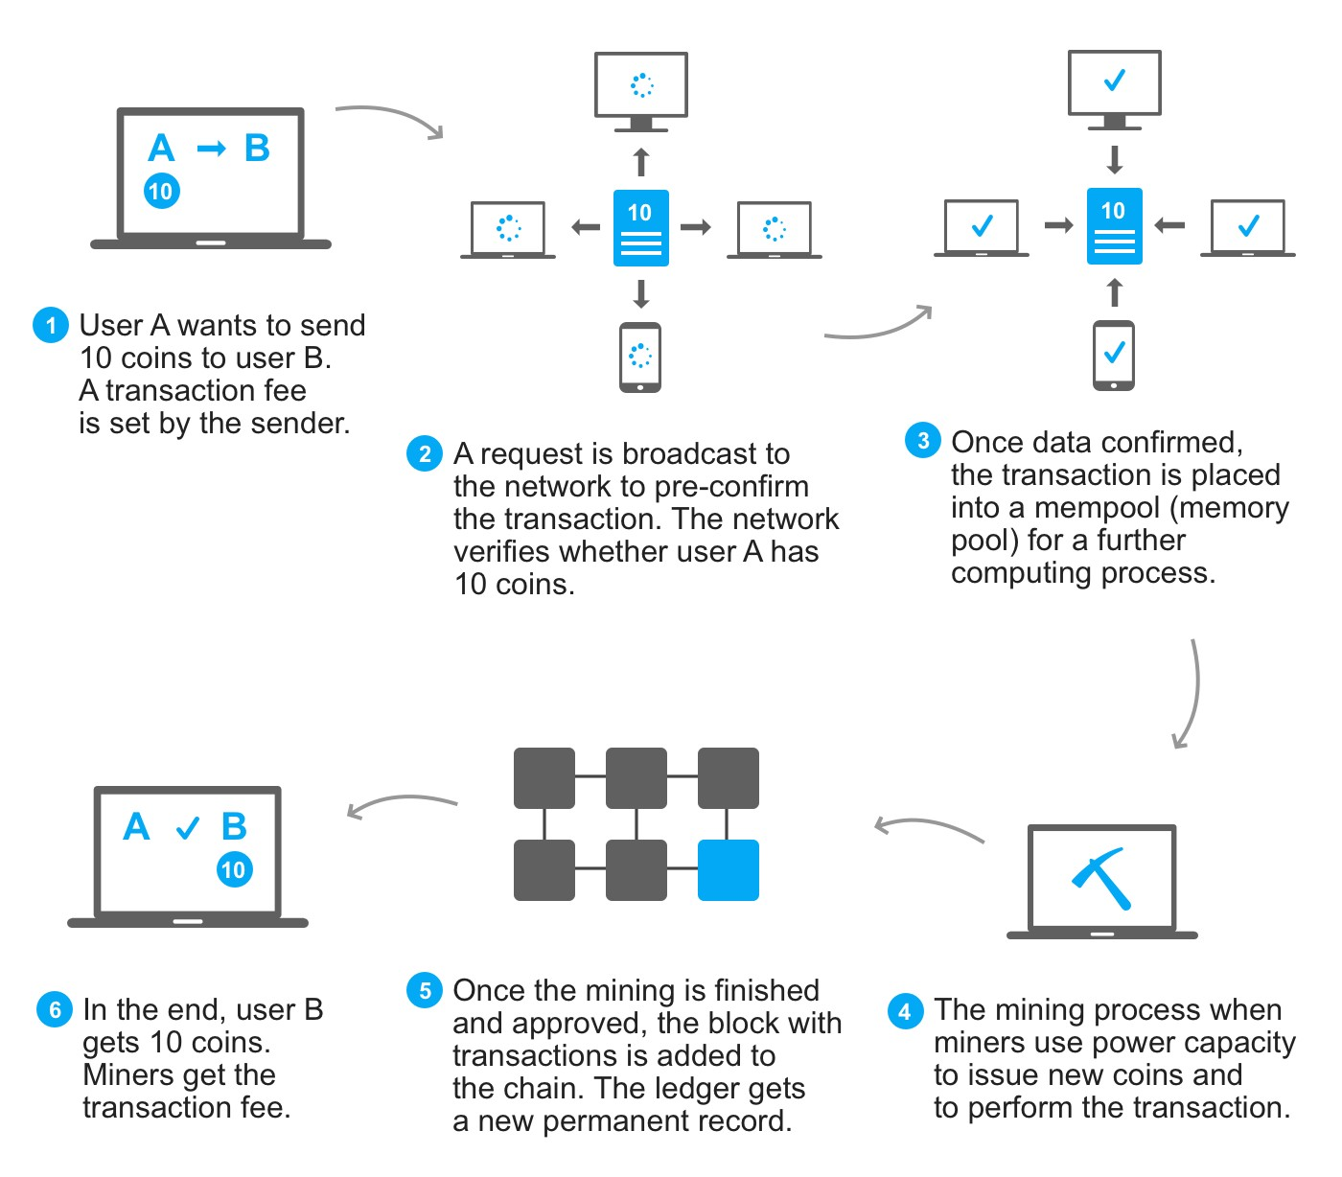
Blockchain

Slide 4
Challenges
Continuous evolution
Environmental cost
Regulations
Complexity
  Technology
  Speed
Anonymity
Accessibility
  Jurisdiction Sovereign v Global
Vested interests

Slide 5
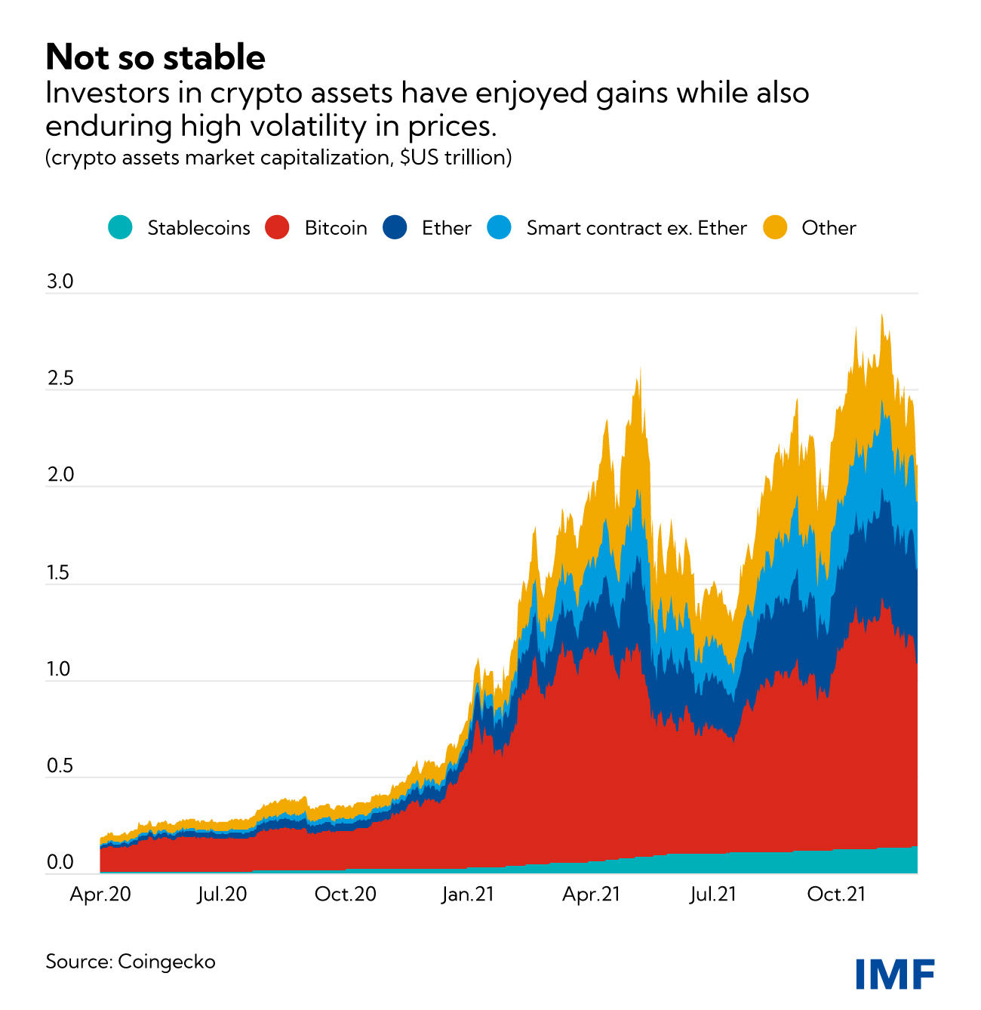
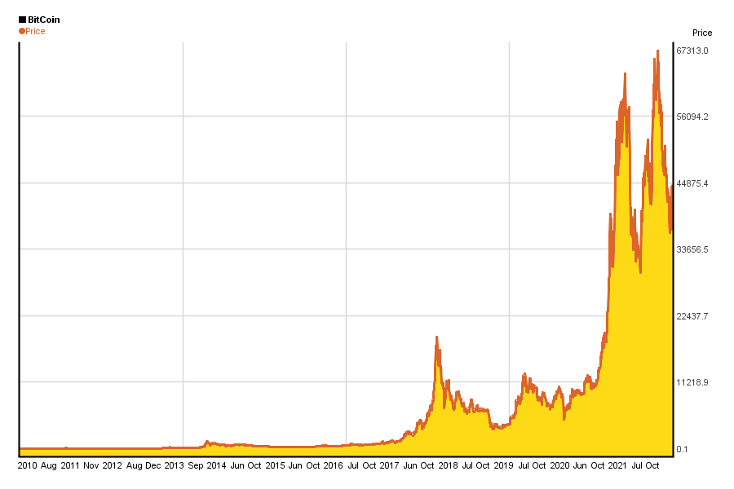
Volatility of Cryptocurrency and Influences

Slide 6
Dark Web
Silk Road
Mixers/Tumblers
Anonymity
Regulations

Slide 7
Transforming Australia’s Payment System
Farrell Review June 2021 – Payments System Review, From systems to ecosystems
Bragg Review October 2021 – Parliamentary Joint Committee on Corporations and Financial Services, Mobile Payment and Digital Wallet Financial Services
Hon Josh Frydenberg Australian Treasurer December 2021 – Government response to reviews - Announces Transforming Australia Payment System

Slide 8
Australian Taxation Office (ATO)
Cryptocurrency – Defined as property
Crypto Investor v Trader
Capital Gains Tax
  Capital Gain 50% tax
  Carried loss
Income

