Slide 1

OECD INTERNATIONAL ACADEMY FOR TAX CRIME INVESTIGATION
VAT/GST FRAUD INVESTIGATIONS PROGRAMME
INTERNATIONAL VAT TYPOLOGIES
JES DETTERER
MAY 2023
OFFICIAL | EXTERNAL

Slide 2



VAT TYPOLOGIES| LEARNING OUTCOMES
Participants will learn about:
 | 1. Carousel Fraud (Refresher)
 | 2. Australian Case Study – Precious Metals 3. International Case Studies
OECD ACADEMY | VAT/GST FRAUD INVESTIGATIONS PROGRAMME

Slide 3






VAT TYPOLOGIES| CAROUSEL FRAUD - REFRESHER
Customer B sells the goods at $1.1m to Customer C. He charges and collects a VAT amount of $100,000 from Customer C.
B can then deduct $70,000 of VAT (input tax credits) in his VAT return.
He pays $30,000 ($100,000 less $70,000) to the Tax Administrator.
Customer C exports the goods to an overseas Customer D.
Exported goods are VAT-free.
C is entitled to a refund of $100,000 in VAT paid to Customer B.
Overseas Customer D can sell the same goods back to A and starts the chain or ‘carousel’ fraud.
Business A imports goods and sells them for $770,000 to Customer B.
A charges and collects $70,000 of VAT from Customer B.
A disappears before paying VAT of $70,000 to the Tax Administrator.
B
A
Tax Loss $70,000
GST received $30,000
GST refunded $100,000
C
D
Note: Adapted from Singapore IRAS Example
OECD ACADEMY | VAT/GST FRAUD INVESTIGATIONS PROGRAMME

Slide 4
PROFILES| MISSING TRADER
Profile of the
missing trader
The entity
Syndicates members engage strawmen and use fake names and ID to conceal their identity
Newly established or off the shelf companies with no financial or trading history
Using strawmen to register entities makes the controlling minds or syndicate leaders more difficult to identify
Strawmen generally have a poor financial profile, low income or may be unemployed
Have low or no internet presence
VAT
Provides deductible VAT to other companies
Does not fulfill any tax obligation including paying VAT
Usually trade form short term lease or residential premises relying on third party warehousing
Has no means or assets e.g., employees, premises
Low profit margin (just enough to set off operating costs)
Absence of proper commercial contracts with terms and conditions
High turnover of directors and easy to replace
Used to create the appearance of real transactions
No response to inquiries or cannot be found physically
Back-to-back bank transactions or cash transactions with no apparent commercial driver
A
OECD ACADEMY | VAT/GST FRAUD INVESTIGATIONS PROGRAMME

Slide 5
PROFILES| BUFFER
Typically after a Missing Trader in the supply chain
Profile of the
buffer
The entity
Easy to replace
VAT
Typically fulfil their tax obligations including paying VAT to the tax administrator
Make investigations difficult as they act as a normal trader within the domestic market
Share some of the common profiles of Missing Traders
Has a low profit margin
Creates distance between Missing Trader and Broker
May also have other genuine businesses but the directors would have no prior background in trading nor industry knowledge of the goods that the buffer entities are trading in
Syndicates that are involved in Missing Trader Fraud for long periods of time utilise lengthier and more sophisticated supply chains with more buffer entities interposed which makes tracing their transactions difficult
B
Profile of
In/out buffer
Same characteristics but act as a normal international trader
D
OECD ACADEMY | VAT/GST FRAUD INVESTIGATIONS PROGRAMME

Slide 6
PROFILES| BROKER
Highest profit margin in the chain
Profile of the
broker
VAT
Claims VAT refunds
Is in the same country as the Missing Trader
Makes purchases from a Buffer
Makes zero rates sales (exports etc.)
C
OECD ACADEMY | VAT/GST FRAUD INVESTIGATIONS PROGRAMME

Slide 7
GROUP ACTIVITY| COMMODITIES RISK
Discuss the following with your group:
1. What do you think might be the indicators of carousel fraud?
2. Are any commodities taxed differently in your jurisdiction based on their form or use?
3. Are you aware of any commodities that are commonly used in carousel fraud?
OECD ACADEMY | VAT/GST FRAUD INVESTIGATIONS PROGRAMME

Slide 8








MISSING TRADER FRAUD| INDICATORS
Types of goods used
Business may run at a loss
Small % of entities have significant turnover
Dormant companies
Use of strawmen
Payment and monetary flows
Hard to get information
OECD ACADEMY | VAT/GST FRAUD INVESTIGATIONS PROGRAMME

Slide 9






MISSING TRADER FRAUD| INDICATORS
Fast payments
Incorrect information on documents
Similar invoices throughout the chain
Money abroad
Customers abroad
Syndicate structures
Simple Invoices
OECD ACADEMY | VAT/GST FRAUD INVESTIGATIONS PROGRAMME

Slide 10








INDICATORS| TYPES OF GOODS USED
Goods that are cheap and easy to transport
High valued goods or services
Electronic goods
Services (building sector, cleaning sector)
Intangibles (licences, carbon credits)
High valued metal (platinum, gold, silver)
Counterfeit goods that do not function
Obsolete goods
Works with the majority of goods and services
OECD ACADEMY | VAT/GST FRAUD INVESTIGATIONS PROGRAMME

Slide 11
AUSTRALIAN CASE STUDY – PRECIOUS METALS
OECD ACADEMY | VAT/GST FRAUD INVESTIGATIONS PROGRAMME

Slide 12
AUSTRALIA| OVERVIEW
Involves artificial arrangements in the gold bullion precious metals refining industry
These arrangements were an attempt to obscure transactions of recycled “Investment Form Previous Metals”
This enabled participants to obtain a tax benefit from the tax system for which there was no entitlement
REFINERS
INDIVIDUALS
SECONDHAND DEALERS
BULLION DEALERS
BUYERS
SCRAP DEALERS
OECD ACADEMY | VAT/GST FRAUD INVESTIGATIONS PROGRAMME

Slide 13
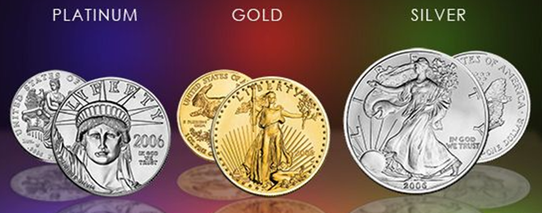
AUSTRALIA| DRIVERS
Missing trader schemes are particularly effective where goods can have a different tax treatment
In Australia, precious metals including gold, silver and platinum can be taxable at 10%, GST free or exempt (input tax)
This depends on their form and the nature of the transaction
For example, if a supply of gold, silver or platinum is in an “investment form” and has the fineness of at least 99.5% it is considered to be a precious metal and it is input taxed
IDENTIFIED RISK Established syndicates, similar to carousel type arrangements, apply various methods to alter the form of precious metal such as defacing, damaging, melting or misrepresenting documentation in order to manipulate the exemptions and special rules.
OECD ACADEMY | VAT/GST FRAUD INVESTIGATIONS PROGRAMME

Slide 14
AUSTRALIA| TRENDS IN BAS REFUNDS
From 2001 – 2016, the trend in BAS refunds issued to precious metal refiners has been:
  2001-2011 the refiners remitted to the ATO a net amount of $14 million; and
  2012-2016 the ATO has paid $300 million in refunds
OECD ACADEMY | VAT/GST FRAUD INVESTIGATIONS PROGRAMME

Slide 15

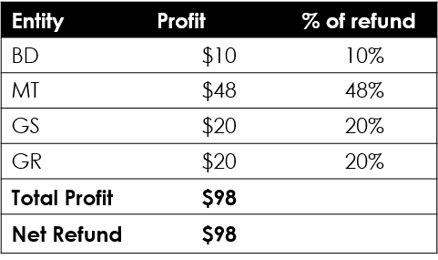


AUSTRALIA| THE SCHEME
Missing Trader
(MT)
Loss of $1078 - $1030
= $48 - $98 (GST)
= -$50
*Makes $48 if they don’t pay GST to ATO
Precious Metal
($1030)
Input-taxed
Non – Precious Metal
($1078)
Incl GST of $98
Melts/scratch/
cut Bullion to make it Taxable
Bullion Dealer
(BD)
Profit of ($1030 - $1020)
= $10
Gold Seller
(GS)
Profit of ($1100 - $1078)
= $22 - $2 (GST)
= $20
Gold Refiner
(GR)
Profit of ($1020 - $1100)
= -$80 + $100 (GST Credit)
= $20
Precious Metal
($1020)
GST-Free
Non – Precious Metal
($1100)
Incl GST of $100
OECD ACADEMY | VAT/GST FRAUD INVESTIGATIONS PROGRAMME

Slide 16

AUSTRALIA| PREVENTATIVE MEASURE
The SFCT releases intelligence bulletins in which it announces awareness of intelligence operations and in particular of artificial arrangements in the gold bullion and precious metal refining industry
OECD ACADEMY | VAT/GST FRAUD INVESTIGATIONS PROGRAMME

Slide 17


AUSTRALIA| REVERSE CHARGE: THE MISCHIEF
From April 2017, Australia introduced a mandatory reverse charge on business to business transactions of precious metals in Australia
This applies to sales between GST registered suppliers and GST registered purchaser to all taxable supplies of gold, silver or platinum
Supplier Business
(Missing Trader)
Fails to remit GST payable, as required under section 9-40
Supplies valuable metals (taxable supply under section 9-5)
Price (inclusive of GST)
ATO
Recipient
Business
Entitled to input tax credit for creditable acquisitions made (section 11-20)
OECD ACADEMY | VAT/GST FRAUD INVESTIGATIONS PROGRAMME

Slide 18
AUSTRALIA| REVERSE CHARGE: NEW LEGISLATION
Supplier Business
(Missing Trader)
Supplies valuable metals (taxable supply under section 9-5)
Price (exclusive of GST)
ATO
Entitled to input tax credit for creditable acquisitions made (section 11-20)
Recipient
Business
Remits GST payable (simultaneous to claim for input tax credit)
OECD ACADEMY | VAT/GST FRAUD INVESTIGATIONS PROGRAMME

Slide 19
AUSTRALIA| REVERSE CHARGE: PRECIOUS METALS
Refiner
1
Business
1
First Supply =
GST free
Subsequent supply
of Precious Metals =
Input taxed
Australian Consumer to Business = NO Reverse Charge
Member of the Public (individual
non-business entity)
Business to Australian Consumer = NO Reverse Charge
Business
3
Business
2
Taxable Sale Valuable Metals =
Reverse Charged
OECD ACADEMY | VAT/GST FRAUD INVESTIGATIONS PROGRAMME

Slide 20
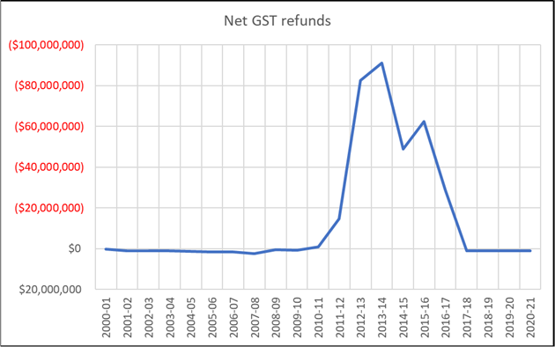
AUSTRALIA| REVERSE CHARGE: IMPACT
The graph below shows BAS refunds paid to precious metal refiners. Prior to commencement of the scheme, refiners were a net remitter of GST.
A significant decline in refunds coincided with the implementation reverse charge mechanism and other ATO strategies including the implementation of the refund retention strategy.
OECD ACADEMY | VAT/GST FRAUD INVESTIGATIONS PROGRAMME

Slide 21
PRECIOUS METALS| CASE STUDY 1
5
106%
Refiner A
Bullion Dealer
Second Hand Dealer
Amalgamator
1
2
3
4
102%
104%
106%
$1000/kg + GST
Transactions
Refiner A supplies ‘precious metal’ (GST free) to Bullion Dealer (not associated) at 102% (spot price).
Bullion Dealer supplies ‘precious metal’ (Input Taxed) to Second Hand Dealer at 104% (spot price) on credit terms – this customer represents 90% of total supplies of Bullion Dealer.
Second Hand Dealer alters form of ‘precious metal’ (melting and recasting) and supplies to Amalgamator.
Refiner advances Amalgamator 106% (spot price GST inclusive) on notification of volume availability.
Amalgamator issues RCTI to Second Hand Dealer and makes payment (106% spot price GST inclusive).
Second Hand Dealer pays Bullion Dealer, 104% (spot price) as per credit terms.
Amalgamator supplies non-precious metal to Refiner – all metal supplied is high purity (99.99%) and invoices commission of $1000/kg + GST for metal supplied.
Second Hand Dealer is a non-lodger contends that supplies and acquisitions were ‘in an investment form’ and input taxed.
Amalgamator contends that all acquisitions were non-investment form.
Refiner contends that all acquisitions were non-investment form – records indicate that some acquisitions are likely to have been received ‘in an investment form’.
OECD ACADEMY | VAT/GST FRAUD INVESTIGATIONS PROGRAMME
Notes:
CASE STUDY 1 – REFINER
On 1 December 2011, unaccredited Refiner A registered for GST after acquiring plant, equipment, clients and trading name of an existing market participant. The main business activities of Refiner A include the acquisition and refinement of scrap gold and other metal applied to the production of ‘investment form’ precious metal (as defined in s 195-1 of the GST Act) for supply to Dealers. Additional activities include the supply of non-investment form precious metal (99.99%) for supply to Jewellers and a minting operation (coins etc).
During the audit period, Refiner A did not have contracts in place with mines to acquire doré and did not make significant acquisitions of mined product as part of its business. The ‘investment form’ precious metal sold by Refiner A was produced from acquisitions of high purity “scrap gold” (at or above 99.99%) not falling within the statutory definition of “precious metal” from intermediate sources which represented 91.86% of Refiner A’ acquisitions.
Supplies of precious metal are GST-free (s38-385), input tax credits can be claimed on the acquisition of gold that does not meet the statutory definition of precious metal. Refiner A accounts for GST on a monthly basis and received refunds in respect of the input tax credits claimed for its non-precious metal acquisitions, because it used that metal to produce precious metal, which it sold GST-free. The precious metal produced was, principally supplied to associate Bullion Dealer A who are common directors and shareholders of Refiner A. Bullion Dealer A funded Refiner A’s acquisitions in advance.
The suppliers (Intermediaries A-Z) of Refiner A directly or indirectly acquired metal from Bullion Dealer A which was ultimately sold to Refiner A. Refiner A promoted paying advances to the intermediaries as a claimed business strategy to improve market attractiveness. The advances provided a source of financial support for the intermediaries who in the absence of this funding would have been unable to acquire and on supply the high volumes of high purity scrap gold purportedly traded.
The view of the Commissioner, is that Refiner A’s entitlement to input tax credits arose from a set of round-robin arrangements. Investment form ‘precious metal’ (as defined in s 195-1 of the GST Act) was being sold by Refiner A to associate Bullion Dealer A and changed to non-precious metal by intermediaries. Refiner A purchased this high purity non-precious metal from suppliers and claimed input tax credits. The scheme created an arrangement whereby Refiner A caused its suppliers to create what would otherwise have been non-existent scrap metal supplies (an artificial market) to Refiner A in order to generate input tax credits from those supplies. It is observed that the input tax credits claimed effectively funded the profits realised by all supply chain participants, including the margin applied on the original sale of precious metal by Bullion Dealer A.

Slide 22
PRECIOUS METALS| CASE STUDY 2
Investors 40%
Investors 50%
Intermediaries
Second Hand Dealer
5
Overseas Refiner
Importer
Bullion Dealer
Buyer
Exporter
1
2
3
4
6
8
9
Purported Export China
Purported Import China
7
Transactions
Buyer receives funds from investors, orders and makes payment for ‘precious metal’ with Bullion Dealer.
Bullion Dealer advances funds (100%) to the Importer for supply of ‘precious metal’.
Importer arranges customs clearance and delivery of ‘precious metal’ (confirmed by customs interception) direct to Bullion Dealer.
Buyer purportedly collects ‘precious metal’ and provides to representative of Chinese entity for export.
Second Hand Dealer purportedly imports scrap from an overseas Chinese entity which is supplied to intermediaries.
Intermediaries supply scrap to Exporter (Second Hand Dealer facilitates transaction lock in price and transport with Exporter in most instances).
Exporter makes payment to intermediaries who retain a commission with balance paid to Second Hand Dealer.
Second Hand Dealer retains a commission with balance paid to Buyer.
Second Hand Dealer and intermediaries do not require capital to find the transactions as payment is not required until funds are received from Exporter.
Exporter supplies scrap to off shore refiner and receives payments for precious metal content (customs interception confirms that exported material is not precious metal (22k consists of copper as the principal alloy).
Exporter makes payment to investors (50% return on investment/gross profit) from ATO refund.
Buyer makes payment to investors (40% return on investment/gross profit).
Note:
Compliance activities confirm that the purported export and import transactions for the Buyer and Second Hand Dealer did not occur.
Buyer and Second Hand Dealer are unable to identify the company representative of the individual who collected ‘precious metal’ or substantiate bona-fides of transactions.
Enquiries reveal that funds for purported export are received directly from Second Hand Dealer.
The structure of transactions provides evidence that there was no margin in the transactions to allow for profit by either the overseas buyer or seller.
OECD ACADEMY | VAT/GST FRAUD INVESTIGATIONS PROGRAMME
Notes:
CASE STUDY 2 – EXPORTER
On 25 September, 2002 Exporter A registered for GST. The business activities of Exporter A include the acquisition of scrap gold which is sold at ‘arm’s length’ to an overseas refiner. Exporter A is invoiced by the overseas refiner for refining and assay fees and enters an agreement to sell the precious metal content at a fixed margin below the prevailing spot price.
Exports are GST-free (s38-185), input tax credits can be claimed on the acquisitions of gold (from a registered entity) that does not meet the statutory definition of precious metal. Exporter A accounts for GST on a monthly basis and received refunds of $24,731,692 in respect of the input tax credits claimed for its acquisitions. The material acquired includes legitimate ‘scrap gold’, however the majority is identified as originating from ‘investment form’ precious metal (as defined in s 195-1 of the GST Act) which is supplied through complex networks. The direct suppliers of Exporter A are Intermediaries who are sourcing material from Buyers and Second Hand Dealers which is imported or acquired within Australia.
The Tax Agent of Exporter A appears to control the arrangements, providing personnel to supervise metal collection from Intermediaries and funding to Exporter A (as representative for investors and/or personal provision of funds). Exporter A would be unable to fund the acquisitions, to the extent of volumes traded, without external funding.
The investors are paid 50% of the gross profits realised by Exporter A. Additional funding is provided by independent Chinese investors to the Second Hand Dealer as advance payment for the acquisition (import) of precious metal entering the supply chain. Similar to the funding arrangements for Exporter A these investors receive returns as high has 40%. The total profits derived are equal to the net refunds claimed by Exporter A.
Compliance activities with respect to Export A (refund reviews/audits) are unable to apply the core provisions in addressing revenue leakage due to verification that acquisitions do not meet the statutory definition of precious metal (ie scrap) and the fact that a physical export has occurred. The Commissioner is currently considering the application of the anti avoidance provisions (Division 165) to address the refund issue.
The Commissioner issued Alternative Assessments to the Buyer and Second Hand Dealer. It is contended that the Buyer acquired ‘precious metal’ (as defined in s 195-1 of the GST Act) and sold scrap to the Second Hand Dealer and the purported arrangement of the supply to a 3rd party in Australia for export was fictitious. In the alternative, it is contended that the Second Hand Dealer did not acquire scrap gold but acquired ‘precious metal’ (as defined in s 195-1 of the GST Act) from the Buyer and altered the form of that ‘precious metal’. Assessments were issued for the 1 January 2014 to 30 September 2014 period for approximately $13m respectively with additional penalties. Objections were submitted by the Buyer and Second Hand Dealer which were disallowed and entities have ceased trading. The Second Hand Dealer matter is currently subject to litigation at the AAT. The immediate impact of the Alternative assessments has resulted in a significant decrease in product entering the supply chain (imports) and consequential refunds.
Additional significant assessments of $20.4m have been issued by the Commissioner on entities which preceded the above.

Slide 23
GROUP ACTIVITY| INTERNATIONAL CASE STUDIES
In your groups, read the case study allocated and identify:
the drivers,
the typology,
the indicators; and
how the jurisdiction prevented, detected or responded to the fraud.
Group 1:
Singapore –
Gold Case Study
Group 2:
Singapore –
IC Chips Case Study
Group 3:
Japan –
Gold Smuggling Case Study
Group 4:
United Kingdom –
Contra Trading Fraud Case Study
OECD ACADEMY | VAT/GST FRAUD INVESTIGATIONS PROGRAMME

Slide 24
SINGAPORE CASE STUDY – PRECIOUS METALS
OECD ACADEMY | VAT/GST FRAUD INVESTIGATIONS PROGRAMME

Slide 25
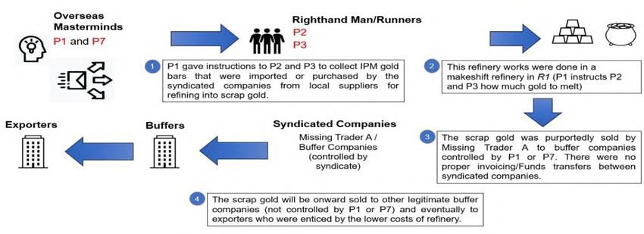
SINGAPORE| THE SCHEME (GOLD)
OECD ACADEMY | VAT/GST FRAUD INVESTIGATIONS PROGRAMME

Slide 26
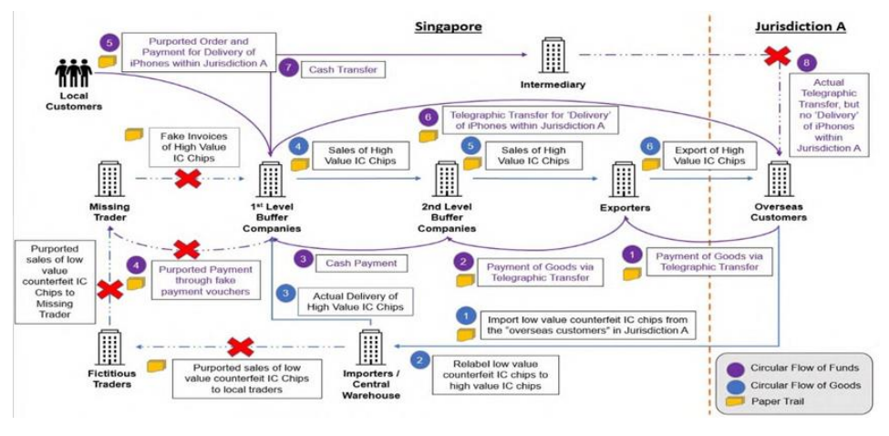
SINGAPORE| THE SCHEME (IC CHIPS)
OECD ACADEMY | VAT/GST FRAUD INVESTIGATIONS PROGRAMME

Slide 27
JAPAN CASE STUDY – GOLD BUILLION SMUGGLING
OECD ACADEMY | VAT/GST FRAUD INVESTIGATIONS PROGRAMME

Slide 28
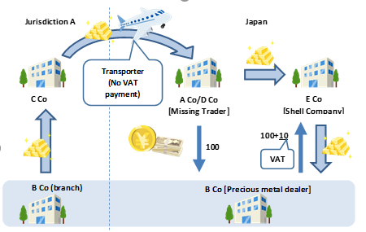
JAPAN| THE SCHEME
OECD ACADEMY | VAT/GST FRAUD INVESTIGATIONS PROGRAMME

Slide 29
UK CASE STUDY – CONTRA TRADING
OECD ACADEMY | VAT/GST FRAUD INVESTIGATIONS PROGRAMME

Slide 30
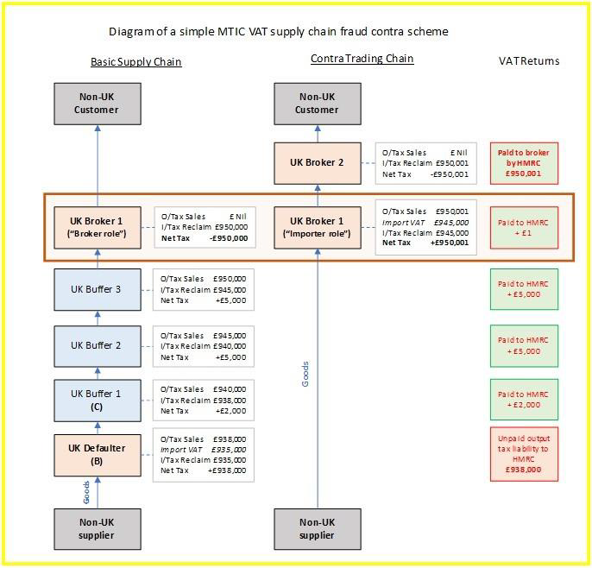
UK| THE SCHEME
OECD ACADEMY | VAT/GST FRAUD INVESTIGATIONS PROGRAMME

