Slide 1
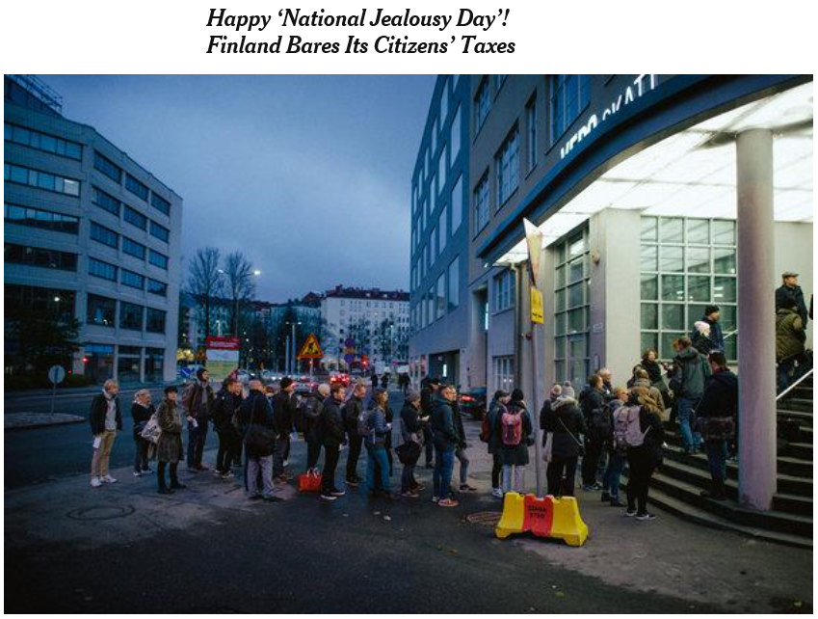

Slide 2
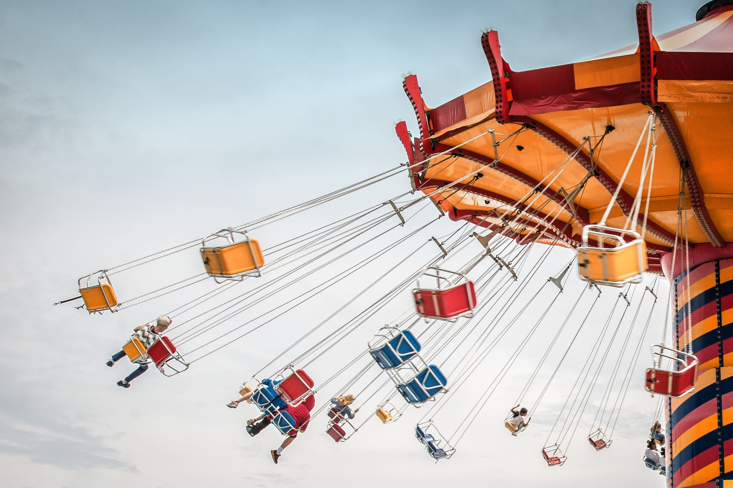
Carousel Fraud

Slide 3
Carousel Fraud
Abuses the VAT system
  Exemption and refund mechanism
Takes advantage of multiple countries
Requires more resources…
  …to commit
  …to investigate
Impact on trade statistics
  Export data unreliable on certain goods
  Balance of trade
Potential for massive damages

Slide 4
Positions in a carousel 1/3
Missing Trader (MT):
  Used to create the appearance of real transactions
  Does not fulfill any tax obligations
  No response to inquiries
  Can‘t be found physically
  No clear commercial activity
  Shadow persons
  Provides deductible VAT to other companies
  Easy to replace

Slide 5
Positions in a carousel 2/3
Defaulter:
  Declares but does not pay the VAT
  Fulfills some of the tax obligations
  Can be harder to prove criminal intent
Broker:
  Highest profit margin in the chain
  Is in the same country as the MT
  Makes purchases from a Buffer
  Makes zero rated sales (exports etc.)
  Claims VAT refunds
  VAT not paid by MT or Defaulter

Slide 6
Positions in a carousel 3/3
Buffer:
  Make investigations more difficult
  Acts as a normal trader on a domestic market
  Usually after a MT in the supply chain
  Creates distance between MT and Broker
  Fulfills the tax obligations
  Very low profit margin
  Easy to replace
In/Out Buffer - Conduit
  Same characteristics as Buffer
  Acts as a normal international trader

Slide 7

Problems with definitions
Definitions
  Can vary from country to country
    Carousel includes multiple countries
  Useful in a professional setting
    Visual explanation of the carousel form
    Role of each country in the fraud
In exchanges of information
  Should not replace written explanation
  Can cause confusion
    Do we agree on the definitions?
    Do we need to clarify?
  Usability in a criminal trial?

Slide 8
Company A Oy role?
Finland
B
A
C
Germany
Estonia
D
X
Z

Slide 9

Why a carousel?
Tax office
What is the problem with this fraudelent chain?
Refund claims
FI
Refunds
1 000 € + 24 % VAT
1 100 € + 24 % VAT
B
(MT)
A
(Buffer)
C
(Broker)
EE
1 000 € + 0 % VAT
1 200 € + 0 % VAT
X
G

Slide 10
Variations

Slide 11
Variation 1
Due to the principle of free movement of goods in the EU, carousels can more easily deal with ficitious goods/services
Modus operandi
A fictitious sale to B
B fictitious "export" to X
X sells the goods back to A
Some countries outside of EU have relaxed customs procedure for certain goods, countries and/or specialty areas
These exceptions can be used by the fraudsters
FI
1 000 € + 24 % VAT
B
(broker)
A
(MT)
EE
1 200 €
0 % VAT
1 000 €
0 % VAT
X
(conduit)

Slide 12

Variation 2
B
(Buffer)
Modus operandi
A domestic sale to B
B domestic sale to C
C export to X
X domestic sale to F
F export to A
Could X also become a missing trader and F a broker?
There can be multiple reasons why the fraudsters would not want to commit a fraud in a specific country → X would not declare the VAT and F would not claim a VAT refund
1 050 € + 24 % VAT
1 000 € + 24 % VAT
C
(Broker)
A
(MT)
FI
1 100 €
0 % VAT
1 150 €
0 % VAT
RU
X
F
(MT)
1 000 €
20 % VAT
(Broker)

Slide 13
Example Damages/profit

Slide 14
Example
Buffer
1 050 € +
24 % VAT
Buffer
T
K
1 100 € +
24 % VAT
1 000 € +
24 % VAT
Finland
A
B
Broker
Missing trader
1 500 €
0 % VAT
Germany
Estonia
950€
0 % VAT
D
X
Z
700 €
0 % VAT
750 € +
20 % VAT
Conduit
Missing trader
Broker

Slide 15
Refunds
Carousel generates 414 € of refunds
Refunds can be invested back to the carousel
A
264 € refund
Tax offices
Finland and Estonia
150 € refund
Z
Broker
Broker
Only two countries in this example!

Slide 16
Payments
Buffers
MT
MT
T
B
X
K
Payment of 24 €
(12 € + 12 €)
Tax office
Finland
Tax office
Estonia
Refund of 264 €
Refund of 150 €
A
Z
Broker
Broker

Slide 17

Profit of the fraud
Profits in total 390 € (240 €+ 150 €)
  From Finland the profits are 240 € (264 € refunds – 24 € VAT paid by the buffers)
  From Estonia the profits are 150 €
Breakdown
  Three countries used in the carousel
  Refunds claimed in two countries
  Adding a broker to Germany?
Costs
  Companies
  Shadow persons
  Logistics
  Equipment
  Rent
Maintaining the carousel requires resources

Slide 18
Practical exercise
Imagine: You are a group of criminals from different countries and you are planning to do the perfect financial crime. You decide to set up a “Carousel Refund Scheme”.

Slide 19
Practical exercise
Design and draw your carousel fraud and present it in class!
  What goods or services would you choose for the fraud?
  What does your group think would be important for a successful carousel fraud?
Group 1: How would you organize the flow of money, circulation of goods/services and invoices?
Group 2: How would you communicate with the other fraudsters and tax officials/investigators? What methods / devices would you use?
Group 3: Focus on what countries you would involve in your carousel, and in which country would you situate your Broker(s) and why?
Group 4: How would you hide your assets? And how can you “move” them out of the Carousel and use them?

Slide 20
Results
Present and explain your carousel!
What goods or services did you choose?
How did you organize the flow of money, circulation of goods/services and invoices? (Group 1)
How did you communicate with the other fraudsters and tax officials/investigators? What methods / devices did you use? (Group 2)
What countries did you involve in your carousel, and in which country would you situate your Broker(s)? (Group 3)
How did you hide the assets and how would you use them? (Group 4)
What else did you consider?

Slide 21

Typical goods and services used
Works with the majority of goods and services
  Depends on the country (reverse charge?)
High valued goods that are cheap and easy to transport
  Electronics (mobile phones, computers, drones…)
  High valued metal (platinum, gold, silver, copper…)
Valuable services
  Rights (licences, carbon credits…)
  “Common“ services (building sector related services)
Are these still ”viable” in carousels?

Slide 22
Investigation - Problems and challenges

Slide 23
Form

Slide 24


Carousel form
Complex form
  Multiple countries and companies
  Replacing a company
  Unraveling a carousel
  Communication
  Distance to the fraud
  Responsibility
    How could i have known?
    How could i have operated this scheme?
So is complex form "better"?

Slide 25
Carousels interlocked
Tax office (FI)
Tax office (CA)
B
(FI)
O
(CA)
F
(CA)
Refunds
Refund claims
Refunds
Refund claims
A
(FI)
D GmbH
(GE)
K
(GE)
Z
(EE)
D
(GE)
Refunds
Refunds
Refund claims
Refund claims
X
(EE)
Tax office (GE)
Tax office (EE)

Slide 26
What is it?
Tax office (FI)
Tax office (CA)
B
(FI)
O
(CA)
F
(CA)
Refunds
Refund claims
Refunds
Refund claims
A
(FI)
Z
(EE)
D
(GE)
K
(GE)
Refunds
Refunds
Refund claims
Refund claims
X
(EE)
Tax office (GE)
Tax office (EE)

Slide 27
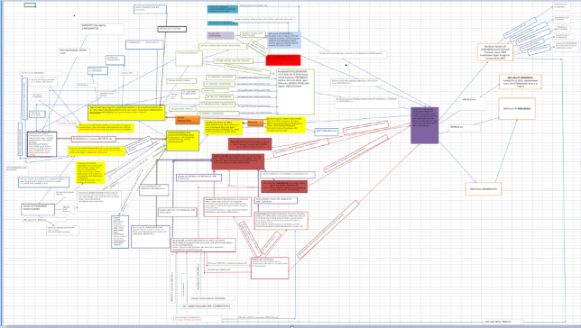
Complexity

Slide 28

Buffer
Conduit
Buffer
Broker
MT

Slide 29
Money flow

Slide 30

Third party payments
Companies A, B and C are buffers in a carousel fraud
Money is not going directly from the buyer to the seller
Unraveling / Detection?
Money
Money
Money
A
(buffer)
B
(buffer)
C
(buffer)
1 000 € +
24 % VAT
1 050 € +
24 % VAT
Tax office

Slide 31

Complexity - APP
Alternative payment platform (APP)
  Key feature = Internal transactions
H
F
A
Internal transactions
D
Payment out
Payment in
C
G
APP

Slide 32

Alternative payment platform
APP = Alternative payment platform
  Key feature = Payments within the system
Host bank
Payment
APP bank account
APP
Payment
Internal
Outgoing
Incoming
A
B
C
D
Sale of goods
Sale of goods
Sale of goods

Slide 33
Example of APP
APP host bank
Supplier
(GE)
Money
Buyer
(FI)
Money
1 000 € +
0 % VAT
1 080 € +
24 % VAT
A
(FI)
B
(FI)
C
(FI)
D
(FI)
1 020 € +
24 % VAT
Not paid
1 040 € +
24 % VAT
1 060 € +
24 % VAT
Fraudsters
Flow of goods

Slide 34
Information from an APP
Purpose
Nature of the service
Features provided
Jurisdiction
Bank account
Server
Staff
Legislation
APP vs banks
Money laundering reports (STR)
Compliance requirements
What does the use of an APP tell us?

Slide 35
Communication

Slide 36





Burner apps
Key features
  Anonymity
  "Burner numbers“
    Some rely on data connection
  Links to other apps
  Masking/hiding the application
  Disquise messages/notifications
  Personal encrypted data / Vaults
  Self-destructing messages
Hushed
CoverMe
Burner
TextMe Up

Slide 37

Security and verification
Accessing websites / forums
  Open and closed sources
  Terms of use
  Personal devices
  Is our connection secure?
  Risks and counter-surveillance
  Value of OSINT
False leads
  Credit cards
  Phones

Slide 38

Challenges
Domestic vs international means
Length of investigation
  Adequate resources
  Acceptable level damages?
Coordination
  What, when and where?
  Risk of exposure
  Miscommunication
  What is requested vs what we can provide

Slide 39

Challenges
Different priorities in joint investigations
  Focus of the investigation
  Acceptable outcome
Cooperation
  Compliance vs Cooperation
  Quantity vs Quality
  Obligation vs Commitment
  Resources vs Requirements

Slide 40

Challenges
Asset recovery
  Multiple countries and jurisdictions
  Identification of assets
  Linking assets to the crime
  Stage of asset recovery?
    Pre-investigation, prosecution etc
  Preserving and managing assets
  Time limits

Slide 41

Challenges
VAT is complex even to professionals
  Margin tax scheme
  Place of taxation
  and many more...
Case presentation
  Law enforcement
  Prosecution
  Judges
  Keep it simple…

Slide 42
Future of taxation
Legislation
Legislation for more access / cooperation. Need for legislation on national and international level (OECD)
Services
Services to make cooperation with Tax administrations easy
Technology
Automated gathering of information, machine learning, AI and analytics
Financing
Need to secure financing for Tax administrations to meet the challenges of the future

Slide 43

Future auditor/investigator
Requirements of the future
  Data management and analysis
    Mixed skillset
    What to apply and when
  Technological literacy
    Know your business
    More specialised auditors?
More is required, not less
    Accounting skills 2.0
    VAT frauds of the future?
      Bots?
      Hacks?

Slide 44
Future of databases
Accessability & usability
  Better design
  Advanced usability (tax investigation etc.)
  More access to different databases
    Combining databases
    Getting rid of fragmentation
    Legislation for more access
More self created databases
  Projects for data gathering

Slide 45
Questions?

