Slide 1
INTERNATIONAL TAX and FINANCIAL CRIMES
COMBATING PROFESSIONAL ENABLERS
and CHALLENGES FACED

Slide 2


International Tax and Financial Crimes
  Managed out of Washington, D.C.
  Currently 12 Special Agents
  Focus is on criminal international tax cases
Focus Areas
  U.S. Citizens residing abroad
  Multi-national corporations
  Offshore Compliance Initiative/Expatriation
  FATCA
  PROFESSIONAL ENABLERS

Slide 3
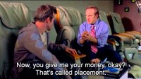
Professional Enablers
Come in many different shapes and sizes
Notes:
Professionals who use their skills and knowledge of the law to actively promote, market and facilitate the commission of crimes by their clients.
May not know what crime their client is committing, just facilitate the crime
Clients may have reliance defense

Slide 4
“All the problems of a domestic case, and that’s the good news”
Is there a mechanism in place to secure necessary evidence and testimony for trial?
Is your evidence located in areas of geo-political, environmental, or personal risk?
Will critical foreign witnesses willingly show up for trial?
Is there anything that would impact the viability of a criminal case? Reliance, age, extradition…
Can the foreign government be trusted with the information you supply them?
Is it worth the time and cost?
Notes:
How do we investigate them?
First step is to identify them and their clients

Slide 5

Case Development
General Investigations
Other Agencies/Referrals
Data Analysis
Informants/Sources
Undercover Activity
Spin-offs

Slide 6
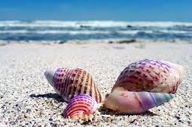
THE SHELL GAME
Notes:
Who is behind the smoke screen?

Slide 7

Constellation of Entities
Incorporated in Malta
Nominee Director in Cyprus
Nominee Shareholder in U.K.
Bank account in Singapore
Beneficial owner is a trust owned by several other trusts.
Who is the UBO?? How do we get records??
Notes:
Break down the Constellation into separate pieces and target the corporate service companies.

Slide 8
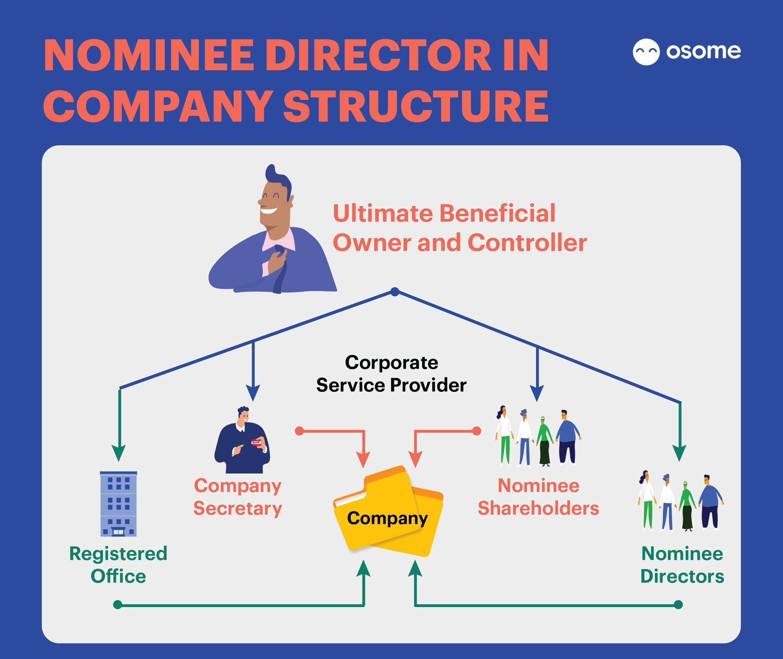
Notes:
No one but the Nominee Shareholder may know the actual UBO
Investigators must target those records

Slide 9
Securing Information and Evidence
Formal Requests
Court Evidence
MLAT, TIEA
Informal Requests
Leads, Intelligence, FIUs, Attachés
Court evidence where no treaty exists. For ex: a cooperative foreign witness
Notes:
Where possible, obtain informal information first
Understand that there will be delays in receiving information
Consider/plan for costs and time involved in translating documents
Immediately EGMONT any foreign lead. Then, follow up with a formal request.
Always ask for interviews to be conducted, and for you to participate in them.
Keep asking for information, no matter how mundane.
Assume that the foreign government will give the witnesses or subjects your request.
Sometimes foreign countries “do their own thing”
Translation of Documents: IRS resources, FBI, CPB, Department of State

Slide 10
Email Search Warrant
Online Books and Records
Correspondent Banks
Media, Facebook, LinkedIn, YouTube
Undercover Activities
Other Investigative Methods
Notes:
May need MLAT

Slide 11
Email Search Warrant
What do you have when:
1.The subject lives in Dubai, banks in the Seychelles, has business operations in Pakistan and has accountants in Hong Kong, and
2. uses a Gmail account for email communications?
Notes:
Answer: A gold mine of U.S. accessible evidence detailing significant foreign activities. All you need to do is write a search affidavit. Make it a priority.

Slide 12
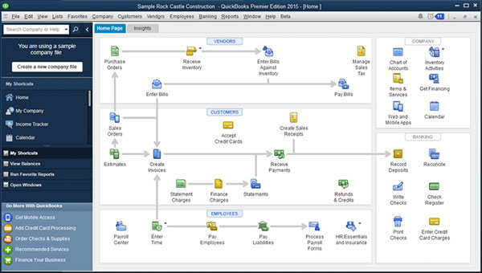
Online Books & Records
Companies’ backup files or actual accounting records online in the United States/overseas
Intuit and other companies can “clone” company file
Notes:
Can be to specific entities, transactions, or bank accounts.
Need a search warrant for wherever the company is located.
Records may also be in the email search warrant

Slide 13
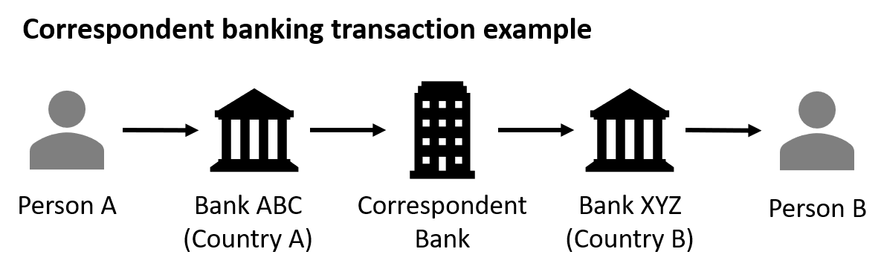
Correspondent Banks
Notes:
Used to move different currencies around the world
Correspondent bank used from currency’s home country. Ex: USD must go through the U.S.
Can subpoena these records from your own country

Slide 14
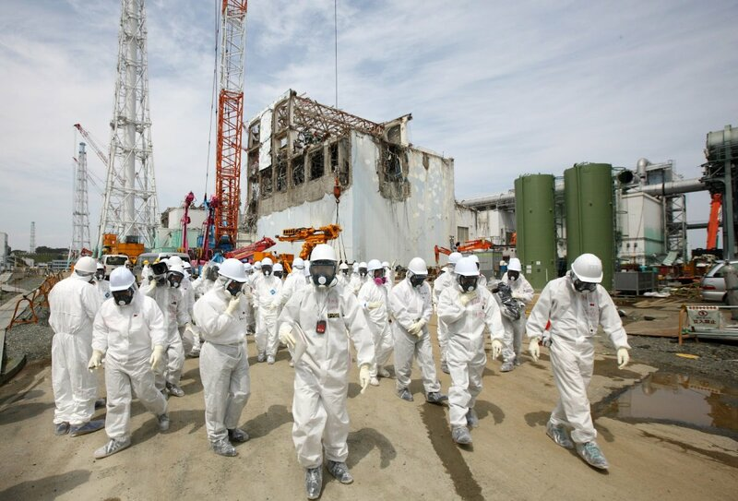
Physical Search Warrant
Notes:
U.K. example during COVID
Walk through process/interview
May be frustrating, but rewarding

Slide 15
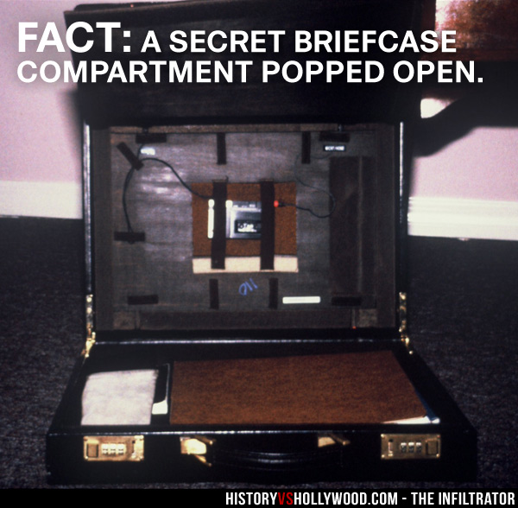
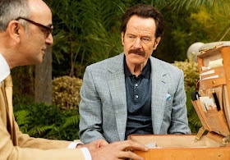
Undercover Activities
Infiltration is the key
UC activities can be conducted abroad.
J5 Initiative offers a clear opportunity for UC activities: U.S., Holland, UK, Australia, and Canada
Real-time vs. Historical
Notes:
Probably the most important thing you can do in a Professional Enablers investigation
Talk about the infiltrator, 3PML
Can be proactive
May be hard to infiltrate.
Utilize whistleblower/develop whistleblowers

Slide 16
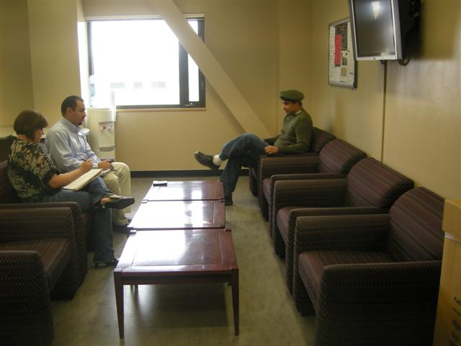
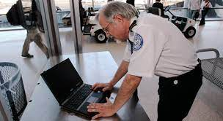
Additional Items To Consider
Border Searches – Consider requesting Border Authority search subject upon exit or entry; no warrant generally required.
US Citizens and foreign citizens on U.S. soil must still comply with a U.S. subpoena.
Material Witness Arrest Warrant – Arrest witness to secure testimony.
Interpol Red Notice/Extradition
Notes:
Parallel investigations with civil to audit clients
Be creative
Develop possible non-tax crimes to assist with MLATs/gathering evidence
Don’t give up!!

