Slide 1

OECD INTERNATIONAL ACADEMY FOR TAX CRIME INVESTIGATION
VAT/GST FRAUD INVESTIGATIONS PROGRAMME
VAT REFUND FRAUD & IDENTITY CRIME
JES DETTERER
MAY 2023
OFFICIAL | EXTERNAL

Slide 2






IDENTITY CRIME| LEARNING OUTCOMES
Participants will learn about:
 | 1. What is identity crime
 | 2. Growth in cyber identity theft 3. Case studies: GST refund fraud & identity crime in Australia 4. The ATO approach to combatting identity crime
OECD ACADEMY | VAT/GST FRAUD INVESTIGATIONS PROGRAMME

Slide 3





FINANCIAL CRIME ENABLERS| OVERVIEW
Enablers facilitate serious and organised crimes. Understanding the role and characteristics of enablers assists investigators plan investigations, follow the money, and gather admissible evidence.
Money Laundering
Technology
Identity Crime
Professional Enablers
Illegal Phoenix Activity
OECD ACADEMY | VAT/GST FRAUD INVESTIGATIONS PROGRAMME
Notes:
Key enablers have a unique role in facilitating serious and organised crime.
Activities such as money laundering and identity crime contribute to the effectiveness of other types of organised crime. While not all of the above enablers are present in every illicit market, two or more enablers may be used concurrently within the same criminal enterprise.
Enablers are integral to the business of serious and organised crime groups. Law enforcement, regulatory, legislative or policy actions against enabling activities have the potential to disrupt criminal networks across multiple illicit markets or to severely hinder their activities. For example, increased law enforcement and regulatory capability to identify and prosecute professional facilitators would have a significant impact on all criminal groups relying on the expert advice and knowledge provided by such facilitators to perpetrate or conceal criminal activity. Similarly, reduced ability of crime groups to realise their illicit proceeds or conceal their illicit wealth through targeting of money laundering would be likely to affect future illicit activity by serious and organised crime groups.

Slide 4




IDENTITY CRIME| OVERVIEW
The term identity encompasses the identity of natural persons (living or deceased) and the identities of body corporate.
Identity Fabrication: The creation of a fictitious identity
Identity Crime: A generic term to describe activities/offences in which a perpetrator uses a fabricated, manipulated or stolen identity.
Identity Theft: The theft or assumption of a pre-existing identity, with or without consent
Identity Manipulation: The alteration of one’s own identity
OECD ACADEMY | VAT/GST FRAUD INVESTIGATIONS PROGRAMME

Slide 5

IDENTITY CRIME| KEY OBSERVATIONS
Key Observations:
The theft, and subsequent on-selling, of personal identifying information is a highly lucrative crime that can enable other serious financial crimes such as VAT/GST refund fraud.
Identity crime particularly the harvesting of personal identifying information, continues to increase as this data is increasingly stored online.
Establishing a false business
Taking over another business
Tax Agents inflate VAT refunds
Setting up false bank accounts
Some of the ways identity crime can enable VAT/GST fraud include:
OECD ACADEMY | VAT/GST FRAUD INVESTIGATIONS PROGRAMME
Notes:
Identity crime continues to be one of the most common types of crime committed in Australia, and acts as an enabler of significant criminal activities including money laundering, financial crimes, drug trafficking and fraud. The true extent of identity crime is difficult to quantify due to under-reporting, discrepancies in cross-jurisdictional reporting, and instances where identify theft is undetected. There is a growing trend towards the commission of identity crime online through the production and sale of identity documentation and fraudulent use of personal identifying information.
As well as enabling crime, it is also a crime in its own right, carried out by serious and organised crime groups and cybercriminals.
PII is a valuable commodity, traded and sold by criminals to serious and organised crime groups with a view to facilitating other financial crimes.
Phishing refers to identity theft tactics surrounding email and internet use. Social engineering is the use of deception to manipulate individuals into revealing PII that may be used for fraudulent purposes.
Identity crime will likely increase in frequency as the volume of PII stored online increases. As more financial services are provided online, there is a requirement for more personal identifiers, such as personal identification numbers, passwords, access codes and security questions, to be created and stored. These personal identifiers are of value to criminal entities and will continue to be harvested, sold and used in fraud and to access systems for other criminal purposes. Identity takeover is likely to emerge as the primary identity crime methodology used to facilitate financial crime, rather than identity creation. As government agencies and private institutions increase services offered online, it is likely that new identity crime enabled financial crime methodologies will be observed.
Refunds fraud Is characterised by the submission of false income tax returns or activity statements
It is with the intention of fraudulently obtaining refunds

Slide 6
















IDENTITY CRIME| EXAMPLE
Perpetrator Steals employee records
Identities are compromised
ORGANISATION
Perpetrator accesses ASIC portal
Registers company using compromised identity as director
ASIC
Perpetrator accesses ATO portal
Updates bank account details (fraudulent bank account)
ATO
VICTIM
ORGANISATION
Lodges BAS
Receives GST refund
OECD ACADEMY | VAT/GST FRAUD INVESTIGATIONS PROGRAMME

Slide 7







IDENTITY CRIME| CYBER IDENTITY THEFT
The risk of cyber identity theft is increasing which potentially results in an increase in VAT refund fraud (or other types of tax fraud):
> In 2021-22, the Australian Cyber Security Centre (ACSC) reported an increase of nearly 13% in cybercrimes from the previous financial year.
> In July to December 2022, Office of the Australian Information Commissioner (OAIC) reported a 41% increase in data breaches resulting from malicious or criminal attacks.
Cyber identity theft commonly occurs through…
‘Phishing’ activities
Information on social media
Data breaches
Hacking online accounts
Fake job adverts
OECD ACADEMY | VAT/GST FRAUD INVESTIGATIONS PROGRAMME

Slide 8

IDENTITY CRIME| CASE STUDY 1
A man has been sentenced to one year and ten months imprisonment for defrauding the Australian Tax Office (ATO) of more than $3 million in GST refunds.
The man, 39, pleaded guilty in October 2022 to two counts of dealing in the proceeds of crime and the sentence imposed in March 2023 by the Parramatta District Court.
A joint AFP and ATO Serious Financial Crime Taskforce (SFCT) investigation began in 2021 into fraudulent Business Activity Statement (BAS) refunds lodged under multiple companies identified by the ATO.
Further enquiries revealed the bank account details associated with those companies had been changed to ones controlled by the man.
Sydney man sentenced for defrauding the ATO of more than $3 million | Australian Federal Police (afp.gov.au)
OECD ACADEMY | VAT/GST FRAUD INVESTIGATIONS PROGRAMME

Slide 9

IDENTITY CRIME| CASE STUDY 2
A 38-year-old fraud syndicate member who conspired to defraud the Commonwealth of more than $5 million through Goods and Services Tax (GST) refunds, has been sentenced to 5 years imprisonment with a non-parole period of 3 years.
The offenders conspired to defraud the Commonwealth through an intricate money laundering and fraudulent tax claim scheme involving hundreds of stolen identities, shell companies, bank accounts and false returns.
The scheme was uncovered by a taxpayer when they conducted an internet search and discovered their personal details located in a spreadsheet titled ‘wolf2012’. The taxpayer reported what they had found to both the police and the ATO.
The man pleaded guilty to conspiracy with the intention of dishonestly obtaining a gain from the Commonwealth. He was sentenced to five years imprisonment, with a non-parole period of three years, bringing the eight-year long joint investigation to a close.
GST fraudster sentenced over multi-million dollar scheme | Australian Taxation Office (ato.gov.au)
OECD ACADEMY | VAT/GST FRAUD INVESTIGATIONS PROGRAMME

Slide 10




IDENTITY CRIME| ATO APPROACH TO IDENTITY CRIME
The case studies highlight how the ATO responds to identity crime in terms of criminal investigations and prosecutions.
However, there are a number of other ways we prevent, detect and respond to identity crime:
DETECT
We use intelligent systems to automatically detect tax returns suspected of being lodged using another person’s identity.
PARTNER
We are a partner agency in a whole-of-government approach to reducing identity crime.
EDUCATE
We provide education to the general public to assist in preventing identity crime.
SUPPORT
Our Client Identity Support Centre supports taxpayers who have had their identity’s stolen.
Identity crime | Australian Taxation Office (ato.gov.au)
OECD ACADEMY | VAT/GST FRAUD INVESTIGATIONS PROGRAMME

Slide 11



IDENTITY CRIME| MYGOV ID
MyGov ID is a unique digital identity that allows people to prove who they are online and securely sign into government online services.
There are three identity strengths, basic, standard and strong.
OECD ACADEMY | VAT/GST FRAUD INVESTIGATIONS PROGRAMME

Slide 12
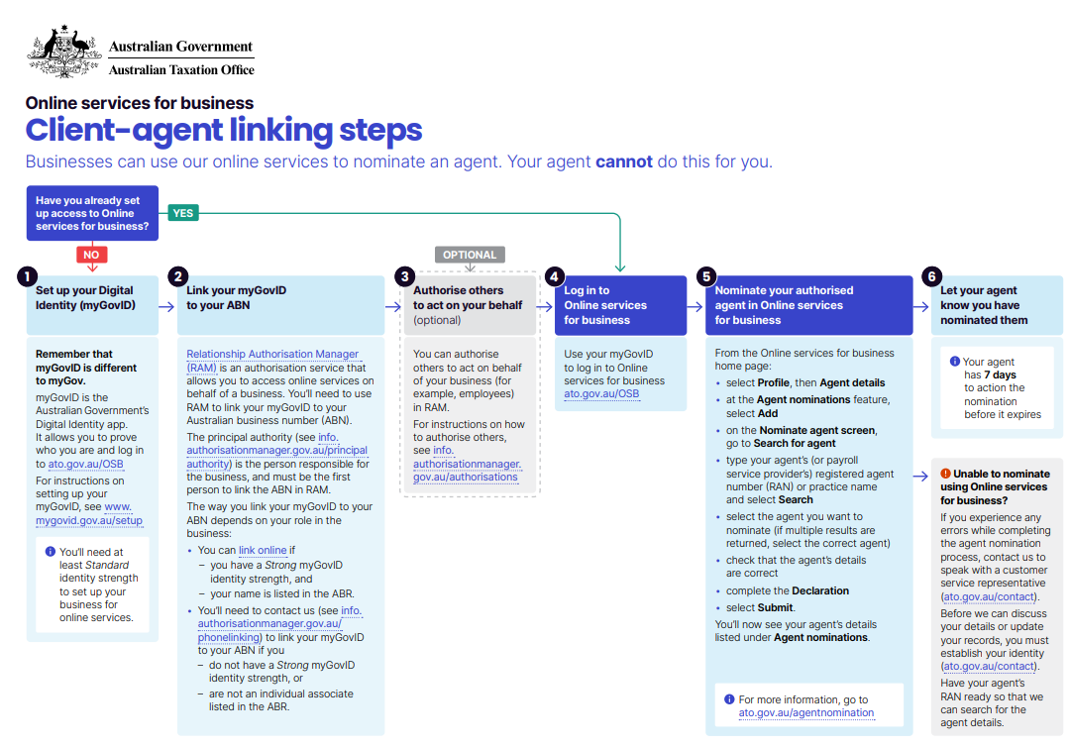
IDENTITY CRIME| TAX AGENTS
Identity theft and fraud can occur to taxpayers and registered agents. Criminals may pose as:
taxpayers and engage an agent to help them (unknowingly) commit fraud
agents to gain access to client information and services available on our digital platforms.
The ATO is currently rolling out a new client-agent linking program to strengthen its front-end controls and protect tax agents & clients against fraud and identity theft after a successful pilot in 2022.
OECD ACADEMY | VAT/GST FRAUD INVESTIGATIONS PROGRAMME

Slide 13

IDENTITY CRIME| DIRECTOR ID
A director identification number (director ID) is a unique identifier anyone who is a director of a company keeps forever.
All directors are required by law to verify their identity with the ATO before receiving a director ID. This is important because it will help to:
prevent the use of false or fraudulent director identities,
make it easier for external administrators and regulators to trace directors’ relationships with companies over time; and
identify and eliminate director involvement in unlawful activity, such as illegal phoenix activity.
OECD ACADEMY | VAT/GST FRAUD INVESTIGATIONS PROGRAMME

Slide 14


IDENTITY CRIME| MEDIA REPORT
Peter carried out weeks of electrical work on new apartment buildings in Melbourne. Before Imagebuild paid Peter the half milion he was owed, the company was liquidated. When he took the builder to court, he was told it wasn't Imagebuild who owed him money — it was a twin company whose director was a woman named Lisa.
Lisa said her life was "a mess" a few years ago when she got caught up in the scheme. She was couch surfing around the western suburbs of Melbourne when a friend introduced her to an accountant named Jesus. Ms Baker said he signed her on as a director of a company in exchange for a few hundred dollars.
The multi-million-dollar 'dummy director' scam using vulnerable Australians to rip off the tax office - ABC News
OECD ACADEMY | VAT/GST FRAUD INVESTIGATIONS PROGRAMME

Slide 15
GROUP ACTIVITY| IDENTITY CRIME
Working in your groups, complete the following activities:
1. Is identity crime an issue in your work?
2. What evidence would you gather to prove who is behind identity crime?
3. Discuss how your jurisdictions respond to identity crime. Are there any criminal charges in your jurisdiction? How should such a crime be prosecuted?
OECD ACADEMY | VAT/GST FRAUD INVESTIGATIONS PROGRAMME

Slide 16
OECD ACADEMY | VAT/GST FRAUD INVESTIGATIONS PROGRAMME

