Slide 1

OECD INTERNATIONAL ACADEMY FOR TAX CRIME INVESTIGATION
VAT/GST FRAUD INVESTIGATIONS PROGRAMME
VAT REFUND FRAUD – OPERATION PROTEGO
JES DETTERER
MAY 2023
OFFICIAL | EXTERNAL

Slide 2


OPERATION PROTEGO| LEARNING OUTCOMES
Participants will learn about:
 | 1. Operation Protego typology (simple VAT refund fraud)
 | 2. Application of the ATO External Fraud & Corruption Control Plan
OECD ACADEMY | VAT/GST FRAUD INVESTIGATIONS PROGRAMME

Slide 3



OPERATION PROTEGO| OVERVIEW
Operation Protego is the Australia’s biggest VAT/GST fraud to date.
It involves individuals who invent fake businesses to get a refund.
Promotors of the scheme used social media to recruit participants.
As at 31 December 2022...
Compliance action on more than 53,000 clients
Stopped $2.5 billion in fraudulent refunds
OECD ACADEMY | VAT/GST FRAUD INVESTIGATIONS PROGRAMME

Slide 4

VAT REFUNDS| TYPOLOGY
Typology - Simple refund fraud
Mostly committed by individuals
Goods or services (and everything else) is fabricated
Cash withdrawn as refund received
Little response to detailed inquiries
No assets, employees, business premises etc.
Can involve identity theft and/or coercion
Individual
Refund claimed
Tax Office
Refund paid
OECD ACADEMY | VAT/GST FRAUD INVESTIGATIONS PROGRAMME

Slide 5



VAT FRAUD| PREVENT, DETECT & RESPOND
The ATO Fraud and Corruption Control Plan outlines the approach to managing fraud risks.
Prevent
Detect
Respond
OECD ACADEMY | VAT/GST FRAUD INVESTIGATIONS PROGRAMME

Slide 6

PREVENT| OVERVIEW
Preventative strategies are the first line of defence and include proactive measures designed to help reduce the risk of fraud occurring.
Their aim is to educate and put in place systems and protocols such that syndicates are unable to set up the procedures required in order to substantiate and be successful with respect to VAT Fraud
Client education & comms
System integrity
Implementing a strategy
OECD ACADEMY | VAT/GST FRAUD INVESTIGATIONS PROGRAMME

Slide 7
PREVENT| IMPLEMENT A STRATEGY
CRIMINAL
Conduct investigations
Work with other agencies to prosecute offences
Educate other agencies on fraud typologies
Media releases on fraud cases
Respond
Detect
Prevent
CIVIL
Review entitlements
Deregister entities
Work with external organisations
Apply analytics to detect fraud
Create typologies library
Payment suspension
Taxpayer education
Tighten GST registration checks
Introduce new legislation
OECD ACADEMY | VAT/GST FRAUD INVESTIGATIONS PROGRAMME

Slide 8

PREVENT| EDUCATION & COMMUNICATION
Education and communication are the cornerstone of a preventative strategy
Active education of members of the public, business communities and Tax Agents on arrangements can help prevent people from being unknowingly drawn into schemes
OECD ACADEMY | VAT/GST FRAUD INVESTIGATIONS PROGRAMME

Slide 9


PREVENT| SYSTEM INTEGRITY
Registry Control (VAT)
VAT Control (refund)
Tax Audit
(if selected)
Fraudster needs to get through:
Conflicting interests?
Customer Service
Anti-fraud measures
OECD ACADEMY | VAT/GST FRAUD INVESTIGATIONS PROGRAMME

Slide 10





DETECT| OVERVIEW
Organisational awareness & coordinated approach
Payment suspension
Development of VAT fraud indicators and typologies
Data sources, modelling and analytics for identifying VAT fraud
OECD ACADEMY | VAT/GST FRAUD INVESTIGATIONS PROGRAMME

Slide 11






OPERATION PROTEGO | RISK DETECTION
Working with:
> Law Enforcement Agencies
> Intelligence Agencies
> Financial Institutions
> Social media platforms
Community
Tip-offs
Sophisticated
Risk Model
OECD ACADEMY | VAT/GST FRAUD INVESTIGATIONS PROGRAMME

Slide 12

RESPOND| OVERVIEW
Respond refers to the actions that we take to disrupt the fraud after it has been detected and includes assessment, investigation, referral, prosecution and recovery.
Streamlined treatments
Referrals to the ACIC
Working with State Law Enforcement Agencies
Warning Letters for recovery of monies
Partnering with social media platforms
OECD ACADEMY | VAT/GST FRAUD INVESTIGATIONS PROGRAMME

Slide 13
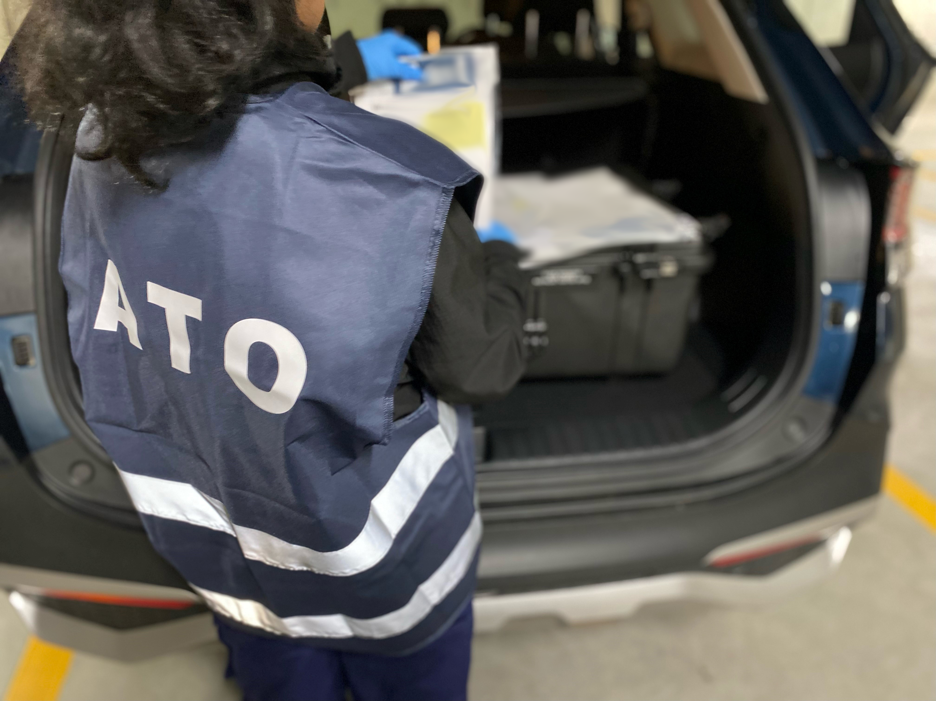
Enforcement activity has been undertaken across Australia by the ATO-led Serious Financial Crime Taskforce (SFCT), including the execution of search warrants for those suspected of promoting on social media and the issuing of warning letters.

Slide 14
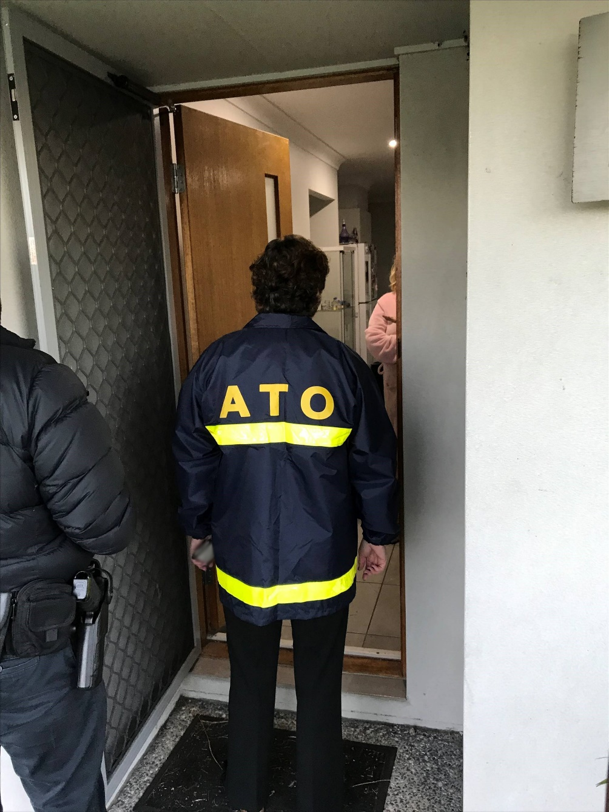
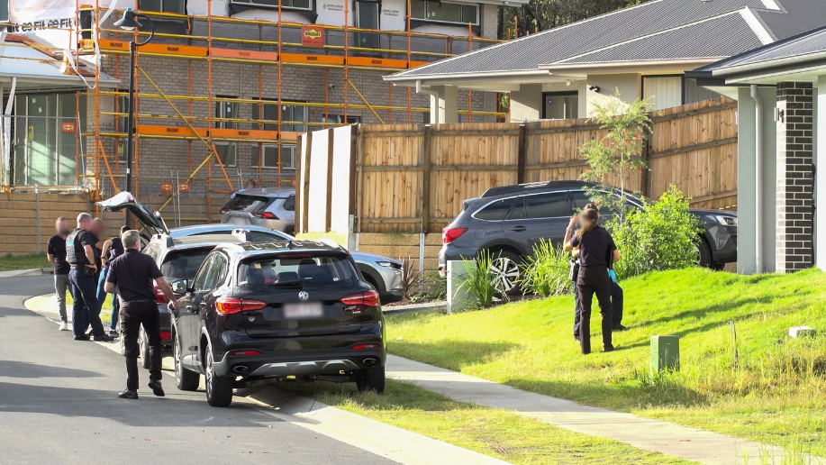
OPERATION PROTEGO | ENFORCEMENT ACTIVITY
2 individuals have been sentenced to jail time for their crimes so far.
This follows 87 earlier arrests across the country, with many more to come.
It is expected more charges will be laid over coming months.
OECD ACADEMY | VAT/GST FRAUD INVESTIGATIONS PROGRAMME

