Slide 1
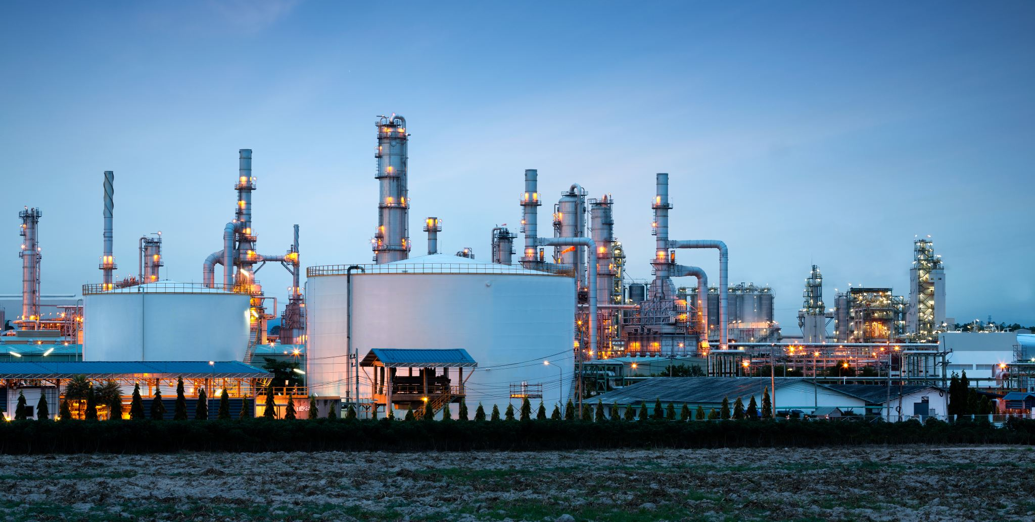
Industry cooperation
Industry cooperation

Slide 2
What is it about?
Cooperation with the private sector
Specific companies
Trade organisations, unions, coalitions etc.
What is the goal?
To gather relevant information for anti-fraud purposes
To engage the private sector to take a more active role in anti-fraud
Cooperation not compliance
Cooperation or whistleblowers?
Long term or short term?
Proactively and reactive tool
Useful in ongoing audits and in fraud prevention
Mutually beneficial relationship
Anti-fraud efforts promote healthy competition
A new source of information for anti-fraud

Slide 3

Possible benefits
Short term
Overview of the industry
Knowledge of key players
Knowledge of business practices
Supply chain
Long term
Active steps to combat fraud
Can provide real time information
Deeper knowledge of industry standards
Expert testimonies for criminal trial
Visibility of the anti-fraud efforts!
Can encourage others to cooperate
Success feeds success
Can create whistleblowers

Slide 4

Benefits for business
Removal of unfair competition
Fair competition in business
Increased honest economic activity
Sales and profits
Hiring
Investments
Tax payments
Image
Participation in anti-fraud efforts
Acting on the values

Slide 5
Individual companies
Does the company have information on the industry?
What is the position of the company in the markets (seller, buyer, manufacturer etc.)
Market share and influence?
What kind of information does the company have?
How are the goods/services used in the fraud connected?
Purchaser, seller, intermediary, third party?
Is there an interest in clearing fraudsters from the markets?
Manufacturer
Competitor
Benefiter
Compliance of the company
Should have “normal” tax compliance history
Reasonable level of certainty that the company is not part of the fraud and is not benefiting from it knowingly

Slide 6
Organisations
Any organization that covers a specific sector or field of business
Level of information
Influence
Power
Is the fraudster or fraud connected to the organisation?
Fraudsters not usually members of trade organisations, unless it is required to do business
Being a member could require more reporting (to the organisation) and attract unwanted attention to the fraudster
Is there an interest in clearing fraudsters from the markets?
Individual company vs organisation
Clearing unfair competition

Slide 7


Basic idea
Information
Analyze
Verify
Act
Tax administration
Trade organisation / company
Establish a relationship
Feedback
Advise
Encourage
Maintain

Slide 8
Correct approach
Setting up requires strategy
Plan the details
Ensure adequate resources beforehand
Timing can be important
Fraudulent activities found in a business sector can encourage cooperation
Cooperation > compliance
Define the goal
Adjust expectations
Be proactive and patient

Slide 9
Risks/costs
Time
Building and maintaining a relationship takes time
Real possibility of deterioration
Level of commitment
Tax administration
Is the time and recourses invested enough?
Do our actions encourage cooperation?
Private sector
Active or passive?
Illusory participation
Reasons for participating?
How long do we want to maintain it?

Slide 10
Risks/costs
Reliability of information
Companies can give exaggerated information on competition
Industry guidelines vs application of guidelines (benefit or a risk?)
Individual companies vs trade organisations
Quality of information
Level of trust
How much does the company/organisation value the cooperation?
Building trust always takes time and results
Trade organisations vs individual companies
Official vs unofficial statements
Value and usability

Slide 11
Detection speed
Company
X
(Fraudster)
Detection
Sales offer
(below market price)
Evades risk analysis
when registered for VAT
Raw information
Company
A
Trade organisation
member
Tax administration
Cooperation
Processed information
Raw Information
Trade organisation

Slide 12
Example
Customers
Information
Price + 24 % VAT
Not paid
Price + 24 % VAT
Z Oy
Tax administration
X Oy
V Oy
A Oy
B Oy
C Oy
D Oy
X Oy
Detected
Y Oy
Q Oy
Trade organisation
Price + 0 % VAT
FI
EE
Sales or
Sales offers
EE Oü
Domestic purchases

Slide 13
Discussion

Slide 14
Discussion
What kind of cooperation do you have with the private sector in your country?
  Are there many organisations to cooperate with?
  Has it been successful?
  Have you encounter any problems?
What kind of cooperation you would like to have with the private sector?

Slide 15
Fraudsters evolve and adapt

Slide 16

Evolution of the fraud
Customers
Price + 24 % VAT
Price + 24 % VAT
Not paid
A Oy
B Oy
C Oy
D Oy
Z Oy
(MT)
Trade organisation
Price + 0 % VAT
FI
EE
Z Oy, G Oü and the missing traders are part of the fraud
G Oü
(broker)
Missing
traders
Price + 20 %
VAT Not paid

Slide 17
Evolution of the fraud
Price + 24 % VAT
X Oy
Customers
Price + 24 % VAT
Price + 24 % VAT
Not paid
A Oy
B Oy
C Oy
D Oy
Z Oy
(MT)
Trade organisation
Price + 0 % VAT
FI
EE
Z Oy, G Oü and the missing traders are part of the fraud
G Oü
(broker)
Missing
traders
Price + 20 %
VAT Not paid

Slide 18
Evolution of the fraud
Customers
Price + 24 % VAT
A Oy
B Oy
C Oy
D Oy
Trade organisation
Price + 0 % VAT
FI
EE
G Oü and the missing traders are part of the fraud
G Oü
(broker)
Missing
traders
Price + 20 %
VAT Not paid

Slide 19

Evolution of the fraud
0 % VAT
VAT Not paid
0 % VAT
A
(MT)
B
(broker)
Poland
0 % VAT
C
(MT)
VAT Not paid
D
(broker)
0 % VAT
Customers
Supplier
Latvia
Germany
Finland
0 % VAT
E
(MT)
VAT Not paid
F
(broker)
0 % VAT
Sweden

Slide 20
Where are we now?
”Fraud” moved away from Finland
VAT fraud happens somewhere in Europe?
Goods still end up in Finland?
Do the customers in Finland know?
Measuring success
Tax administration vs private sector?
Fraudsters adapt
New version of the fraud was already waiting
Flow of goods did not stop completely

Slide 21
Questions?

