Slide 1

OECD INTERNATIONAL ACADEMY FOR TAX CRIME INVESTIGATION
VAT/GST FRAUD INVESTIGATIONS PROGRAMME
SHINING LIGHT ON THE VAT/GST SHADOW ECONOMY
JES DETTERER
MAY 2023
OFFICIAL | EXTERNAL

Slide 2



SHADOW ECONOMY| LEARNING OUTCOMES
Participants will learn about:
 | 1. What is the shadow economy
 | 2. The Australian Tax Gap 3. ATO approach to the shadow economy
OECD ACADEMY | VAT/GST FRAUD INVESTIGATIONS PROGRAMME

Slide 3

SHADOW ECONOMY| OVERVIEW
The shadow economy refers to dishonest and criminal activities that take place outside the tax and regulatory system. It reduces available funding for essential community services such as health care, disaster response, education, transport and infrastructure.
Paying cash-in-hand to avoid obligations
Not registering
Not reporting or underreporting income
Exaggerating expenses
Underpayment of wages
Identity Fraud
VISA fraud
VAT/GST and duty fraud
Illegal drugs and tobacco
Illegal phoenixing
Sham contracting (presenting an employment relationship as contracting)
Unregulated gambling
Dealing in counterfeit goods
Money laundering
OECD ACADEMY | VAT/GST FRAUD INVESTIGATIONS PROGRAMME

Slide 4
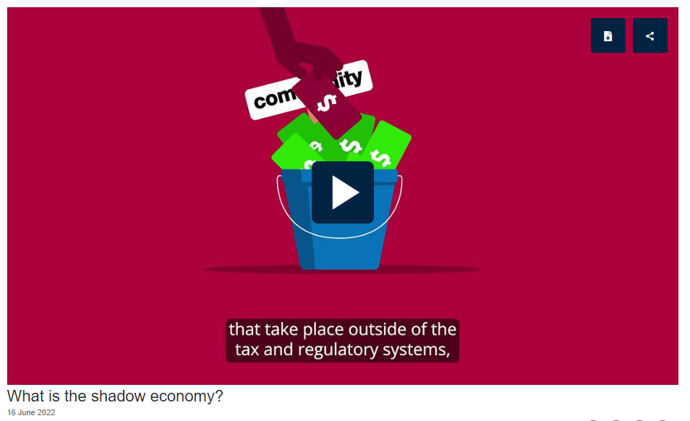
SHADOW ECONOMY| ATO VIDEO
What is the shadow economy? (ato.gov.au)
OECD ACADEMY | VAT/GST FRAUD INVESTIGATIONS PROGRAMME

Slide 5
THE AUSTRALIAN TAX GAP| OVERVIEW
The Black Economy Taskforce estimates the broader economic effect of the entire shadow economy is up to $50 billion or about 3% of national gross domestic product (GDP) is lost from the Australian economy each year.
The ATO Tax Gap program also provides a measure of the impact of the shadow economy.
Around $12.4 billion in tax is missing each year as a result of the shadow economy.
$12.4 billion is driven by shadow economy behaviour
Behaviour driving
the overall gap
$33.4 billion tax gap
$21 billion is driven by other behaviours (e.g. mistakes, non compliance)
$446.4 billion or 93% reported or paid voluntarily
OECD ACADEMY | VAT/GST FRAUD INVESTIGATIONS PROGRAMME

Slide 6
THE AUSTRALIAN TAX GAP| OVERALL TAX GAP
Of the overall $33.4 billion tax gap, 75% is from:
Individuals (not-in-business),
Small Business, and
Goods and Services Tax (GST).
Small business taxpayers are the most significant contributors to the overall gap, but not all of this is driven by shadow economy behaviour.
Excise
($2.6B)
*Large corporate
groups ($2.6B)
*High wealth and
medium business
($1.7B)
Goods and
services tax
($4.2B)
Other gaps
($1.3B)
Overall tax gap
$33.4 billion or 7.0%
*Individuals
not in business
($9.0B)
*Small business ($11.9B)
* Income tax gaps
OECD ACADEMY | VAT/GST FRAUD INVESTIGATIONS PROGRAMME

Slide 7








THE AUSTRALIAN TAX GAP| SMALL BUSINESS INSIGHTS
The random enquiry program used to inform the tax gap has found:
Small businesses that report correctly are usually…
Keeping good records and conducting regular reconciliation processes
Seeking advice from a tax professional when they need it
Using technology to help them run their business
When small businesses get it wrong it’s usually in one of three ways…
Not declaring all income
Not accounting for private use of business assets/funds
Not understanding tax obligations
What have we learnt?
A large percentage of the population want to do the right thing and our job is to make it easy for them to do so.
We need to ensure we are striking the right balance in our treatment strategies.
Tackling the shadow economy will help us to close the tax gap.
OECD ACADEMY | VAT/GST FRAUD INVESTIGATIONS PROGRAMME

Slide 8
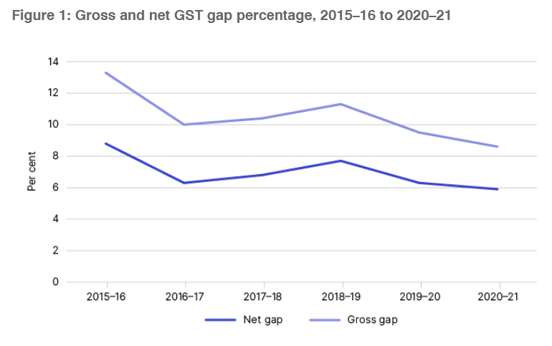
THE AUSTRALIAN TAX GAP| GST TAX GAP
For 2020–21, the ATO estimated a net gap of $4.1 billion or 5.9%. This means businesses paid over 94% of the total theoretical GST.
The gross gap is the gap before taxpayer compliance amendments. It was estimated to be $6.1 billion or 8.6%.
A range of taxpayer actions can affect the GST gap, including:
non-reporting of GST
under-reporting of GST
over-claiming of refunds
non-payment of GST liabilities
OECD ACADEMY | VAT/GST FRAUD INVESTIGATIONS PROGRAMME

Slide 9
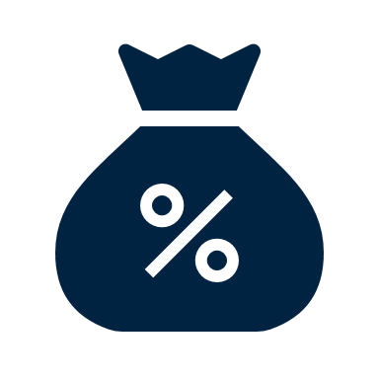
POLL| TAX GAP
Do you measure the tax gap in your jurisdiction?
Do you know roughly what it is?
OECD ACADEMY | VAT/GST FRAUD INVESTIGATIONS PROGRAMME

Slide 10






SHADOW ECONOMY| TACKLING THE SHADOW ECONOMY
The Black Economy Standing Taskforce handed down a final report in October 2017.
The Report included 80 recommendations to tackle the shadow economy.
The government initially allocated funding over 4 years to the ATO to implement recommendation and it was recently extended to 30 June 2025.
As part of this program, the ATO uses five integrated strategies and more than 30 projects to tackle the shadow economy.
Increased visibility of enforcement activities
Using data & technology to better target shadow economy
Prevention and education strategies
Black Economy Standing Taskforce
New law and policy measures
OECD ACADEMY | VAT/GST FRAUD INVESTIGATIONS PROGRAMME

Slide 11
SHADOW ECONOMY PROGRAM| ENFORCMENT ACTIVITIES
Raised over $2.6 billion in additional revenue
Seized and destroyed more then 600 tonnes of illicit tobacco
Identifying electronic sales suppression tools
Working with tax practitioners
Protecting the rights of employees
Business visits to 5,100 businesses in 22 high risk locations
Increased visibility of enforcement activities
OECD ACADEMY | VAT/GST FRAUD INVESTIGATIONS PROGRAMME

Slide 12
ENFORCEMENT ACTIVITIES| BUSINESS VISITS
The areas the ATO visits are considered to be higher risk. Risk identified include:
Unreported sales, omitted income or overstated expenses
Lack of record keeping knowledge
Discrepancies between VAT/GST & income tax
Businesses that are operating outside the tax system
When lifestyle and assets don't match up
Businesses reporting outside of the business benchmarks
Not complying with employer obligations
If businesses need or ask for help, the ATO will help them get back on track as well as show them the ATO tools and information available to assist them. However, if the ATO is concerned that a business is deliberately doing the wrong thing, it will investigate further and take any necessary action.
OECD ACADEMY | VAT/GST FRAUD INVESTIGATIONS PROGRAMME

Slide 13
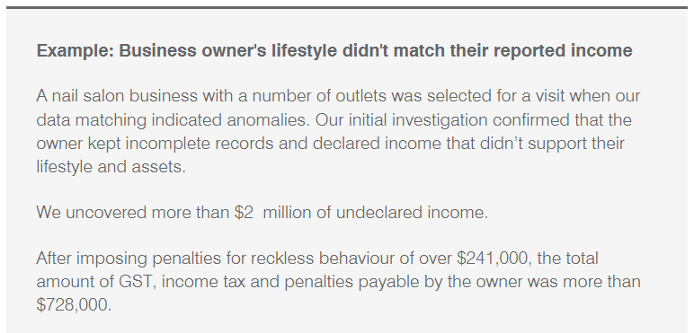

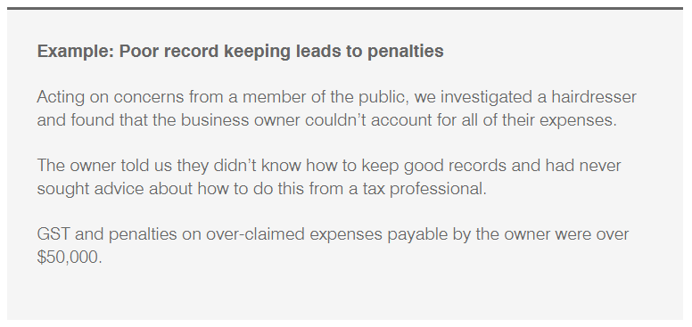

BUSINESS VISITS| HAIR & BEAUTY
The ATO’s activities in the hair and beauty industry resulted in:
an increase in timely lodgment of activity statements – up 4%
an increase in GST registrations being corrected
more timely payments of income tax and activity statement liabilities
a reduction in outstanding payment obligations
business owners being supported and educated to make informed decisions about their tax obligations.
OECD ACADEMY | VAT/GST FRAUD INVESTIGATIONS PROGRAMME

Slide 14
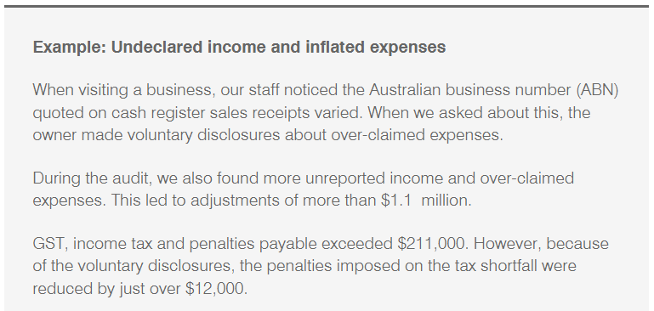

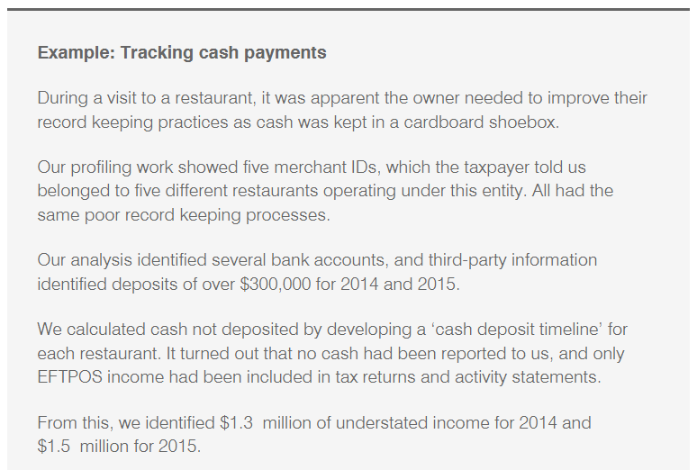

BUSINESS VISITS| RESTAURANTS
The ATO’s activities in the restaurant, café, takeaway and catering industry resulted in:
an increase in timely lodgment of activity statements – up 6%
an increase in GST registrations
an increase in timely payments of income tax and activity statement liabilities
business owners being supported and educated to make informed decisions about their tax obligations.
OECD ACADEMY | VAT/GST FRAUD INVESTIGATIONS PROGRAMME

Slide 15
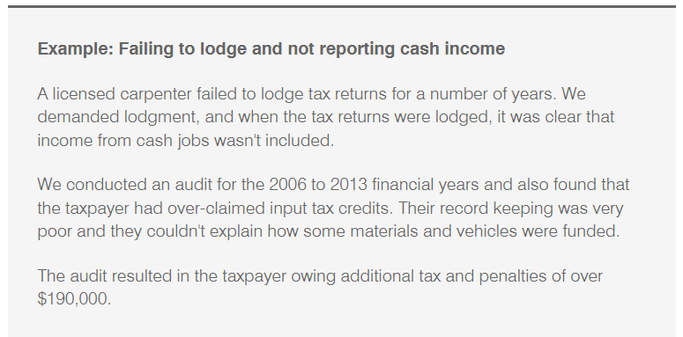

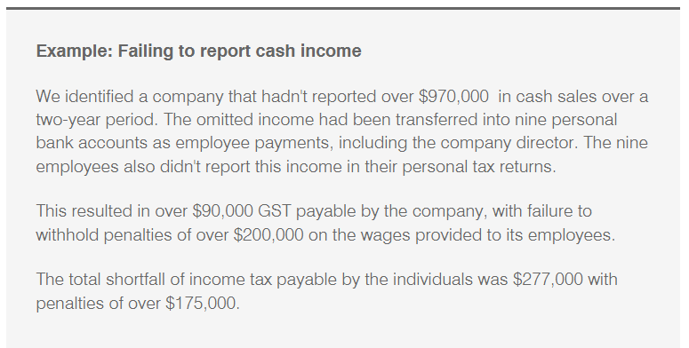

BUSINESS VISITS| BUILDING & CONSTRUCTION
The ATO’s activities in the building and construction industry have resulted in:
an increase in timely lodgment of activity statements – up 5%
over 760 businesses in the building and construction industry have been shown our range of online tools and services.
OECD ACADEMY | VAT/GST FRAUD INVESTIGATIONS PROGRAMME

Slide 16

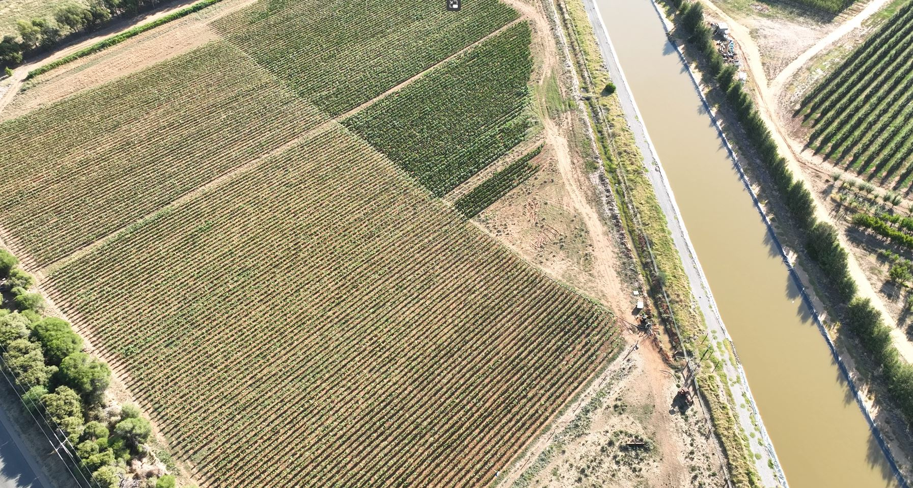
ENFORCEMENT ACTIVITIES| ILLICIT TOBACCO
It has been illegal to grow tobacco in Australia for more than a decade.
Penalties for growing, selling or possessing illicit tobacco are significant. If convicted, criminals may face up to 10 years’ imprisonment, a fine of at least $412,500, or both.
Since January 2022, multiple illicit tobacco crops throughout rural Victoria have been seized and destroyed, comprising of a total of:
  more than 119.5 acres of tobacco crops
  535 tonnes of green weight tobacco
  other tobacco products with a combined excise value in excess of $103 million.
Tip-off pays off as illicit tobacco uprooted in joint raids | Australian Taxation Office (ato.gov.au)
OECD ACADEMY | VAT/GST FRAUD INVESTIGATIONS PROGRAMME

Slide 17

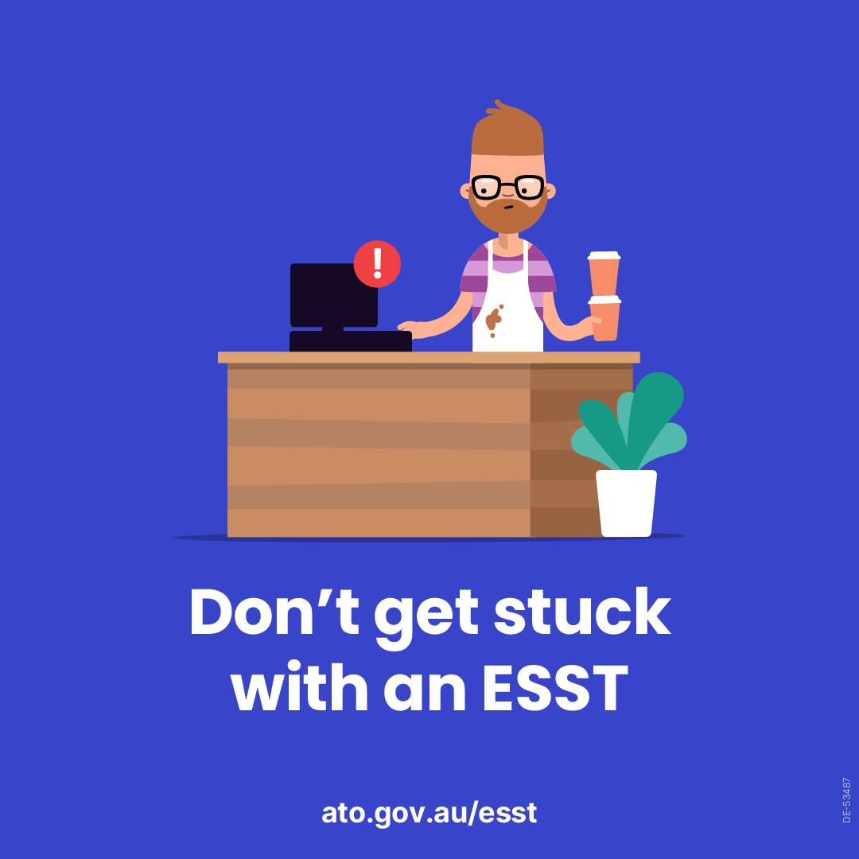

ENFORCEMENT ACTIVITIES| ESST
> Operation Flutter, a coordinated global crackdown by the Joint Chiefs of Global Tax Enforcement (J5), involved businesses suspected of supplying and using illegal electronic sales suppression tools (ESST) or software to avoid paying tax.
> ATO officers worked closely with counterparts in His Majesty’s Revenue and Customs (HMRC) in the United Kingdom and the Internal Revenue Service (IRS) in the United States, as part of a lengthy and comprehensive investigation.
Globally, the coordinated action involved the collection of evidence, intelligence gathering, search warrants, notices to produce, interviews, taxation assessments, and subpoenas.
In Australia, raids were undertaken by the Australian Taxation Office (ATO) at 35 separate premises suspected of supplying and using ESST.
OECD ACADEMY | VAT/GST FRAUD INVESTIGATIONS PROGRAMME

Slide 18
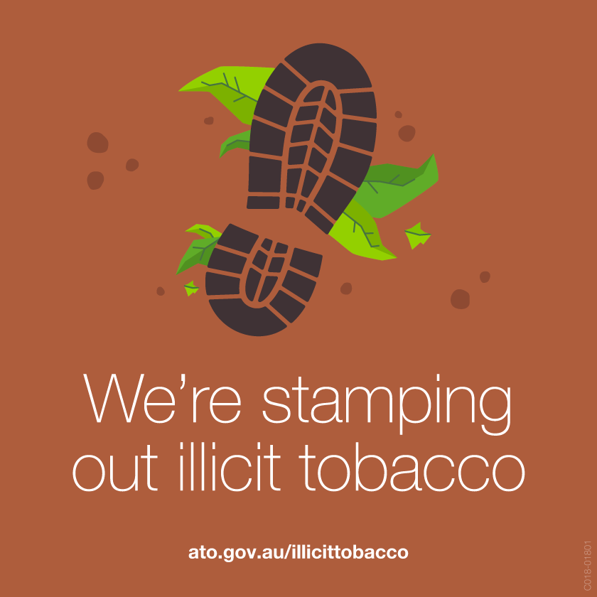


ENFORCEMENT ACTIVITIES| COMMUNICATIONS
We communicate our efforts to tackle the shadow economy to build community confidence and foster willing participation.
The community needs to know that we are taking action to maintain the integrity of the system and make it fair for everyone.
We have conducted campaigns for many of our shadow economy law changes and projects.
OECD ACADEMY | VAT/GST FRAUD INVESTIGATIONS PROGRAMME

Slide 19









SHADOW ECONOMY PROGRAM| DATA & TECHNOLOGY
Acquired new data
Improve how we capture, use and share community tip-offs: Tax Integrity Centre (TIC)
Built better analytical models to target shadow economy populations
Tax Integrity Centre: Community Tip-offs
Since the launch in 2019, over 97,000 tip-offs have been received:
A single point of entry
Better capture, storage, analysis and sharing
Improved detection
Using data & technology to better target shadow economy
Community
ATO staff
Tax Practitioners
Other Government
agencies
Topics | Not declaring income Demanding cash from customers Paying workers ‘cash in hand’
ATO business areas
Other Government agencies
OECD ACADEMY | VAT/GST FRAUD INVESTIGATIONS PROGRAMME

Slide 20
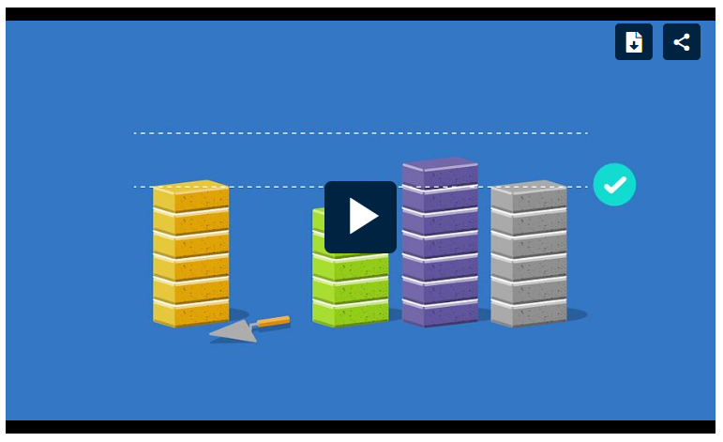
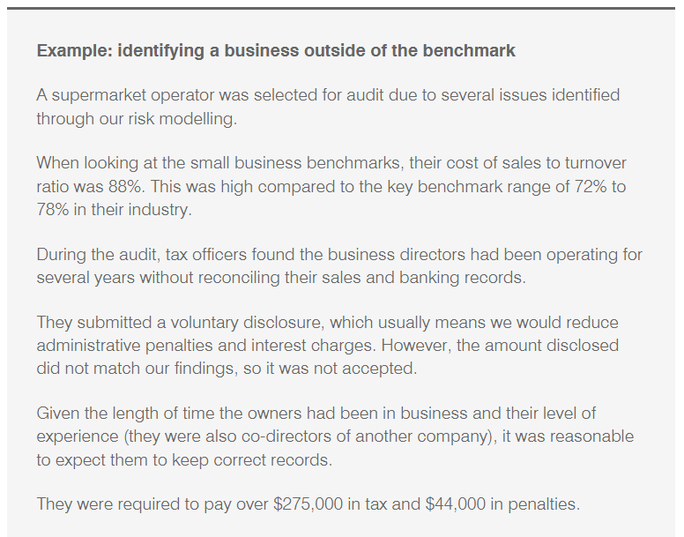

DATA & TECHNOLOGY| BENCHMARKS
Benchmarks are one of the tools the ATO uses to identify businesses that may be avoiding their tax obligations.
Compare your business now | Australian Taxation Office (ato.gov.au)
OECD ACADEMY | VAT/GST FRAUD INVESTIGATIONS PROGRAMME

Slide 21
SHADOW ECONOMY PROGRAM| EDUCATION
Developed and released Digital Cash Flow Coaching Kit for small business
Educating future generations and new migrants
> We have made over 950 presentations to schools and youth audiences
> We also connected with migrant communities with more than 730 presentations reaching over 26,500 people
Working to have tax and super in school curriculum
Prevention and education strategies
OECD ACADEMY | VAT/GST FRAUD INVESTIGATIONS PROGRAMME

Slide 22
SHADOW ECONOMY PROGRAM| LAW & POLICIES
Banning electronic sales suppression technology
Extended the successful Taxable Payments Reporting System to new services
Satisfactory statement of tax record required for government contracts over $4m
Collecting tobacco duties and taxes at the border
Introducing director identification numbers (director IDs)
New law and policy measures
OECD ACADEMY | VAT/GST FRAUD INVESTIGATIONS PROGRAMME

Slide 23
SHADOW ECONOMY PROGRAM| TASKFORCE
A whole of government taskforce that works to share intelligence and conduct joint operation
This combined intelligence has enabled the agencies to develop co-ordinated approaches to disrupt activities of groups of interest
11 government agencies involved
Black Economy Standing Taskforce
OECD ACADEMY | VAT/GST FRAUD INVESTIGATIONS PROGRAMME

Slide 24

GROUP ACTIVITY| SHADOW ECONOMY RISKS
Working in your groups, complete the following activities:
1. What are the common shadow economy risks in your jurisdiction?
3. What actions have been taken in your jurisdiction to tackle the shadow economy?
2. What difficulties for investigators have in investigating these cases?
OECD ACADEMY | VAT/GST FRAUD INVESTIGATIONS PROGRAMME

