Slide 1

OECD INTERNATIONAL ACADEMY FOR TAX CRIME INVESTIGATION
VAT/GST FRAUD INVESTIGATIONS PROGRAMME
OECD PRINCIPLES 4, 8 & 9
JES DETTERER
MAY 2023
OFFICIAL | EXTERNAL

Slide 2




OECD PRINCIPLES| LEARNING OUTCOMES
Participants will learn about:
 | 1. OECD Principle 8: Interagency Cooperation
 | 2. OECD Principle 9: International Cooperation 3. OECD Principle 4: Asset Recovery
OECD ACADEMY | VAT/GST FRAUD INVESTIGATIONS PROGRAMME

Slide 3
OECD PRINCIPLES| OVERVIEW
OECD ‘Fighting Tax Crime – The Ten Global Principles’
Principle 1: Ensure tax offences are criminalised
Principle 2: Devise an effective strategy for addressing tax crimes
Principle 3: Have adequate investigate powers
Principle 4: Have effective powers to freeze, seize and confiscate assets
Principle 5: Put in place an organisational structure with defined responsibilities
Principle 6: Provide adequate responses for tax crime investigation
Principle 7: Make tax crimes a predicate offence for money laundering
Principle 8: Have an effective framework for domestic inter-agency co-operation
Principle 9: Ensure international co-operation mechanisms are available
Principle 10: Protect suspects rights
OECD ACADEMY | VAT/GST FRAUD INVESTIGATIONS PROGRAMME

Slide 4

OECD PRINCIPLES| INTERAGENCY COOPERATION
OECD ‘Combatting Tax Crimes More Effectively in APEC Economies’ (2019):
[A]n agency-by-agency approach is not sufficient. Financial crimes will often cross multiple agencies mandates, and governments must therefore adopt integrated models for co-operation.
Tax authorities, customs, police, prosecutors, anti-money laundering authorities and regulators are all key allies in the fight against corruption and other financial crimes and each authority must ensure that their individual priorities align with a broader common goal towards combating financial crime through collective efforts’.
OECD ‘Fighting Tax Crime – The Ten Global Principles’
Principle 1: Ensure tax offences are criminalised
Principle 2: Devise an effective strategy for addressing tax crimes
Principle 3: Have adequate investigate powers
Principle 4: Have effective powers to freeze, seize and confiscate assets
Principle 5: Put in place an organisational structure with defined responsibilities
Principle 6: Provide adequate responses for tax crime investigation
Principle 7: Make tax crimes a predicate offence for money laundering
Principle 8: Have an effective framework for domestic inter-agency co-operation
Principle 9: Ensure international co-operation mechanisms are available
Principle 10: Protect suspects rights
OECD ACADEMY | VAT/GST FRAUD INVESTIGATIONS PROGRAMME

Slide 5


INTERAGENCY COOPERATION| TAX CRIME MODELS
Model 1: The tax administrator has responsibility for directing and conducting investigations
Australia, Canada, Germany, Greece, India, Ireland, Israel, Japan, Korea, Malaysia, New Zealand, Singapore, South Africa, Switzerland, Uganda, the United Kingdom and the United States
Austria, Azerbaijan, El Salvador, Estonia, Germany, Hungary, Latvia, the Netherlands, Portugal, Serbia, Sweden, Spain and the United States
Model 4: The police or public prosecutor has responsibility for conducting investigations.
Belgium, Brazil, Chile, Colombia, Costa Rica, the Czech Republic, Denmark, Ecuador, Finland, France, Greece, Iceland, Lithuania, Luxembourg, Mexico, Norway, Peru, the Slovak Republic, Slovenia, Spain and Sweden
Model 3: A specialist tax agency outside the tax administrator has responsibility for conducting investigations
Georgia, Ghana, Greece, Iceland and Turkey
Model 2: The tax administrator has responsibility for conducting investigations, under the direction of the public prosecutor
Effective Inter-Agency Co-operation in Fighting Tax Crimes and Other Financial Crimes - Third Edition (oecd.org)
OECD ACADEMY | VAT/GST FRAUD INVESTIGATIONS PROGRAMME

Slide 6
INTERAGENCY COOPERATION|AUSTRALIA
AFP (Australian Federal Police) – investigate
ATO (Australian Taxation Office) – audit, investigate, prosecute*
CDPP (Commonwealth Department of Public Prosecutions) – prosecute
* ATO role in investigation and prosecution is shared with two other government agencies.
OECD ACADEMY | VAT/GST FRAUD INVESTIGATIONS PROGRAMME

Slide 7

INTERAGENCY COOPERATION| INFORMATION SHARING
Model 1: Direct access to information contained in agency records or databases
Where information is suitable for using analytics and high-level risk assessment, direct access, or automatic or spontaneous exchange could be most effective.
Discretionary spontaneous sharing of information may be very effective when there is a longstanding co-operative relationship between the agencies involved.
Model 4: An obligation or ability to provide information but only in response to a specific request which is made on a case-by-case basis
Where the information needed is very specific or needs to be in a certain form, information on request or direct access to a specific case record may be most suitable.
Model 3: An ability, but not an obligation, to provide information spontaneously
Model 2: An obligation to provide information automatically or spontaneously
Fighting Tax Crime – The Ten Global Principles, Second Edition (oecd.org)
OECD ACADEMY | VAT/GST FRAUD INVESTIGATIONS PROGRAMME

Slide 8






INTERAGENCY COOPERATION| ENHANCED CO-OPERATION
Enhanced Cooperation
Joint Investigation Teams
Centres of Intelligence
Secondments
Training
Other Models
Shared Databases
Effective Inter-Agency Co-operation in Fighting Tax Crimes and Other Financial Crimes - Third Edition (oecd.org)
Fighting Tax Crime – The Ten Global Principles, Second Edition (oecd.org)
OECD ACADEMY | VAT/GST FRAUD INVESTIGATIONS PROGRAMME

Slide 9












INTERAGENCY COOPERATION| SUCCESSFUL PRACTICES
Sharing information with the tax administration for the purpose of assessing taxes
Tax administration access to Suspicious Transaction Reports
A co-ordinated strategy for dealing with Suspicious Transaction Reports
A centralised structure for inter-agency co-operation
The use of multi-agency task forces to combat financial crimes
Co-operation between the tax administrator and the police
National and Regional Intelligence Centres
A co-ordinated approach to monitoring the proceeds of crime
Co-operation with the private sector in the fight against crime
Effective Inter-Agency Co-operation in Fighting Tax Crimes and Other Financial Crimes - Third Edition (oecd.org)
OECD ACADEMY | VAT/GST FRAUD INVESTIGATIONS PROGRAMME

Slide 10






INTERAGENCY COOPERATION| OECD RECOMMENDATIONS
The OECD’s work on enhancing inter-agency co-operation proposes steps that economies could take to improve their ability to combat tax crimes and other financial crimes:
Develop robust and clearly defined institutional frameworks for co-operation
Establish a solid legal basis for reporting and information sharing between tax authorities and anti-corruption authorities
Adopt a cross-agency approach to policy development
Institute streamlined and efficient procedures and training for making and receiving reports and seeking and providing information related to suspicions of tax crime and corruption
Make available a range of enhanced co-operation mechanisms, such as joint operations and taskforces, parallel investigations, staff secondments, co-ordination forums, and joint intelligence centres
Take measures to develop a culture of co-operation
Combatting Tax Crimes More Effectively in APEC Economies (oecd.org)
OECD ACADEMY | VAT/GST FRAUD INVESTIGATIONS PROGRAMME

Slide 11
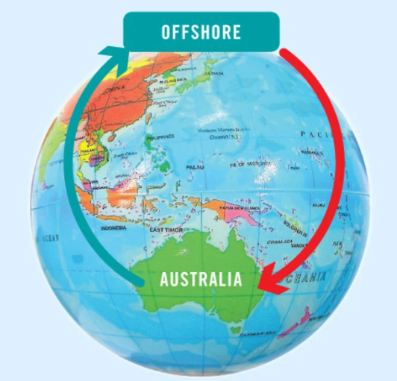
INTERAGENCY COOPERATION| PROJECT WICKENBY
Project Wickenby was a multi-agency taskforce established in 2006 to protect the integrity of Australia’s financial and regulatory systems.
In order to enable agencies to share information for the purposes of Project Wickenby special legislation was enacted.
The Taskforce worked with both Australian and international bodies to prevent, detect and respond to arrangements involving secrecy havens, international tax evasion, breaches of Australian financial laws and regulations, attempts to defraud the community including investors and creditors, money laundering and concealment of income or assets.
The Serious Financial Crime Taskforce which began operating on 1 July 2015 built on the success of Project Wickenby.
OECD ACADEMY | VAT/GST FRAUD INVESTIGATIONS PROGRAMME

Slide 12


INTERAGENCY COOPERATION| SFCT
The Serious Financial Crime Taskforce is a joint-agency taskforce led by the Australian Taxation Office.
It brings together the knowledge, resources and experience of relevant law enforcement and regulatory agencies.
It is the primary mechanism utilised by the ATO to respond to serious financial crime.
The Serious Financial Crime Taskforce (SFCT) started operation on 1 July 2015 and at 31 March 2023, the Taskforce has progressed cases that have resulted in:
  completion of 1,770 audits and reviews
  conviction and sentencing of 21 people
  raised liabilities of $1.647 billion
  collected $652 million.
OECD ACADEMY | VAT/GST FRAUD INVESTIGATIONS PROGRAMME

Slide 13




INTERAGENCY COOPERATION| OPERATION BEAUFIGHTER
Interest & Fees
Leasing Fees
THE BANK
THE PARTNERSHIP
THE FACTORY
THE PUBLIC COMPANY
Lent $200m to
to buy
from
OECD ACADEMY | VAT/GST FRAUD INVESTIGATIONS PROGRAMME

Slide 14
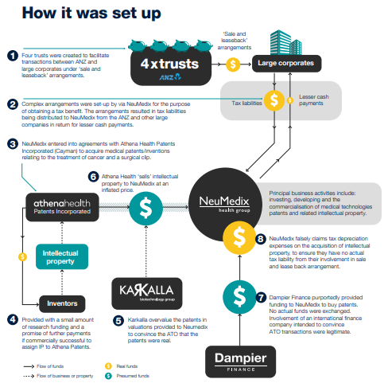
OPERATION BEAUFIGHTER| HOW IT WAS SET UP
OECD ACADEMY | VAT/GST FRAUD INVESTIGATIONS PROGRAMME

Slide 15
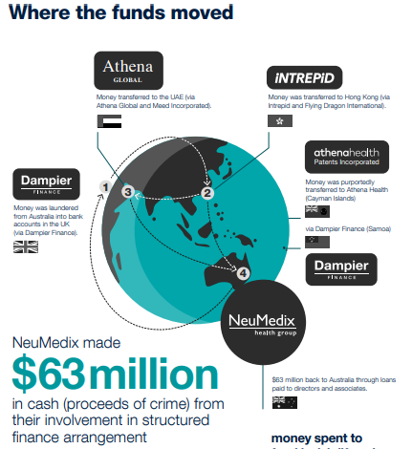
OPERATION BEAUFIGHTER| THE MONEY
OECD ACADEMY | VAT/GST FRAUD INVESTIGATIONS PROGRAMME

Slide 16
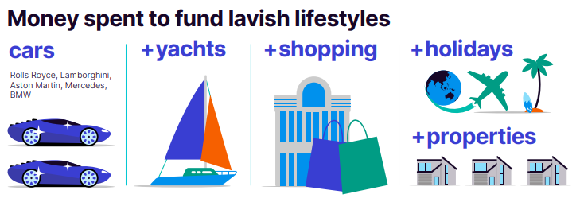
OPERATION BEAUFIGHTER| THE OUTCOME
Issakidis was sentenced to 10 years and three months jail for his involvement in the operation. This followed the 2015 sentencing of Dickson, whose original 11-year sentence was increased to 14 years on appeal.
One count of conspiring to dishonestly cause a loss or risk of a loss contrary to section 135.4(5) of the Criminal Code; and
One count of conspiring to deal with property of a value of $1,000,000 or more believing it to be proceeds of crime contrary to section 11.5(1) and section 400.3(1) of the Criminal Code.
The AFP also seized $60 million in assets.
OECD ACADEMY | VAT/GST FRAUD INVESTIGATIONS PROGRAMME

Slide 17

GROUP ACTIVITY| INTERAGENCY COOPERATION
Imagine you are investigating the carousel fraud you designed and are now working together with the other agencies involved to find out more about the arrangement:
1. How are you able to share information within your agencies? Do you receive some information directly and have to request other types of information?
3. Are there limits to working together?
2. In what ways do you (or could you) collaborate with other agencies in your jurisdictions?
OECD ACADEMY | VAT/GST FRAUD INVESTIGATIONS PROGRAMME

Slide 18

INTERNATIONAL COOPERATION| OVERVIEW
OECD ‘Combatting Tax Crimes More Effectively in APEC Economies’ (2019):
Tax crimes, corruption, terrorist financing, money laundering and other financial crimes threaten the strategic, political, and economic interests of all countries. The sums lost to illicit financial flows, including those that derive from these crimes are vast.
These crimes are all closely related and thrive in a climate of secrecy […] and weak inter-agency co-operation. By exploiting these weaknesses and advances in technology, criminals can covertly move substantial sums between multiple jurisdictions with relative ease and great speed. Consequently, criminal activity and the illicit financial flows that follow are becoming ever more sophisticated.
OECD ‘Fighting Tax Crime – The Ten Global Principles’
Principle 1: Ensure tax offences are criminalised
Principle 2: Devise an effective strategy for addressing tax crimes
Principle 3: Have adequate investigate powers
Principle 4: Have effective powers to freeze, seize and confiscate assets
Principle 5: Put in place an organisational structure with defined responsibilities
Principle 6: Provide adequate responses for tax crime investigation
Principle 7: Make tax crimes a predicate offence for money laundering
Principle 8: Have an effective framework for domestic inter-agency co-operation
Principle 9: Ensure international co-operation mechanisms are available
Principle 10: Protect suspects rights
OECD ACADEMY | VAT/GST FRAUD INVESTIGATIONS PROGRAMME

Slide 19




INTERNATIONAL COOPERATION| INFORMATION SHARING
Tax Treaties
Tax treaties are formal bilateral agreements between two jurisdictions. Australia has tax treaties with more than 40 jurisdictions.
A tax treaty is also referred to as a tax convention or double tax agreement (DTA). They prevent double taxation and fiscal evasion, and foster cooperation between Australia and other international tax authorities by enforcing their respective tax laws.
Multilateral Convention
The convention is a freestanding agreement designed to promote international cooperation. It provides for:
the exchange of information
the service of documents
other forms of co-operation including joint audits
assistance in collection of outstanding tax liabilities
Convention on Mutual Administrative Assistance in Tax Matters - OECD
Taxation Information Exchange Agreements
The TIEA outlines the obligation between Australia and a non-OECD participating partner to help each other by exchanging correct tax information relevant to the administration and enforcement of their respective domestic tax laws (civil and criminal).
Information may only be provided on request.
Mutual Legal Assistance Treaties (MLATs)
MLATs are an important tool in obtaining evidence for the investigation and prosecution of transnational crime, particularly drug trafficking, fraud, money laundering, child pornography and other child exploitation offences and terrorism offences.
This is the process used to obtain government to government assistance in criminal investigations and prosecutions.
OECD ACADEMY | VAT/GST FRAUD INVESTIGATIONS PROGRAMME

Slide 20

GROUP ACTIVITY| DOUBLE TAX AGREEMENT
Working within your groups, consider the Double Tax Agreement (DTA) between Australia & Japan and answer the following questions:
1. What is able to be requested under the DTA?
3. Are there limits to working together?
2. How must the jurisdiction treat the information received?
OECD ACADEMY | VAT/GST FRAUD INVESTIGATIONS PROGRAMME

Slide 21
INTERNATIONAL COOPERATION| DTA
The following was extracted from the agreement with japan:
ARTICLE 28: EXCHANGE OF INFORMATION
The competent authorities of the Contracting States shall exchange such information as is foreseeably relevant for carrying out the provisions of this Convention or to the administration or enforcement of the domestic law concerning taxes of every kind and description imposed on behalf of the Contracting States, insofar as the taxation thereunder is not contrary to the Convention.
Any information received under paragraph 1 by a Contracting State shall be treated as secret in the same manner as information obtained under the domestic law of that Contracting State and shall be disclosed only to persons or authorities (including courts and administrative bodies) concerned with the assessment or collection of, the enforcement or prosecution in respect of, the determination of appeals in relation to the taxes referred to in paragraph 1, or the oversight of the above. Such persons or authorities shall use the information only for such purposes. They may disclose the information in public court proceedings or in judicial decisions.
In no case shall the provisions of paragraphs 1 and 2 be construed so as to impose on a Contracting State the obligation:
a) to carry out administrative measures at variance with the law and administrative practice of that or of the other Contracting State;
b) to supply information which is not obtainable under the law or in the normal course of the administration of that or of the other Contracting State;
c) to supply information which would disclose any trade, business, industrial, commercial or professional secret or trade process, or information, the disclosure of which would be contrary to public policy.
OECD ACADEMY | VAT/GST FRAUD INVESTIGATIONS PROGRAMME

Slide 22
INTERNATIONAL COOPERATION| DTA (CONTINUED…)
The following was extracted from the agreement with japan:
ARTICLE 28: EXCHANGE OF INFORMATION
If information is requested by a Contracting State in accordance with this Article, the other Contracting State shall use its information gathering measures to obtain the requested information, even though that other Contracting State may not need such information for its own tax purposes. The obligation contained in the preceding sentence is subject to the limitations of paragraph 3 but in no case shall such limitations be construed to permit a Contracting State to decline to supply information solely because it has no domestic interest in such information.
In no case shall the provisions of paragraph 3 be construed to permit a Contracting State to decline to supply information solely because the information is held by a bank, other financial institution, nominee or person acting in an agency or a fiduciary capacity or because it relates to ownership interests in a person.
OECD ACADEMY | VAT/GST FRAUD INVESTIGATIONS PROGRAMME

Slide 23

GROUP ACTIVITY| TIEA
Working within your groups, consider the Taxation Information Exchange Agreement (TIEA) between Australia & the Cayman Islands and answer the following questions:
1. What is able to be requested under the TIEA?
3. Is there an ability to enforce debt collection?
2. Does it need to be relevant to other tax jurisdiction?
OECD ACADEMY | VAT/GST FRAUD INVESTIGATIONS PROGRAMME

Slide 24

INTERNATIONAL COOPERATION| TEIA
The following was extracted from the agreement with the Cayman Islands:
ARTICLE 1 - Object and scope of this Agreement
The competent authorities of the Contracting Parties shall provide assistance through exchange of information that is foreseeably relevant to the administration and enforcement of the domestic laws of those Parties concerning taxes covered by this Agreement. Such information shall include information that is foreseeably relevant to the determination, assessment and collection of such taxes, the recovery and enforcement of tax claims, or the investigation or prosecution of tax matters.
ARTICLE 5 - EXCHANGE of information upon request
The competent authority of the Requested Party shall provide upon request information for the purposes referred to in Article 1. Such information shall be provided without regard to whether the conduct being investigated would constitute a crime under the laws of the Requested Party if such conduct occurred in the Requested Party.
If the information in the possession of the competent authority of the Requested Party is not sufficient to enable it to comply with the request for information, that Party shall use all relevant information gathering measures to provide the Applicant Party with the information requested, notwithstanding that the Requested Party may not need such information for its own tax purposes.
OECD ACADEMY | VAT/GST FRAUD INVESTIGATIONS PROGRAMME

Slide 25

INTERNATIONAL COOPERATION| COUNTRY BY COUNTRY
CBC reporting involves the comprehensive exchanges of information between participating jurisdictions.
It implements Action 13 of the Organisation for Economic Co-operation and Development (OECD) / G20 base erosion and profit shifting (BEPS) project.
Essentially, certain entities are required to provide reporting statements with disclosures on:
  the revenues, profits and taxes paid by the global group, broken down by tax jurisdiction
  the operations and activities of the global group to which an entity belongs
  an entity's international related party dealings.
Australia is one of over 80 jurisdictions that have signed the CBC reporting Multilateral Competent Authority Agreement (MCAA) to facilitate the exchange of CBC reports between tax authorities in different jurisdictions.
OECD ACADEMY | VAT/GST FRAUD INVESTIGATIONS PROGRAMME

Slide 26




INTERNATIONAL COOPERATION| CASE STUDY: FIFA
The Federation Internationale de Football Association (FIFA) corruption investigation is an example of a successful inter-agency co-operation not only between tax and anti-corruption authorities but also with the foreign law enforcement counterparts which provided valuable assistance.
The scheme involved bribery, money laundering conspiracies, wire fraud and other illicit activities among high-ranking FIFA officials and corporate executives.
TOURNAMENT ORGANISER
Media & marketing rights
SPORTS
MARKETING
COMPANIES
Media & marketing rights
BROADCASTERS & CORPORATE SPONSORS
$$$
$$$
Official
support
CORRUPT OFFICIALS
Bribes &
kickbacks
INTERMEDIARIES
Source: US Department of Justice
OECD ACADEMY | VAT/GST FRAUD INVESTIGATIONS PROGRAMME

Slide 27

INTERNATIONAL COOPERATION| CASE STUDY: ADMIRAL
Operation Admiral: EPPO uncovers organised crime groups responsible for VAT fraud estimated at €2.2 billion | European Public Prosecutor’s Office (europa.eu)
OECD ACADEMY | VAT/GST FRAUD INVESTIGATIONS PROGRAMME

Slide 28



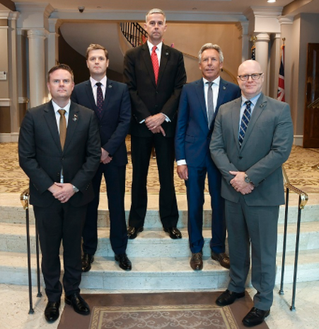

INTERNATIONAL COOPERATION| TAX FOCUSSED FORUMS
As FTA Vice Chair with sponsorship of the JITSIC, I am committed to ensuring the expanded network continues to build on the significant achievements of the past year.
The new network is a growing assembly of FTA members with a global mind-set for tackling tax evasion and aggressive tax avoidance. It is an avenue for sharing, learning and taking co-ordinated cross-border compliance action.
The best outcomes for our countries and the international tax system will be achieved by working together.
OECD ACADEMY | VAT/GST FRAUD INVESTIGATIONS PROGRAMME

Slide 29
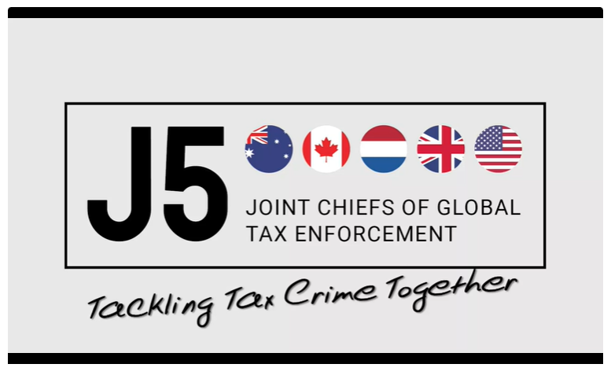
INTERNATIONAL COOPERATION| J5: THE VIDEO
Joint Chiefs of Global Tax Enforcement | Australian Taxation Office (ato.gov.au)
OECD ACADEMY | VAT/GST FRAUD INVESTIGATIONS PROGRAMME

Slide 30
GROUP ACTIVITY| TYPES OF INFORMATION
Let’s play a game…
1. In your groups, list as many types of information that you could either share with or request from other organisations/agencies/jurisdictions for your investigation.
3. For each unique type of information your group will score a point and the group with the most points wins…
2. Nominate someone to share your list with the other groups and keep score.
OECD ACADEMY | VAT/GST FRAUD INVESTIGATIONS PROGRAMME

Slide 31
OECD PRINCIPLES| ASSET RECOVERY
Tax crime investigation agencies should have the ability to freeze and seize assets.
This is during the course of a tax investigation prior to charges being laid.
They should also include the power to confiscate assets.
OECD ‘Fighting Tax Crime – The Ten Global Principles’
Principle 1: Ensure tax offences are criminalised
Principle 2: Devise an effective strategy for addressing tax crimes
Principle 3: Have adequate investigate powers
Principle 4: Have effective powers to freeze, seize and confiscate assets
Principle 5: Put in place an organisational structure with defined responsibilities
Principle 6: Provide adequate responses for tax crime investigation
Principle 7: Make tax crimes a predicate offence for money laundering
Principle 8: Have an effective framework for domestic inter-agency co-operation
Principle 9: Ensure international co-operation mechanisms are available
Principle 10: Protect suspects rights
OECD ACADEMY | VAT/GST FRAUD INVESTIGATIONS PROGRAMME

Slide 32



ASSET RECOVERY| OVERVIEW
Freezing temporarily suspends rights over the asset.
Seizure temporarily restrains an asset or puts it into the custody of the government.
Confiscation of assets is the permanent removal of assets by order of a court or other competent authority.
MAP-TNC | INTERMEDIATE TAX CRIME COURSE

Slide 33
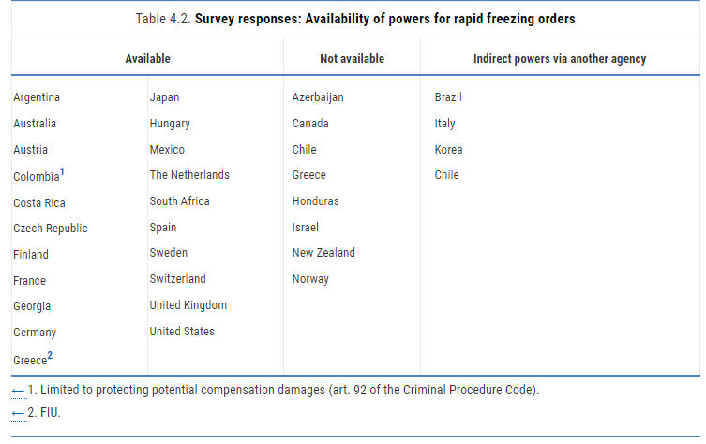
ASSET RECOVERY| RAPID FREEZING OF ASSETS
Principle 4. Have effective powers to freeze, seize and confiscate assets | Fighting Tax Crime – The Ten Global Principles, Second Edition | OECD iLibrary (oecd-ilibrary.org)
OECD ACADEMY | VAT/GST FRAUD INVESTIGATIONS PROGRAMME

Slide 34
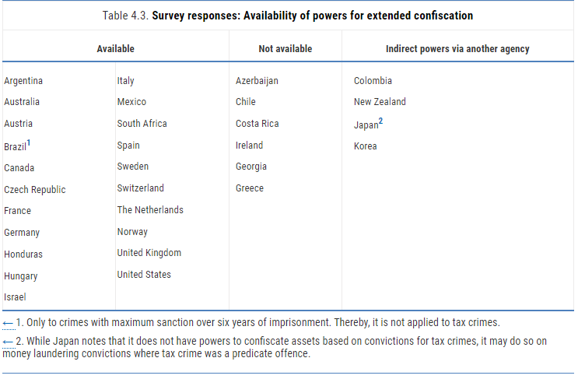
ASSET RECOVERY| EXTENDED CONFISCATION
Principle 4. Have effective powers to freeze, seize and confiscate assets | Fighting Tax Crime – The Ten Global Principles, Second Edition | OECD iLibrary (oecd-ilibrary.org)
OECD ACADEMY | VAT/GST FRAUD INVESTIGATIONS PROGRAMME

Slide 35
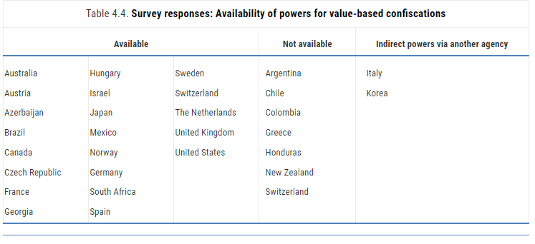
ASSET RECOVERY| VALUE BASED CONFISCATION
Principle 4. Have effective powers to freeze, seize and confiscate assets | Fighting Tax Crime – The Ten Global Principles, Second Edition | OECD iLibrary (oecd-ilibrary.org)
OECD ACADEMY | VAT/GST FRAUD INVESTIGATIONS PROGRAMME

Slide 36
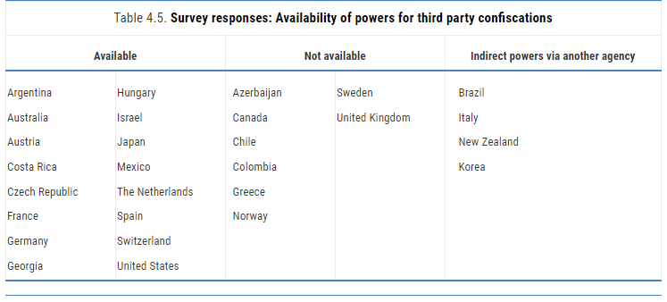
ASSET RECOVERY| THIRD PARTY CONFISCATION
Principle 4. Have effective powers to freeze, seize and confiscate assets | Fighting Tax Crime – The Ten Global Principles, Second Edition | OECD iLibrary (oecd-ilibrary.org)
OECD ACADEMY | VAT/GST FRAUD INVESTIGATIONS PROGRAMME

Slide 37
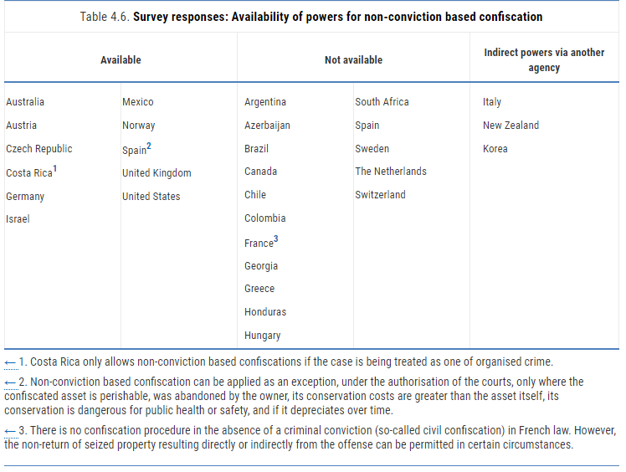
ASSET RECOVERY| NON-CONVICTION CONFISCATION
Principle 4. Have effective powers to freeze, seize and confiscate assets | Fighting Tax Crime – The Ten Global Principles, Second Edition | OECD iLibrary (oecd-ilibrary.org)
OECD ACADEMY | VAT/GST FRAUD INVESTIGATIONS PROGRAMME

Slide 38
ASSET RECOVERY| OECD RECOMMENDATIONS
The OECD notes that in order to effectively recover criminal assets, jurisdictions should consider the following:
Having the necessary governance framework to ensure enforcement agencies operate transparently, and are adequately supervised in connection with the handling of assets to ensure integrity
Having the necessary investigative, legal and operational expertise
Putting in place a clear organisational structure to manage asset cases.
Ensuring that the rights of suspects are protected during an asset recovery process
Having the process to safely manage the assets
Effective use of international co-operation, given that asset recovery cases can be complex and involve criminal assets located in foreign jurisdictions.
Principle 4. Have effective powers to freeze, seize and confiscate assets | Fighting Tax Crime – The Ten Global Principles, Second Edition | OECD iLibrary (oecd-ilibrary.org)
OECD ACADEMY | VAT/GST FRAUD INVESTIGATIONS PROGRAMME

Slide 39




ASSET RECOVERY| ATO APPROACH
Prevent
Detect
Respond
Asset Recovery
OECD ACADEMY | VAT/GST FRAUD INVESTIGATIONS PROGRAMME

Slide 40


ASSET RECOVERY| METHODS OF RECOVERY
Civil recovery
Information gathering: The person has the right not to incriminate themselves
Civil law involve disputes between people or corporations involving money, compensation or damages
Conviction-based recovery
Standard of proof: ‘Balance of Probabilities’
Criminal law involves the government representing the community to prosecute people or corporations.
Information gathering: The person can be compelled to provide information
Standard of proof: ‘Beyond reasonable doubt’
Purpose: Deals with a taxation debt that has been raised
Purpose: Specifically considers criminal offences
OECD ACADEMY | VAT/GST FRAUD INVESTIGATIONS PROGRAMME

Slide 41


ASSET RECOVERY| RECOVERY OPTIONS (CIVIL)
Payment Plan
Garnishee notice
Freezing order
Warrant of seizure
Mutual Assistance
Director Penalties
Departure Prohibition order
OECD ACADEMY | VAT/GST FRAUD INVESTIGATIONS PROGRAMME

Slide 42

ASSET RECOVERY| CACT
The Criminal Assets Confiscation Taskforce (CACT) brings together resources from several federal government agencies (Australian Federal Police, Australian Taxation Office, Australian Criminal Intelligence Commission, AUSTRAC and Australian Border Force)
Together, these agencies trace, restrain and ultimately confiscate criminal assets.
$5 million in assets, including 47 vehicles, restrained by AFP led Criminal Assets Confiscation Taskforce | Australian Federal Police
OECD ACADEMY | VAT/GST FRAUD INVESTIGATIONS PROGRAMME

Slide 43







ASSET RECOVERY| CACT – TYPES OF ASSETS
The following assets can be confiscated by the CACT:
Cash
Bank accounts
Property
Share portfolios
Cars & motorcycles
Artwork & jewellery
Aircraft and boats
OECD ACADEMY | VAT/GST FRAUD INVESTIGATIONS PROGRAMME

Slide 44


ASSET RECOVERY| FEDERAL LEGISLATION
The Proceeds of Crime Act 2002 (POCA 2002) came into force on 1 January 2003 and is the principle federal legislation for asset confiscation.
However, each of the States have similar enacted legislation that addresses the recovery of proceeds of crime.
Interim measures
Recovery orders
OECD ACADEMY | VAT/GST FRAUD INVESTIGATIONS PROGRAMME

Slide 45


ASSET RECOVERY| LEGISLATION – INTERIM MEASURES
Three main types of interim measures are available under POCA (all of which can be applied on an ex parte basis from a court)
Freezing temporarily suspends rights over the asset.
Seizure temporarily restrains an asset or puts it into the custody of the government.
Restraining orders prevents the disposal of or dealing with property pending the outcomes of confiscation proceedings.
OECD ACADEMY | VAT/GST FRAUD INVESTIGATIONS PROGRAMME

Slide 46
ASSET RECOVERY| LEGISLATION – RECOVERY ORDERS
Forfeiture orders can either be conviction based or non-conviction based:
Civil recovery
Person-directed: Forfeiture of property where the court is satisfied that a person is engaged in conduct constituting one or more serious offences.
Conviction-based recovery
Forfeiture upon application of the Australian Federal Police (AFP) or Commonwealth Director of Public Prosecutions (CDPP). The application must be made within six months of the offence of an ‘indictable offence’.
Asset-directed: Forfeiture of property where the court is satisfied that the property is the proceeds or instrument of certain offences or no claim has been made in respect to the property.
Automatic forfeiture, six months after conviction of a ‘serious offence’ of all property subject to a restraining order relating to the offence.
In both cases, the property must be subject to a restraining order for at least six months prior.
OECD ACADEMY | VAT/GST FRAUD INVESTIGATIONS PROGRAMME

Slide 47




ASSET RECOVERY| CONFISCATION IN PRACTICE
Confiscating the proceeds of crime is a complex process that usually involves:
1
Substantiation of unlawful conduct and property identification (Investigation)
2
Restraint of property
3
Confiscation of property
4
Disposal of confiscated property
OECD ACADEMY | VAT/GST FRAUD INVESTIGATIONS PROGRAMME

Slide 48

ASSET RECOVERY| UNEXPLAINED WEALTH
If the court is not satisfied that part of the person’s wealth was not derived from such offences, the court may make an unexplained wealth order requiring them to pay that part of his or her wealth to the Commonwealth.
Where there are reasonable grounds to suspect that a person’s wealth exceeds the value of his or her lawfully acquired wealth, the court may make an order requiring person to attend court and prove, on the balance of probabilities, that his or her wealth was not derived from a relevant offence.
OECD ACADEMY | VAT/GST FRAUD INVESTIGATIONS PROGRAMME

Slide 49
ASSET RECOVERY| CROSS BORDER ISSUES
Civil recovery
Australian superior courts have the power to make an order for the issue of a letter of request to the judicial authorities of a foreign country requesting the taking of evidence from a person in that country.
Conviction-based recovery
Mutual Assistance to and from Australia is governed by the Mutual Assistance in Criminal Matters Act 1987 (Mutual Legal Assistance Treaties (MLATs))
Available methods of enforcement can include writ of execution to seize and seell assets, garnishee order, charging order and insolvency orders.
Australia can request assistance from foreign countries for the issue of order similar in nature to those under POCA in aid of criminal proceedings or criminal investigation regarding a serious offence.
OECD ACADEMY | VAT/GST FRAUD INVESTIGATIONS PROGRAMME

Slide 50

ASSET RECOVERY| CASE STUDY 1
A man has been sentenced to one year and ten months imprisonment for defrauding the Australian Tax Office (ATO) of more than $3 million in GST refunds.
The man, 39, pleaded guilty in October 2022 to two counts of dealing in the proceeds of crime and the sentence imposed in March 2023 by the Parramatta District Court.
A joint AFP and ATO Serious Financial Crime Taskforce (SFCT) investigation began in 2021 into fraudulent Business Activity Statement (BAS) refunds lodged under multiple companies identified by the ATO.
Further enquiries revealed the bank account details associated with those companies had been changed to ones controlled by the man.
Sydney man sentenced for defrauding the ATO of more than $3 million | Australian Federal Police (afp.gov.au)
The matter was also investigated by the AFP-led Criminal Assets Confiscation Taskforce (CACT), who sought and obtained restraining orders under the Proceeds of Crime Act 2002 (Cth) over multiple bank accounts and a luxury vehicle. The assets, worth a combined value of about $2.73 million, were suspected to be the proceeds of the fraudulent activity.
OECD ACADEMY | VAT/GST FRAUD INVESTIGATIONS PROGRAMME

Slide 51

ASSET RECOVERY| CASE STUDY 2
A 38-year-old fraud syndicate member who conspired to defraud the Commonwealth of more than $5 million through Goods and Services Tax (GST) refunds, has been sentenced to 5 years imprisonment with a non-parole period of 3 years.
The offenders conspired to defraud the Commonwealth through an intricate money laundering and fraudulent tax claim scheme involving hundreds of stolen identities, shell companies, bank accounts and false returns.
The scheme was uncovered by a taxpayer when they conducted an internet search and discovered their personal details located in a spreadsheet titled ‘wolf2012’. The taxpayer reported what they had found to both the police and the ATO.
The man pleaded guilty to conspiracy with the intention of dishonestly obtaining a gain from the Commonwealth. He was sentenced to five years imprisonment, with a non-parole period of three years, bringing the eight-year long joint investigation to a close.
GST fraudster sentenced over multi-million dollar scheme | Australian Taxation Office (ato.gov.au)
Police executed search warrants at a number of Melbourne properties and safety deposit boxes, seizing more than $1.5 million in cash.
OECD ACADEMY | VAT/GST FRAUD INVESTIGATIONS PROGRAMME

Slide 52

GROUP ACTIVITY| ASSET RECOVERY
Working within your groups, consider the following:
1. Thinking about the VAT carousel you designed, what is the best asset confiscation strategy?
3. Would you pursue conviction based or non-conviction based confiscation?
2. Which assets would you target and why?
OECD ACADEMY | VAT/GST FRAUD INVESTIGATIONS PROGRAMME

Slide 53
OECD ACADEMY | VAT/GST FRAUD INVESTIGATIONS PROGRAMME

