Slide 1

Detection and Analysis
of Professional Enablers

Slide 2
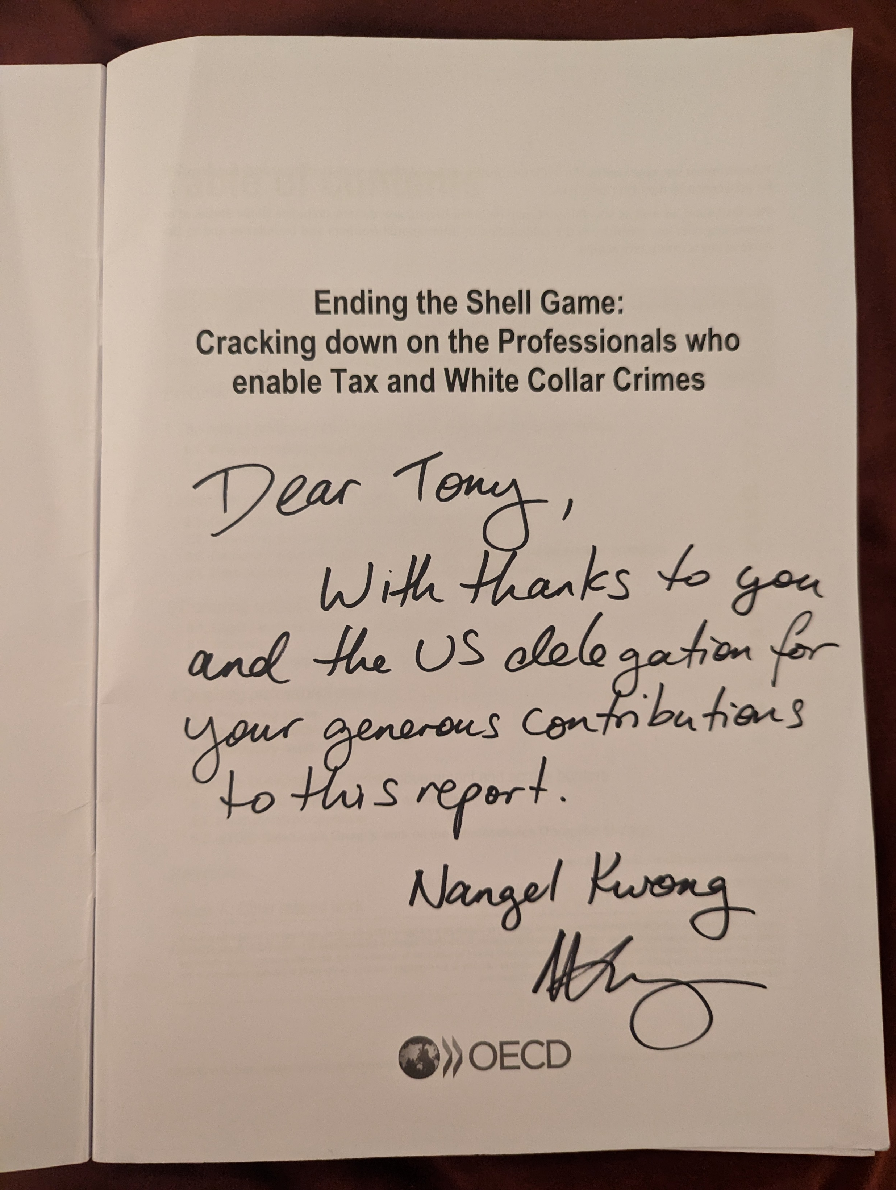

Slide 3
Ending the Shell Game Report
Use of Data Analytics and Intelligence
Intelligence is often held in different databases across organizations and countries
Risk analysis to identify trends and patterns of repeat offenders
Dedicated units to target enablers (to target individuals who create shell companies and offshore structures)
  In response to trends
    Cyber Crimes Unit, National Coordinated Investigation Unit, Global Illicit Financial Team, International Tax Team, Operation ID Theft, Task Forces from Suspicious Activity Reports, Casino General Investigations, Cash Only Projects, Form 1099-K
We previously talked about Heat Maps and Threat Assessments (programmatic or geographic)

Slide 4
Heat Map
If building a Threat Assessment Toolkit, what factors are important:
    Response to MLAT’s or Tax Treaties
    Public Corruption Index
    Extradition Agreement
    Will they share intelligence informally (without MLAT and not for trial)
    FATF Mutual Evaluation
    Public Registries
    Strong FIU and compliance departments within legal framework

Slide 5
Remember…the Report only focuses on illicit activity
Ugland House is a building located in George Town, Cayman Islands. Located at 121 South Church Street, the building is occupied by the law firm Maples and Calder and is the registered office address for 40,000 entities, including many major investment funds, international joint ventures and capital market issuers.
No corporation taxation (depends on citizenship)
Privacy
Good weather / nice beach / generally safe
Business-friendly (may not need to contribute minimum capital)
Easy to set up (may not need to have annual audits of financial statements – also a risk)
Directors not liable for debts or losses against the business
May Become Subject of UCO

Slide 6
You asked me what? In front of 500 people.
What do you think of the term TAX HAVEN?
I was presenting once in Europe and was asked this question:
“USA does not respond or comply with MLAT requests, do you agree that the USA is a tax haven?”
How would you have responded (as a person on diplomatic assignment)?

Slide 7
Some Items to Look Out For
  Legal persons unknowingly may be involved with some type of criminal financial activity (bank teller)
  Funds flow from individual accounts, to corporate accounts, to trust accounts overseas where the identify of the true beneficiary is concealed
  Shell companies are being utilized to facilitate bribery (criminals aware the additional layers of insulation in multiple jurisdictions make it increasingly difficult for law enforcement to identify the true ownership)
    Trade Based Money Laundering is becoming increasingly more complex and adding structures will only make “Following the Money’ more difficult
  Anonymous trading of securities in offshore brokerage houses to escape capital gains taxes (referred to as market fraud). Since Covid-19, significant increase in day trading (which lead to Boiler Room schemes).
    Why wouldn’t someone just use a brokerage house in their jurisdiction? That question was posed to subjects of the investigation.

Slide 8
Why are Corporations so Appealing
    Corporations are generally easy to set up – can be done online – doesn’t have to be expensive
    Limit individual liability
    Corporations can have charitable affiliations used to transfer funds overseas
      Professional Enablers that create illicit entities for individuals, and combine proceeds with illicit activities, to me, makes it much harder to trace
    Illicit Funds have the appearance of legal income or dividends
    Shell companies can be used for bribery
      Such a threat, especially if these officials oversee police, border, ports, etc.
    Many jurisdictions do not have a national database of corporations

Slide 9
Added Bonuses (to Evading Taxes or Laundering Money)
    Shareholders do not have to be reported
    No capital gains tax
    The corporations can be both legitimate or illegitimate
      Many individuals portray an upstanding presence in the community (build parks, hospitals, roads, schools, etc.)
    Shield assets from creditors, spouses, children, business partners
    File bankruptcy without discovering assets owned
      Prevalent in bankruptcy fraud cases (which can be good referrals for tax cases)
      Make contacts with lawyers and officials in bankruptcy court

Slide 10
OECD Pillar I and II
  For discussion
  Pillar I
    Expand a country's authority to tax profits from companies that make sales into their country but don't have a physical location there.
  Pillar 2
    Sets out global minimum tax rules designed to ensure that large multinational businesses pay a minimum effective rate of tax of 15% on profits in all countries.
  How does this impact legitimate companies shopping for jurisdictions to lower corporate tax rates?

Slide 11
Detection in Motion
    Multi-jurisdictional entities and trusts with no specific purpose
    Foreign partners without a clear connection to the business
    Loans between unaffiliated individuals
    Use of offshore bank accounts with no economic necessity
    Does the business have legitimate reasons to incorporate in this jurisdiction
    Use of nominees and shell companies for bank accounts, shareholders, directors
      Imagine the level of trust to give someone else signatory authority over your account
    Investment by Citizenship – not illegal but a possible threat / red flag
      Will address this Friday during Whole-of-Government approach

