Slide 1
Before we begin!
NETWORK, NETWORK, NETWORK.
This is your opportunity to network with fellow participants and instructors to exchange ideas and possibly seek assistance with current ongoing investigations.
WE ARE APPLYING CHATAM HOUSE RULES
“When a meeting, or part thereof, is held under the Chatham House Rule, participants are free to use the information received, but neither the identity nor the affiliation of the speaker(s), nor that of any other participants, may be revealed. The purpose of the rule is to encourage open discussion since anything said is "off the record".

Slide 2
Combatting Professional Enablers of tax and other financial crimes
Asia-Pacific Academy in Tokyo, Japan (Specialty programme) 2023
OECD Tax Crime Academy course leader
BRENDON NORMAN-ROSS

Slide 3
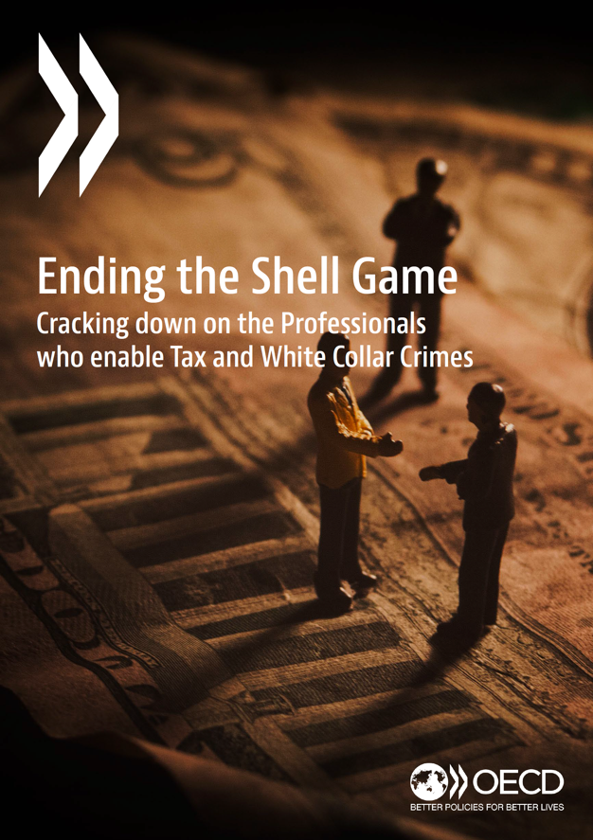
PROFESSIONAL enablers
Essential reading – 46 pages of valuable information
and guidance.
https://youtu.be/AfYA64tIMFU

Slide 4
The role of professional enablers in tax
and other financial crimes
Key Two Point to Consider
Law-abiding professionals performing their duties in accordance with the law are an important part of the legal and financial system, and help ensure compliance with the law.
Professional enablers are a distinct segment of professionals that intentionally and actively devise strategies to facilitate the commission of crimes (whether serving both legitimate clients and those engaging in tax crimes or other financial crimes).
In this academy programme we will be focusing on point two.

Slide 5
The role of professional enablers in tax
and other financial crimes
Who are Professional Enablers?

Slide 6
The role of professional enablers in tax
and other financial crimes
Who are Professional Enablers? - Typically an individual or entity with professional expertise to perform a specific service to aid clients in carrying out a tax offence or other financial crime.

Slide 7
The role of professional enablers in tax
and other financial crimes
Who are Professional Enablers? - Typically an individual or entity with professional expertise to perform a specific service to aid clients in carrying out a tax offence or other financial crime.
Common attributes of professional enablers:
Professional qualifications or training.
Expertise in taxation, legal or financial processes.
Experience in setting up tax structures, or structures with cross-border elements.
Experience setting up opaque structures for avoiding investigative scrutiny.

Slide 8
the professional enabler – a simple example
Saul, the lawyer:
https://www.youtube.com/watch?v=RhsUHDJ0BFM

Slide 9
professional enablers – complicit, negligent or unwitting?
Virtually all high-end money laundering schemes, and several cash-based ones, are facilitated by the abuse of legitimate processes and services.
Accounting and legal professionals, and estate agents, can be criminally exploited:
– this is sometimes complicit, negligent, or unwitting –
This small minority of people can pose a very significant threat. They can act as intermediaries and use their skills, knowledge and abilities to draft documentation, disseminate funds, and allow highly complex structures to be created that move and store large amounts of criminal money and conceal ownership effectively.
National Crime Agency

Slide 10
The role of professional enablers in tax
and other financial crimes
So what is a typical enabler for financial crime?

Slide 11
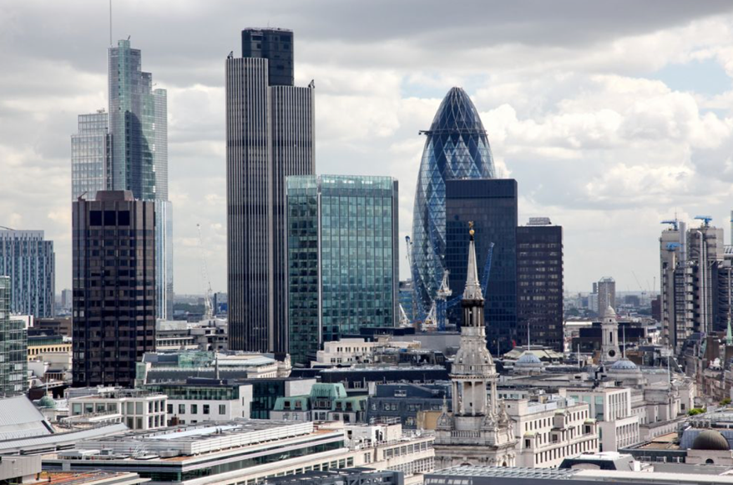
The role of professional enablers in tax
and other financial crimes
So what is a typical enabler for financial crime?
Company

Slide 12
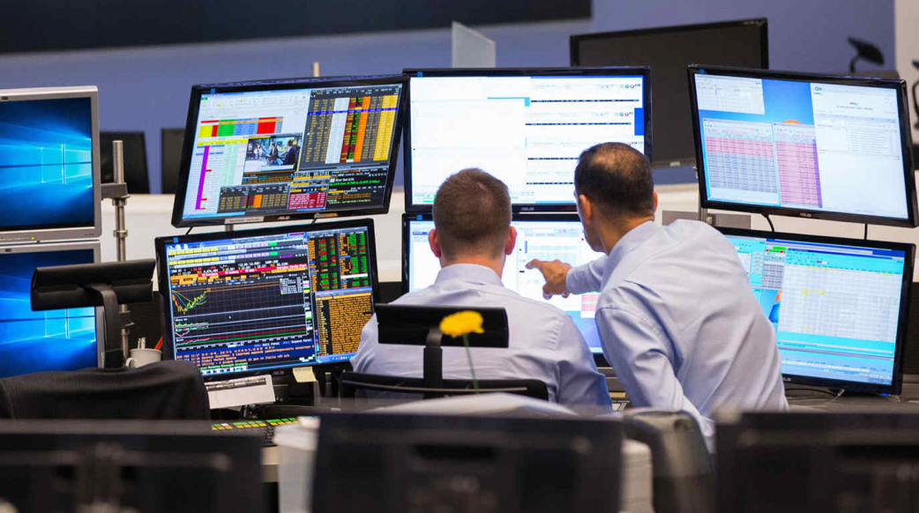
The role of professional enablers in tax
and other financial crimes
So what is a typical enabler for financial crime?
Company
Individual

Slide 13
Criminal Penalties available & DPA’s
UK Deferred Prosecution Agreement (DPA) is an agreement reached between a prosecutor and an organisation which could be prosecuted, under the supervision of a judge.
The agreement allows a prosecution to be suspended for economic crimes for a defined period provided the organisation meets certain specified conditions.
They apply to organisations, never individuals.
They enable a corporate body to make full reparation for criminal behaviour without the collateral damage of a conviction (for example sanctions or reputational damage that could put the company out of business and destroy the jobs and investments of innocent people).

Slide 14
Issues prosecutions are long and difficult
UK SFO Deferred Prosecution Agreements (organisations not individuals – small number)
Standard Bank 2015
Sarclad Ltd 2016
Rolls Royce 2017
Tesco 2017
Serco Ltd 2019
Guralp Systems Ltd 2019
Airbus 2020 (£12m – US $400m)
G4S & Justice Services 2020
Airline Services Ltd 2020
Amec Foster Wheeler Energy Limited 2021
Two Companies for Bribery Act offences 2021. Reporting restrictions apply under the Contempt of Court Act 1981
https://www.sfo.gov.uk/publications/guidance-policy-and-protocols/guidance-for-corporates/deferred-prosecution-agreements/

Slide 15
Issues with Penalties notwithstanding large fines
US Deferred Prosecution Agreements (hundreds)
Ericsson to plead guilty and pay over $206M following breach of 2019 FCPA
Deferred Prosecution Agreement with HSBC Private Bank (Suisse) - $1.92Billion
FirstEnergy charged federally, agrees to terms of deferred prosecution - $230M
Shareholders typically foot the bill for the fines. Executives that have enabled and/or engaged in the criminal misconduct that has made them rich are not held accountable.
The New Yorker points out that “federal prosecutions of white-collar crime are now at a twenty-year low.”
Note - Public Interest – Suicide and Bankruptcy (Enron)

Slide 16
What about criminal sanctions?
Deferred Prosecution Agreements – HSBC:
https://www.youtube.com/watch?v=4C05S0pVKQE

Slide 17
proceeds of crime: how much is out there?
How Much Is In Circulation - Any ideas?

Slide 18
The issue – PROCEEDS OF CRIME IN CIRCULATION
USD$2trillion

Slide 19
The issue – PROCEEDS OF CRIME IN CIRCULATION
USD$2trillion
Increasing year on year.

Slide 20
The issue – PROCEEDS OF CRIME IN CIRCULATION
USD$2trillion
If a country, it would represent
worlds 5th largest economy re GDP

Slide 21
The ISSUE regarding facilitation
The estimated amount of money laundered globally in one year is
2-5% of global GDP, or $800bn/2tn (inclusive of VAT/GST).
United Nations Office on Drugs and Crime
Consider the variant between 2 - 5% then you understand the challenge in just determining even a ‘rough’ estimate of global proceeds of crime.
With respect to VAT, EU Member States lost an estimated €134 billion in VAT revenues in 2019 and €93 billion in 2020 (decrease explained by an increase in VAT compliance due in large part to the effect of government support measures introduced in response to the COVID-19 pandemic.)
European Commission

Slide 22
The Basel institute on governance
Four things holding back the global fight against money laundering:

Slide 23
The Basel institute on governance
Four things holding back the global fight against money laundering:
1. A strong response to threats from virtual assets - The use of virtual assets such as cryptocurrencies is exploding.

Slide 24
The Basel institute on governance
Four things holding back the global fight against money laundering:
1. A strong response to threats from virtual assets - The use of virtual assets such as cryptocurrencies is exploding
2. Effective prevention, not just enforcement (much cheaper than cure).

Slide 25
The Basel institute on governance
Four things holding back the global fight against money laundering:
1. A strong response to threats from virtual assets - The use of virtual assets such as cryptocurrencies is exploding
2. Effective prevention, not just enforcement (much cheaper than cure)
3. Beneficial ownership transparency - Ineffective implementation of beneficial ownership transparency measures provide safe havens for dirty money - In 2022, UK set up the Register of Overseas Entities (ROE), which was also the first of its kind in the world.

Slide 26
The Basel institute on governance
Four things holding back the global fight against money laundering:
1. A strong response to threats from virtual assets - The use of virtual assets such as cryptocurrencies is exploding
2. Effective prevention, not just enforcement (much cheaper than cure)
3. Beneficial ownership transparency - ineffective implementation of beneficial ownership transparency measures provide safe havens for dirty money - In 2022, UK set up the Register of Overseas Entities (ROE), which was also the first of its kind in the world.
4. Addressing ML/TF vulnerabilities beyond the financial sector - weak application of AML/CFT preventive measures by lawyers, accountants, real estate agents and other designated non-financial businesses and professions (DNFBPs).

Slide 27
The Basel institute on governance
Four things holding back the global fight against money laundering:
1. A strong response to threats from virtual assets - The use of virtual assets such as cryptocurrencies is exploding
2. Effective prevention, not just enforcement (much cheaper than cure)
3. Beneficial ownership transparency - ineffective implementation of beneficial ownership transparency measures provide safe havens for dirty money - In 2022, UK set up the Register of Overseas Entities (ROE), which was also the first of its kind in the world.
4. Addressing ML/TF vulnerabilities beyond the financial sector - weak application of AML/CFT preventive measures by lawyers, accountants, real estate agents and other designated non-financial businesses and professions (DNFBPs).

Slide 28
Professional facilitators & shell companies - UK
Example of UK Initiatives:
Corporate Directors – UK Proposal - ‘Businesses will only be able to operate as corporate directors on the boards of other companies in the UK if all of their directors are real people whose identity has been verified by Companies House. Evidence suggests that the use of corporate directors can muddy the waters around ownership and provide a screen behind which to conduct illicit activity,"
Beneficial Ownership Register - The UK beneficial ownership registry has more than 5.1 million names of people with significant control over UK registered companies. The Beneficial Ownership of Legal Persons (Guernsey) Law, 2017, effective; 15 August 2017.
More than 25% of shares in the company
More than 25% of voting rights in the company
The right to appoint or remove the majority of the board of directors

Slide 29
Professional facilitators & shell companies - UK
United Kingdom – The UK has three registers, the People with Significant Control register, the Trusts Register and the Overseas Entities register. In terms of the latter, overseas entities had to register with Companies House and tell them who their registrable UBO or managing officers were by January 31, 2023. Changes are also being made to the UK registers via the Economic Crime and Corporate Transparency Bill which is currently making its way through Parliament.
Countries currently applying deterrents:
United States, Canada, Europe (CJEU), Netherlands, France, Germany Luxembourg, Italy, United Arab Emirates, Australia, Hong Kong, Singapore, Shanghai, South Africa, Turkey.
FATF - Recommendation 25

Slide 30

Beneficial ownership registers - coverage
Should beneficial ownership registers become more common they would provide an important tool for cross-checking underlying customer data and proactively identify relevant sanctions exposure by looking beyond immediate corporate ownership.

Slide 31
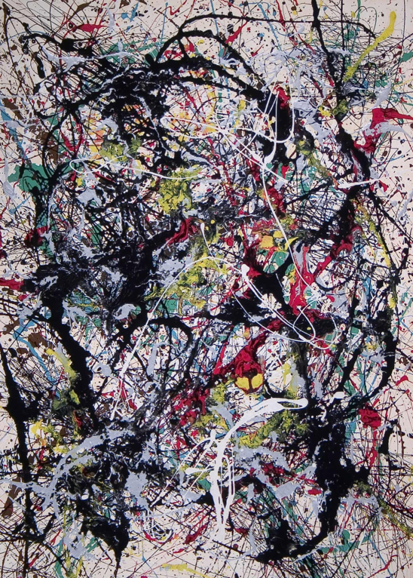
Professional facilitators & fine art market
Of the approximate USD 67.4 billion global art market, UNODC estimates USD 6.3 billion are linked to transnational crime. That’s circa 10% of trading in Art. (Sotheby's, Christies, Bonhams, etc.)
Veil of secrecy on transactions in the art market with
no stable or predictable pricing.
Buyers and sellers seek privacy, relying on intermediaries and shell companies.
Art easily transported - extremely difficult to trace.
Note: 5th Anti-Money Laundering Directive FATF 2021
Notes:
TRADE-BASED MONEY LAUNDERING
Trade-based money laundering (TBML) is one of the most frequently used methods of money laundering. It is also one of the most difficult methods to detect. TBML is hidden among the trillions of dollars of international trade each year. It often involves criminals falsifying trade documents to disguise illicit proceeds as seemingly legitimate revenue. In December 2020, the FATF and Egmont Group of Financial Intelligence Units finalised a report that aims to help public and private sector with the challenges of detecting TBML.

Slide 32

the fine art market – how it can lead to material fraud
1MDB – LDC birthday ‘gift.’
Leonardo DiCaprio Surrenders $3.2 Million Picasso and
$9 Million Basquiat to US Government:
‘Last July, upon hearing of the government’s civil action against certain parties involved in the making of The Wolf of Wall Street, Mr. DiCaprio’s representatives—working under his instruction—initiated contact with the Department of Justice. This effort was to determine if there were any gifts or charitable donations originating from the parties named in the civil complaint, and to offer the return of any such gifts or donations with the aid and instruction of the government.’
Purchased from the Helly Nahmad gallery in New York in March 2013 with funds controlled by an entity known as Tanore. No evidence of the UBO.
Notes:
TRADE-BASED MONEY LAUNDERING
Trade-based money laundering (TBML) is one of the most frequently used methods of money laundering. It is also one of the most difficult methods to detect. TBML is hidden among the trillions of dollars of international trade each year. It often involves criminals falsifying trade documents to disguise illicit proceeds as seemingly legitimate revenue. In December 2020, the FATF and Egmont Group of Financial Intelligence Units finalised a report that aims to help public and private sector with the challenges of detecting TBML.

Slide 33
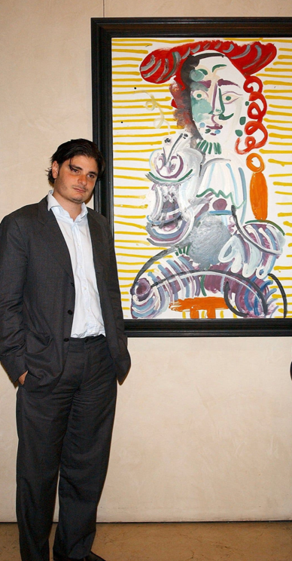
Helly Nahmad gallery - fine art market
F.B.I. raided the family’s Helly Nahmad New York Gallery.
Nahmad, is accused along of playing leadership roles in a $100 million gambling and money-laundering network with connections to Russian organized-crime figures.
Nahmad charged in a racketeering indictment. In one conversation he speaks of using the family’s art business as a cover to move around illicit money.
“Sometimes a bank needs a justification for a wire, right?” “We can just say, Oh, you are buying a painting. Oh yeah, I bought a Picasso drawing or something.”
Nahmad laundered tens of millions of dollars through shell companies in Cyprus; legitimate hedge funds and real estate in the United States.
Notes:
TRADE-BASED MONEY LAUNDERING
Trade-based money laundering (TBML) is one of the most frequently used methods of money laundering. It is also one of the most difficult methods to detect. TBML is hidden among the trillions of dollars of international trade each year. It often involves criminals falsifying trade documents to disguise illicit proceeds as seemingly legitimate revenue. In December 2020, the FATF and Egmont Group of Financial Intelligence Units finalised a report that aims to help public and private sector with the challenges of detecting TBML.

Slide 34
‘LondonGRAD’ & professional enablers
    Over the past two decades, London became one of the preferred investment locations — if not the favoured destination — for Russian oligarchs, as well a key financial centre for Russian and eastern European companies.
    Critics have dubbed it the “London laundromat,” an apparatus that allowed billions of pounds — to be siphoned out of example the Russian and Azerbaijan economy and into assets in the UK.
    Transparency International has identified £1.5bn worth of UK property — nearly 150 land titles — bought by Russians accused of corruption.
Notes:
TRADE-BASED MONEY LAUNDERING
Trade-based money laundering (TBML) is one of the most frequently used methods of money laundering. It is also one of the most difficult methods to detect. TBML is hidden among the trillions of dollars of international trade each year. It often involves criminals falsifying trade documents to disguise illicit proceeds as seemingly legitimate revenue. In December 2020, the FATF and Egmont Group of Financial Intelligence Units finalised a report that aims to help public and private sector with the challenges of detecting TBML.

Slide 35
Professional enablers and sar’s (STR’s)
    An aggravating factor, notwithstanding their explicit regulatory obligations, is the failure by facilitators to submit Suspicious Activity Reports (SARs), as identified by Donald Toon, Director of Economic and Cybercrime at the NCA London:
‘Lawyers are failing in their duty to combat suspected money laundering and have ignored repeated warnings to increase their reporting of suspicious activity by clients. There are cases where banks had reported dubious property deals for which there had been no corresponding alert from solicitors involved in the same transaction.’
Notes:
TRADE-BASED MONEY LAUNDERING
Trade-based money laundering (TBML) is one of the most frequently used methods of money laundering. It is also one of the most difficult methods to detect. TBML is hidden among the trillions of dollars of international trade each year. It often involves criminals falsifying trade documents to disguise illicit proceeds as seemingly legitimate revenue. In December 2020, the FATF and Egmont Group of Financial Intelligence Units finalised a report that aims to help public and private sector with the challenges of detecting TBML.

Slide 36
Professional enablers - sar’s & Intelligence
    The scale of the problem UK National Crime Agency investigators are required to tackle is vast. The government estimates £100bn of cash is laundered in Britain every year.
    The increase is being fuelled by banks, which flagged 901,255 transactions in the year to March 2022.
    Concerningly law firms, including those specialising in property conveyancing, filed just 2,859 SAR alerts (circa 0.32% % - statistically no movement).
    Consider the fact that these are the lawyers that are part of the conveyancing of property and acting as intermediaries in establishing financial structures – the same assets / structures that banks are externalising SAR’s on.
    https://www.eversheds-sutherland.com/global/en/what/articles/index.page?ArticleID=en/Fraud_and_financial_crime/SARs_Annual_Report_2022
Notes:
WHAT DOES THIS ANOMALY TELL US ABOUT LAW FIRMS?

Slide 37
Offshore structures
Corporate entities or arrangements are interposed in different jurisdictions, (shell companies) with complex ownership and control structures.
Professional enablers facilitate the creation of instruments used to obscure beneficial ownership; bearer shares / nominee directors / shareholders. They enable the creation of such instruments, thus concealing the identity of those involved in tax or other financial crimes.
An example of this can be where “dummy” directors, trustees, shareholders etc., are provided by the professional enabler to disguise their client’s beneficial ownership.
Notes:
TRADE-BASED MONEY LAUNDERING
Trade-based money laundering (TBML) is one of the most frequently used methods of money laundering. It is also one of the most difficult methods to detect. TBML is hidden among the trillions of dollars of international trade each year. It often involves criminals falsifying trade documents to disguise illicit proceeds as seemingly legitimate revenue. In December 2020, the FATF and Egmont Group of Financial Intelligence Units finalised a report that aims to help public and private sector with the challenges of detecting TBML.

Slide 38
Tax havens - (IMF)
Tax havens collectively cost governments between $500 billion and $600 billion a year in lost corporate tax revenue, depending on the estimate through legal and
not-so-legal means. Of that lost revenue, low-income economies account for some $200 billion—a larger hit as a percentage of GDP than advanced economies and more than the $150 billion or so they receive each year in foreign development assistance.
American Fortune 500 companies alone held an estimated $2.6 trillion offshore in 2017, though a small portion of that has been repatriated following US tax reforms in 2018.
(Crivelli, de Mooij, and Keen; Cobham and Janský)

Slide 39
Tax havens - (IMF)
Data suggests that individuals have deposited $8.7 trillion in tax havens. Economist James S. Henry’s more comprehensive estimates a yield of circa $36 trillion.
Both, assuming very different rates of return, put global individual income tax losses at around $200 billion a year, which must be added to the corporate total.
‘To grasp why rich jurisdictions top the lists, ponder how many rich Nigerians might stash secret assets in Geneva or London—then consider how many rich Swiss or Britons would hide assets in Lagos. Offshore capital tends to drain from poor countries to rich ones.’ (IMF)
Hold this thought; ‘is the MLAT in its present form expedient enough given the effectiveness of instant electronic distribution of assets / cash?’
Notes:
Bring up the MLAT process regarding speed as a general topic for discussion if time is left.

Slide 40
‘Every degree of business has its invitation to do evil.
Necessity temps the poor man and avarice tempts the rich’.
Daniel Defoe
(1660 –1731, English trader, writer, journalist, pamphleteer and spy)

