Slide 1
Data Sources for identifying Professional Enabler activity
Asia-Pacific Academy in Tokyo, Japan (Specialty programme) 2023
OECD Tax Crime Academy course leader
BRENDON NORMAN-ROSS

Slide 2
Quick recap

Slide 3
1. Identifying professional enablers
  Organisational awareness of professional enablers:
  In the United Kingdom, electronic learning packages have been created for tax authority staff to explain what is meant by the term ‘professional enablers’ and what to do if they identify one. Another approach is to designate a lead official in each organisation who is responsible for the issue of professional enablers. This person could also have responsibility for raising awareness in the organisation through briefings, meetings and training sessions.
  Measuring the threat of professional enablers:
  Once a country has defined the parameters of its professional enabler definition, it can consider how to identify, record and measure professional enabler activity.

Slide 4
1. Identifying professional enablers
  Detection through development and analysis of professional enabler indicators:
  Use of data and intelligence is an essential tool to help identify specific professional enablers, as well as the broader pattern of schemes and structures they use. Many countries have collected information on professional enablers connected to offshore service providers or firms for the purpose of utilising it in data analytics and audit strategies.
  Data sources for identifying professional enablers:
  Data mining information from offshore leaks, looking for links to professionals active in the jurisdiction, common clients of those professionals, and common structures. Analysing information from suspicious transaction reports (STRs). Creating a reporting mechanism for officials across the tax administration to report suspicions

Slide 5
2. Disrupting professional enablers
  Legal sanctions for professional enablers:
  Countries have reported a variety of legal approaches to sanctioning the actions of professional enablers. Jurisdictions should address the issue of criminalising the conduct of professional enablers in accordance with their domestic legal frameworks. Professional enablers represent a distinct type of secondary offenders, whose actions can be criminalised by being defined as the aiding, abetting, facilitating or enabling of a tax offence.
  Injunctions:
Court orders and injunctions against practicing law, accounting or advisory services have been cited as tools that countries can use to disrupt professional enabler’s behaviour. Depending on the country and the profession involved, injunctions can be used to require, or restrain an enabler from, specific behaviour upon application to the courts, or can be used to remove professional enablers from operating in their area of expertise all together.

Slide 6
2. Disrupting professional enablers
  Professional supervision and regulation:
Most countries have regulatory and supervisory bodies for AML and CFT purposes, and professional bodies that self-govern their members through a code of conduct or similar set of ethical obligations. This could include for example, a bar association or law society for lawyers, or a chartered accountancy or international ethics and standards board for accountants.
A country’s strategy and legal framework for professional enablers should therefore include co- operation with and the usage of regulatory and professional bodies or other supervisory bodies to ensure disbarment or disqualification of enablers where there is misconduct, so that these enablers can no longer continue their harmful services.

Slide 7
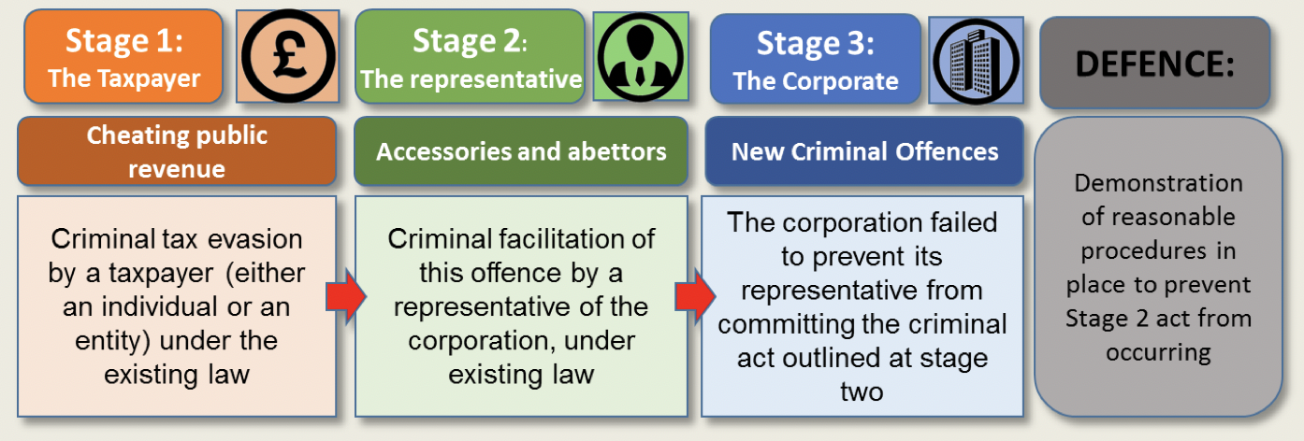
3. Deterring professional enablers
  Preventing abuse:
  Provide clear and accessible guidance on the operation of the tax and criminal laws. Pre-emptive communication strategies can include clear communication and guidance on the parameters of tax rules and consequences for non-compliance.
Criminal Finance Act 2017 - failure to prevent the criminal facilitation of tax evasion.

Slide 8
3. Deterring professional enablers
  ATO– usage of taxpayer alerts to address new tax schemes:
  The Australian Taxation Office (ATO) publishes taxpayer alerts regarding new or emerging high-risk tax schemes. Where intelligence is received by the ATO of a risky arrangement that may not be compliant with the law, the ATO is able to respond with immediacy to warn the community.
  Through taxpayer alerts, the ATO is able to share with tax practitioners and taxpayers its concerns regarding an arrangement that is legally ineffective, involves exploitation or a deliberate misapplication of the law, or which may constitute tax evasion or tax fraud.
  Furthermore, the ATO can indicate what the applicable penalties are for taxpayers who use the tax scheme, or enablers who promote usage of the tax scheme.
  Disclosure facilities / Mandatory disclosure rules (UK Criminal Finance Act 2017 )

Slide 9
3. Deterring professional enablers
The results of such voluntary disclosure programmes can bring significant amounts of revenue to tax administrations:
  As of November 2019, voluntary disclosure programmes and tax investigations helped to identify about EUR 102 billion in additional revenue (tax, interest, penalties). Voluntary disclosure programmes have been the largest contributor to this figure with nearly 40 jurisdictions having reported some form of disclosure between 2009 and 2019.
  For instance, voluntary disclosures brought EUR 462 million in Australia, EUR 13.6 billion in Brazil, nearly EUR 6 billion in Germany, EUR 29 million in Hungary, EUR 54 million in Luxembourg and over EUR 900 million in Mexico. Over 1 million of taxpayers have come forward to voluntarily disclose their assets.

Slide 10
4. Effective investigations: across government and across borders
  Domestic whole government approaches:
  In order to have the most coherent and robust approach to preventing, identifying, disrupting and prosecuting professional enablers, mechanisms should be in place to enable information sharing between the relevant agencies.
  International co-operation.
  Group requests / Spontaneous exchange of information / On-sharing of tax information with other law enforcement agencies.
  The Joint Chiefs of Global Tax Enforcement (the “J5”).

Slide 11
What is Data Mining?
How Does the Commercial Sector Monetize Data Mining to by Selling Data or Using Data?
Data mining is the process of analysing a large batch of information to discern trends and patterns.
Data mining can be used by corporations for everything from learning about what customers are interested in or want to buy to fraud detection and spam filtering.
Data mining programs break down patterns and connections in data based on what information users request or provide.
Social media companies use data mining techniques to commodify their users in order to generate profit.

Slide 12
Data sources for identifying professional enabler activity
Data mining information from offshore leaks, looking for links to professionals active in the jurisdiction, common clients of those professionals, and common structures.
Analysing information from suspicious activity reports (SARs), including SARs on international electronic funds transfers, to identify repeat transactions, professions or persons that are the subject of the reports.
Creating a reporting mechanism for officials across the tax administration to report suspicions or queries with respect to intermediaries (lawyers etc) that are involved in suspect structures or transactions.
Information from voluntary disclosure programmes. Caution.
Anonymous or whistle blower reports. (retaining anonymity)
Information on the internet advertising tax schemes or offshore structures.

Slide 13
Data sources for identifying professional enabler activity
Statistics on companies that have been struck off and cross-matching that information to companies served by the same service provider.
Statistics on disqualified directors and cross-matching that information to those that work for the same service provider. Creating a database of known professional enablers and known associates.
Creating an internal database of shell companies, suspicious addresses, suspicious directors and persons etc. to query or use for data mining.
Validating the authenticity of documents with relevant government agencies (e.g. passport office, company registrar, financial regulators, other law enforcement authorities etc.) Validating the identity of taxpayers through signatures, photos or fingerprints in tax authority or government records.
Consulting the OECD ATP Directory, a confidential database of over 400 aggressive tax planning schemes.

Slide 14
India – Case Example - India’s use of data sources in professional enabler investigations
Objective? Indian Government, in the normal course of business, was collating huge amounts of valuable data from various governmental departments. How could they gather this information and possibly use it to restrict financial crime?

Slide 15
India – Case Example - India’s use of data sources in professional enabler investigations
Objective? Indian Government, in the normal course of business, was collating huge amounts of valuable data from various governmental departments. How could they gather this information and possibly use it to restrict financial crime?

Slide 16
India – Case Example - India’s use of data sources in professional enabler investigations – The Challenge
Unique Identification Authority using “Aadhaar” numbers, a biometric-based unique identification number for individuals.

Slide 17
India – Case Example - India’s use of data sources in professional enabler investigations – The Challenge
Unique Identification Authority using “Aadhaar” numbers, a biometric-based unique identification number for individuals.
Income Tax Department through permanent account numbers (PANs), a unique taxpayer identity number mandatory for all taxpayers

Slide 18
India – Case Example - India’s use of data sources in professional enabler investigations – The Challenge
Unique Identification Authority using “Aadhaar” numbers, a biometric-based unique identification number for individuals.
Income Tax Department through permanent account numbers (PANs), a unique taxpayer identity number mandatory for all taxpayers
Ministry of Corporate Affairs manages the register for corporate entities and directors through the registering of corporate identity numbers (CINs) and director identification numbers (DINs).

Slide 19

India – Case Example - India’s use of data sources in professional enabler investigations – The Challenge
Unique Identification Authority using “Aadhaar” numbers, a biometric-based unique identification number for individuals.
Income Tax Department through permanent account numbers (PANs), a unique taxpayer identity number mandatory for all taxpayers
Objective - perform data analytics across the information held by the three different government departments and data-mine between the three databases.
Ministry of Corporate Affairs manages the register for corporate entities and directors through the registering of corporate identity numbers (CINs) and director identification numbers (DINs).

Slide 20
India – Case Example - So What did India do - and what are PAN’s, Dins etc?
In 2017, the government of India set up a special task force dedicated to the identification and eradication of shell companies. Shell companies are recognised as a risk to the tax base due to their usage in the commission of tax crimes and other financial crimes.
As a country with a large population, information in India on individuals, taxpayers, corporations and directors are held in different databases by separate government departments and ministries. Information on individuals is maintained by the Unique Identification Authority using “Aadhaar” numbers, a biometric-based unique identification number for individuals.
Information on taxpayers is held by the Income Tax Department through permanent account numbers (PANs), a unique taxpayer identity number that is mandatory for all taxpayers (but not necessarily all individuals). Finally, the Ministry of Corporate Affairs manages the register for corporate entities and directors through the registering of corporate identity numbers (CINs) and director identification numbers (DINs).

Slide 21
India’s use of data sources in professional enabler investigations
One of the key tasks in identifying shell companies was to be able to perform data analytics across the information held by the three different government departments and data-mine between the three databases.
The results of this triangulation of information between government departments were dramatic. By linking the information between Aadhaar numbers and PANs, many ghost PAN holders, duplicate PAN holders or fake PANs were identified and removed from the system.
Cases of fraudulent non-quoting of PANs were also identified, which was previously a common way for fraudsters to remain undetected by the Income Tax Department, leading to high value transactions being concealed and fraudsters escaping investigation or audit.

Slide 22
India’s use of data sources in professional enabler investigations
The crosschecking of information with DINs and CINs also revealed the identify of fraudulent directors and shell companies. This was evident when anomalies were found for companies that had filed financial statements but failed to file an annual tax return, or vice versa, where companies had filed an annual tax return but failed to file financial statements, as required.
This resulted in the disqualification of 309 000 directors, and 226 000 companies being struck- off by the Ministry.
Furthermore, in the process of this crackdown on fraudulent activity by directors, fraudulent PANs and companies, approximately 400 professional enablers were identified as responsible.

Slide 23
India’s use of data sources in professional enabler investigations
This straightforward action of combining information and databases that were already in the Indian government’s possession, was able to root out thousands of cases of basic fraud and non-compliance by individuals, companies, directors and other professional enablers.
In particular, the triangulated information also gave the Indian authorities a clearer picture of where wrongdoing was being perpetrated by the same sets of persons repeatedly, which indicated where professional enablers might be involved and further investigation would be warranted.
Result – India was able, due to simple cross checking of the system investigate and prosecute a high number of individuals and furthermore shut down shell companies.

Slide 24
UK example - Simple Data Mining
Industry | April 2021/March 2022 | % of total | % comparison to 2020/ 2021
Banks | 637,776 | 70.77% | +15.57%
Building societies | 56,931 | 6.32% | +90.80%
Money services business | 27,397 | 3.04% | +13.28%
Financial institution: Other | 113,246 | 12.57% | +13.01%
Accountants & tax advisors | 5,863 | 0.65% | +25.47%
Legal professionals | 2,859 | 0.32% | +29.07%
Trust or company service providers | 140 | 0.02% | +53.85%
Estate agents | 780 | 0.09% | +14.71%
Total | 901,255 | 100% | +21.41%
Consider submission of SARs by sector using available data from various agencies.
If banks are submitting circa 637,776 SARs, then how can law firms only be submitting 2,859 SARs as introducers and intermediaries for the same business sector?
I would be conducting data analysis across submitted SARs and challenging relevant law firms and TCSP’s (subject to V high risk pursuant to NRA) Enquire on the basis of ‘reasonable suspicion’, pursuant to POCA 2002.
National Crime Agency (NCA) published statistics

Slide 25
UK example - Simple Data Mining
Industry | April 2021/March 2022 | % of total | % comparison to 2020/ 2021
Banks | 637,776 | 70.77% | +15.57%
Building societies | 56,931 | 6.32% | +90.80%
Money services business | 27,397 | 3.04% | +13.28%
Financial institution: Other | 113,246 | 12.57% | +13.01%
Accountants & tax advisors | 5,863 | 0.65% | +25.47%
Legal professionals | 2,859 | 0.32% | +29.07%
Trust or company service providers | 140 | 0.02% | +53.85%
Estate agents | 780 | 0.09% | +14.71%
Total | 901,255 | 100% | +21.41%
Consider submission of SARs by sector using available data from various agencies.
If banks are submitting circa 637,776 SARs, then how can law firms only be submitting 2,859 SARs as introducers and intermediaries for the same business?
Consider conducting data analysis across submitted SARs and challenging relevant law firms and TCSP’s (subject to V high risk pursuant to NRA)
Enquire on the basis of ‘reasonable suspicion’, pursuant to for example the UK POCA 2002.
National Crime Agency (NCA) published statistics

Slide 26
Ideas on potential data mining sources
Consider one potential source, government or private, of data mining that could enhance / improve investigations.
5/10 Minutes!

Slide 27
Think about local resources and contacts
The Regulator
Tax office
Companies Registration

Slide 28
Think about Your Own regulator
For example, the Guernsey Financial Services Commission (‘GFSC’)
‘Under PRIISM, the Investment, Fiduciary and Pension Division carries out full risk assessment visits and engagement visits to all licensees with an impact rating of Medium Low, Medium High or High. In addition, the Division undertakes focused thematic work across licensees and funds in all impact categories.’
The annual Financial Crime Risk Return is used by the Commission to gather important information and statistical data to assist the Commission in identifying and assessing financial crime risks within the Bailiwick of Guernsey's finance industry.

Slide 29
Think about Your Own regulator
Following the Commission's previous announcements and after consultation with industry, updates made to the 2021 FCRR include:
Additional reporting on suspicious activity and tax related disclosures;
Further information on AML/CFT governance and compliance arrangements;
Controls for identifying PEP connections, adverse media and sanctioned parties;
Additional information on periodic risk reviews; and
Revised geographical data in relation to customers.

Slide 30
Think about Your Own regulator – Additionally, explore data from each division
These regulatory divisions can be explored to enhance investigations regarding professional enablers.
Banking
Insurance
Lending, credit and Finance
Investment
Fiduciary (Trust & Corporate Service Providers)
Non-Regulated Financial Services Businesses
Prescribed Business (legal, Estate Agents, Accountants)

Slide 31
Engage with Your regulator
Given the volume of date collected by way of annual statistical returns, I would encourage you to engage with your local regulator. Annual Return data provided by FSB’s.
  Reporting Suspicion
  Disclosures
  Governance and Controls
  Governance/Structure
  Policies, Procedures and Controls
  Controls for identifying PEP connections, adverse media and sanctioned parties
  Frequency of ML/FT Risk Reviews
  Outsourcing
  Relationships Business Relationships
  Occasional Transactions
  Politically Exposed Persons (PEPs)
  Geographical

Slide 32
Engage with Your regulator
Given the volume of date collected by way of annual statistical returns, I would encourage you to engage with your local regulator. Annual Return data provided by FSB’s.
  Reporting Suspicion
  Disclosures
  Governance and Controls
  Governance/Structure
  Policies, Procedures and Controls
  Controls for identifying PEP connections, adverse media and sanctioned parties
  Frequency of ML/FT Risk Reviews
  Outsourcing
  Relationships Business Relationships
  Occasional Transactions
  Politically Exposed Persons (PEPs)
  Geographical

Slide 33
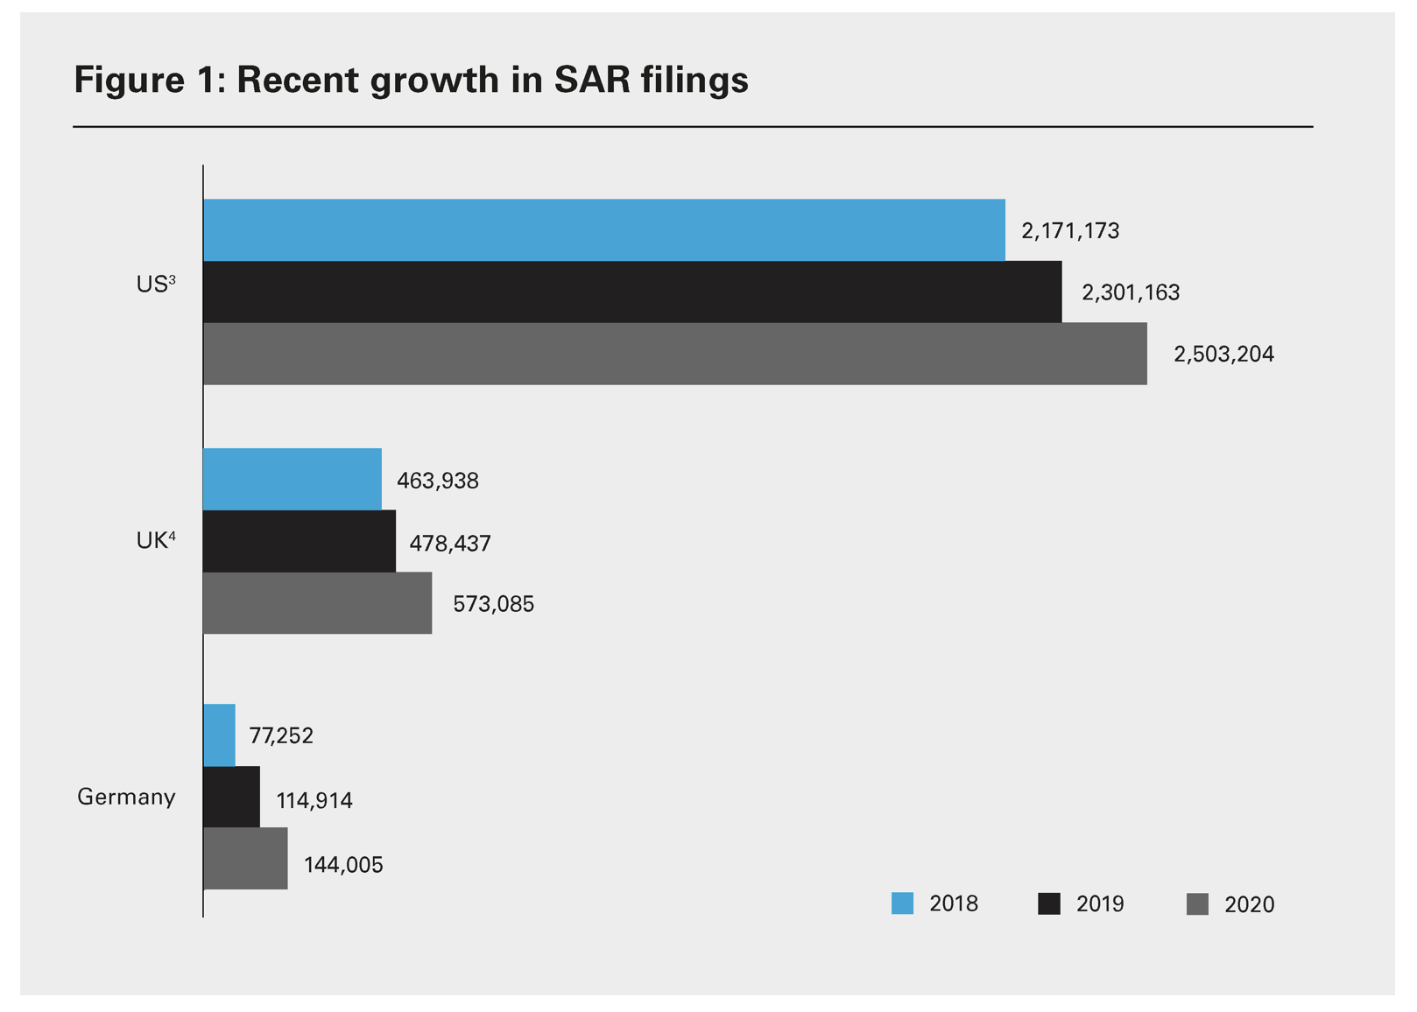
FIU Engagement and communication with business sector
Financial institutions and other reporting entities collectively spend many billions of dollars annually to produce millions of SARs. In addition, the number of SARs filed has increased significantly each year.
‘Despite these process improvements, the global anti-money laundering (AML) regime does not appear to be substantially more effective.’
Data mining means we have an alternative source - a distilled form of intelligence.

Slide 34
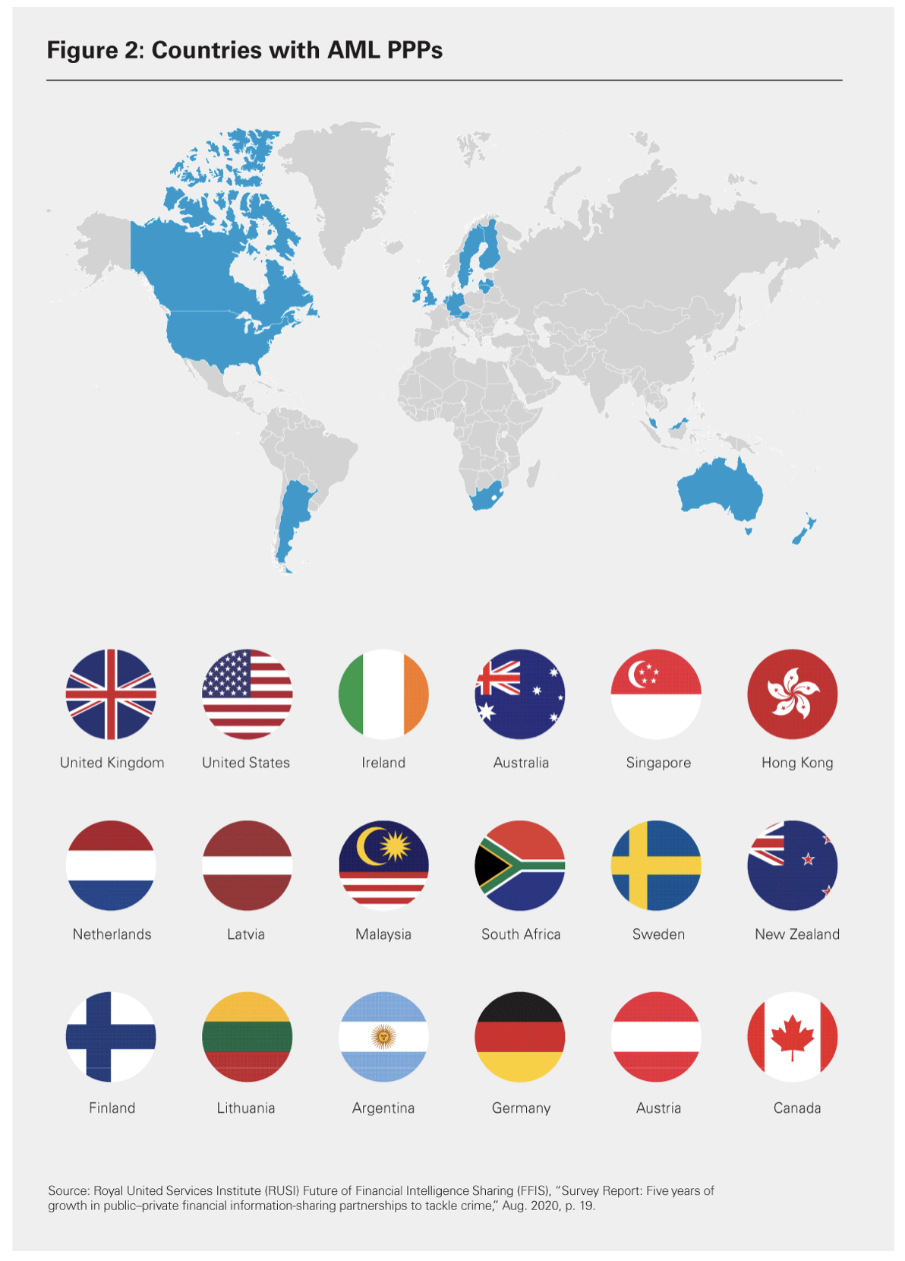
Anti-Money Laundering Public, Private Partnerships - PPPs
Past and present heads of national financial intelligence units (FIUs) acknowledge that only a relatively small handful of SARs are of immediate value to law enforcement.
This low return on investment is frustrating to both governments and reporting institutions and has driven a wave of reform designed to improve the usefulness or effectiveness of SAR reporting.
As of June 2020, 18 countries developed PPPs which has resulted in:
Increase in SAR’s addressing threats prioritised by the PPP.
Timely & relevant reporting regarding investigations or live incidents.
Improved quality and utility of suspicious reporting.
Improved outcomes supporting investigations, prosecutions, asset recovery or other disruption of criminal networks.
More collaborative & constructive relationships between public agencies and regulated entities.
Royal United Services Institute for Defence and Security Studies

Slide 35
In conclusion
Considerations:
Identify the issues (Terms of Reference).
Anticipate the unintended consequences: SARs (increase), GIMLITS (legislative consequences) etc.
Appoint a designated individual to run the the DATA mining project (critical), who has authority and Terms of Reference.
Ensure that the initiative is deliverable and above all measured regarding success, for example consider the SAR issue – extensive increase but no perceivable increase in investigations and prosecution).

Slide 36

finally
There is no greater way of data mining than engaging directly with the financial services sector. Meet, greet, and collaborate.
Relaxed coffee meetings with regulatory counter-parts, MLRO’s and Board Directors is a great ice breaker.
It is important to de-mystify the
FIU and Economic Crime Divisions.

Slide 37
“The difficulty lies not so much in developing new ideas
as in escaping from old ones.”
(John Maynard Keynes - Economist and Philosopher)

