Slide 1
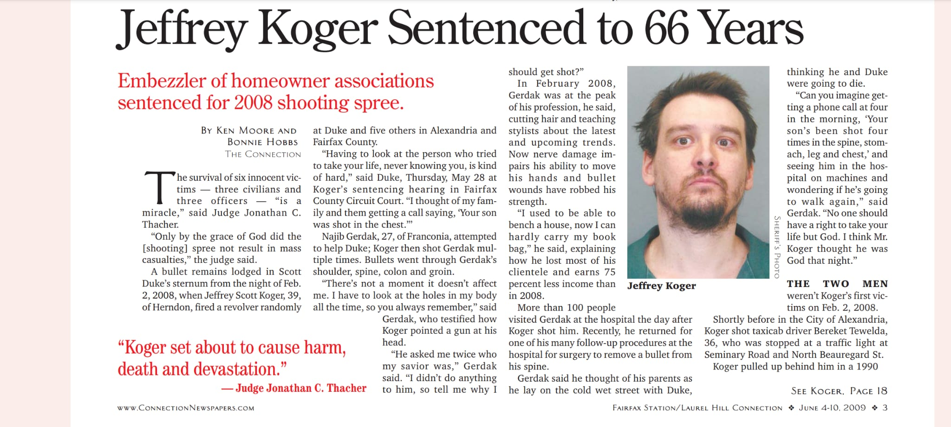

Slide 2
Measuring the Threat
IRS-CI Special Agents focus 100 percent of their time on investigating financial crimes and in 2022 seized over $7 billion US Dollars of criminal proceeds. The average prison sentence for tax crimes is 42 months.
Previous threats have included:
Identify Theft (and the fraudulent filing of tax returns)
Cyber-Enabled Criminality (business email compromises, phishing, identify theft, ransomware, malware, hacking, social engineering, sms phishing, cyber espionage, email spoofing, etc.
Next up: Economic Stimulus Fraud
In the U.S. alone, fraud with the Paycheck Protection Program, likely exceeds $500 billion.
Inflating Amount of Employees
Creating New Businesses Overnight
Take the name of an existing business and apply for the relief funds
Falsely claimed to be operating farms

Slide 3

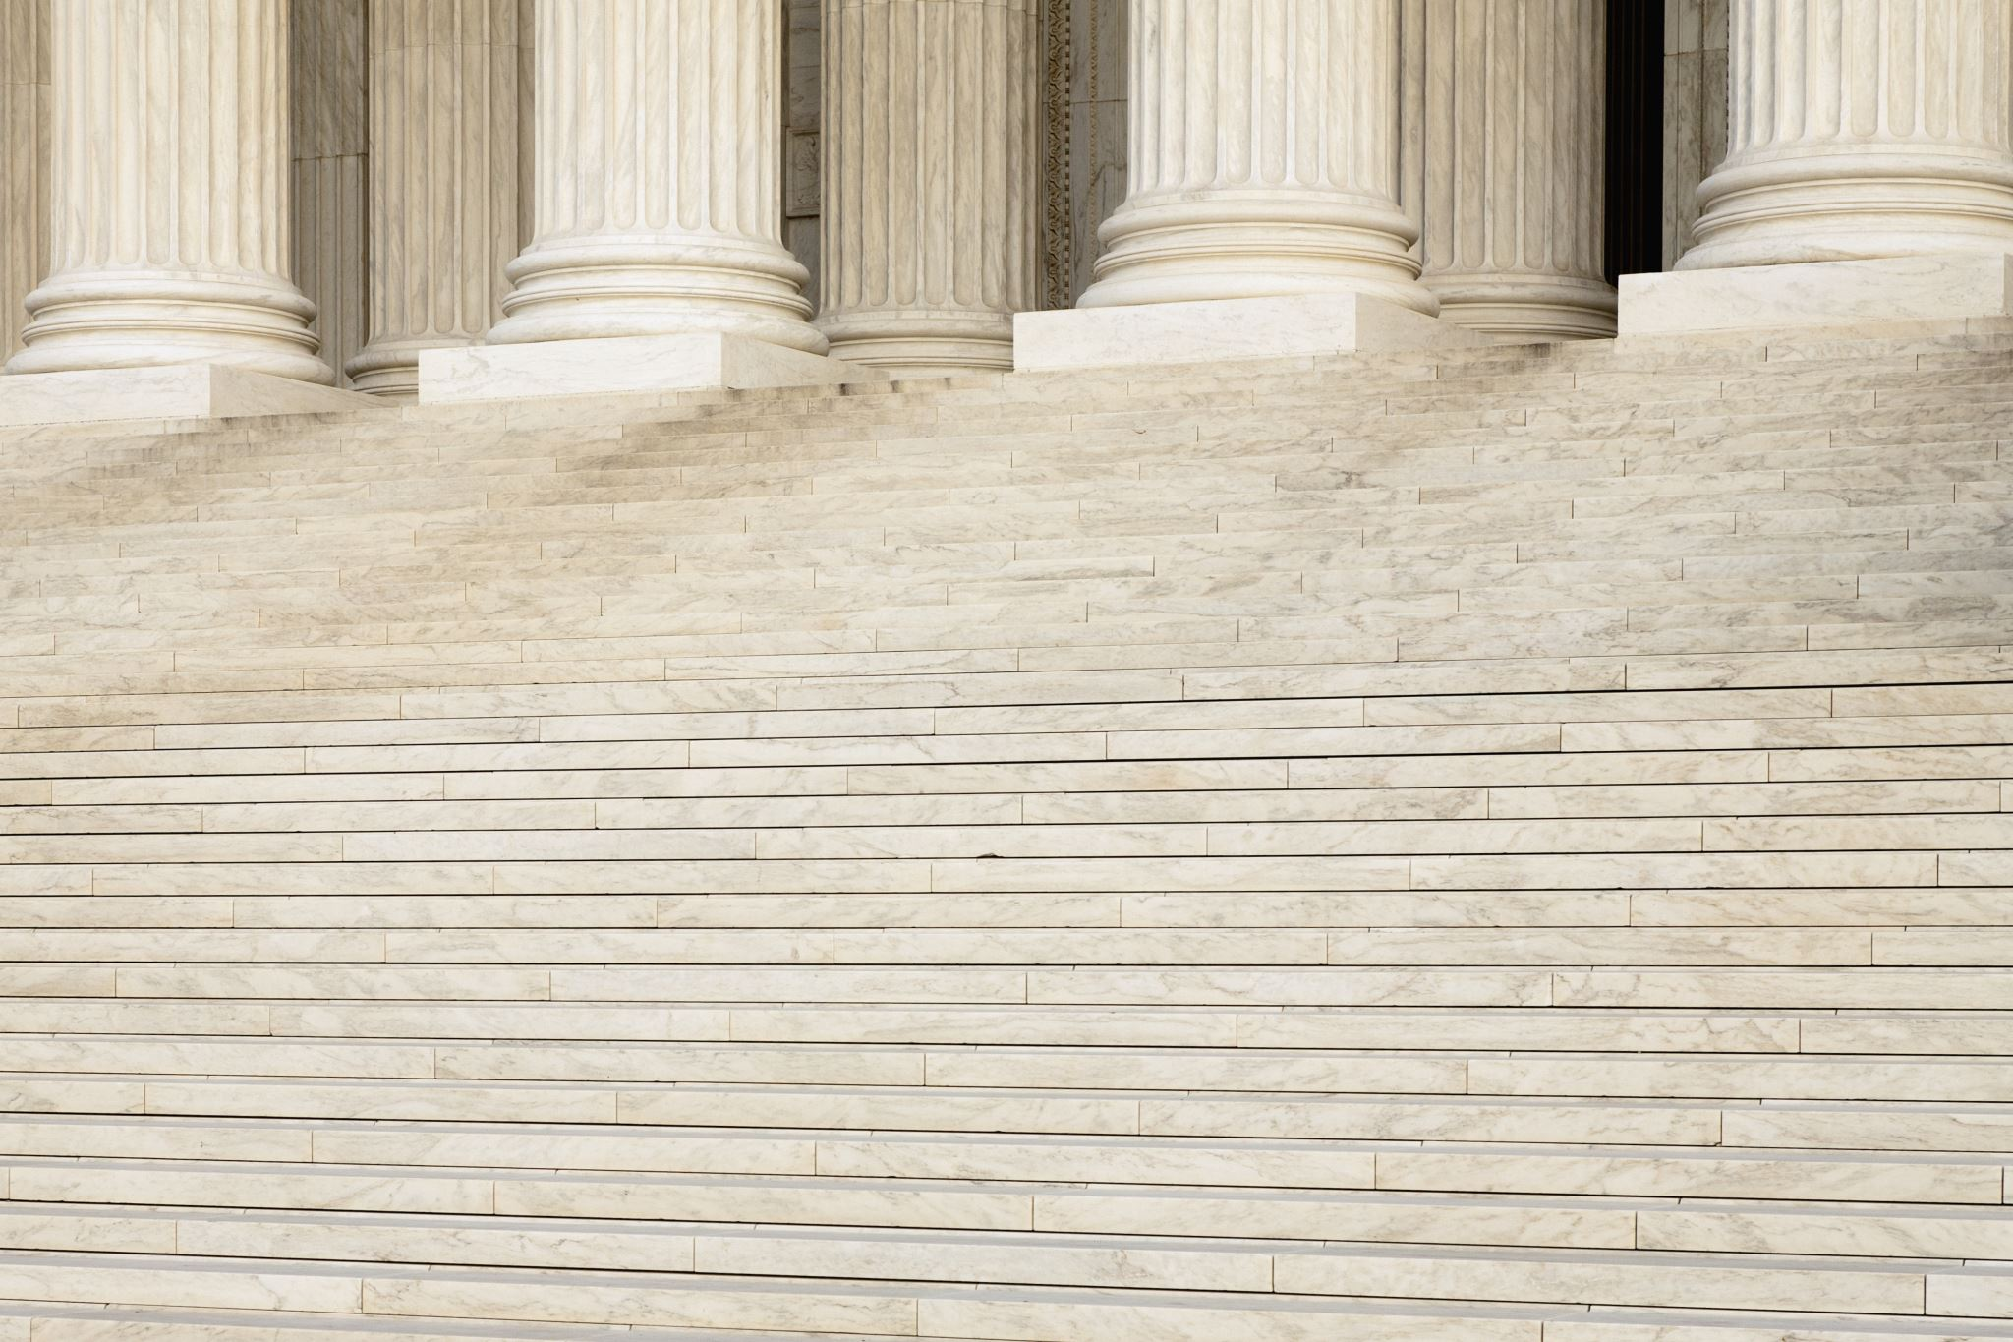
Tony and Caryn work together again!
It started with a phone call…
Because of a Server.

Slide 4


Building Trust
Patience
Why Investing Offshore
Diversification
Managing Risk
“something sensitive”

Slide 5
U.S. Clients
Predisposed to the Activity
Email Search Warrant

Slide 6

Barbados?
IRS has 11 offices overseas

Slide 7
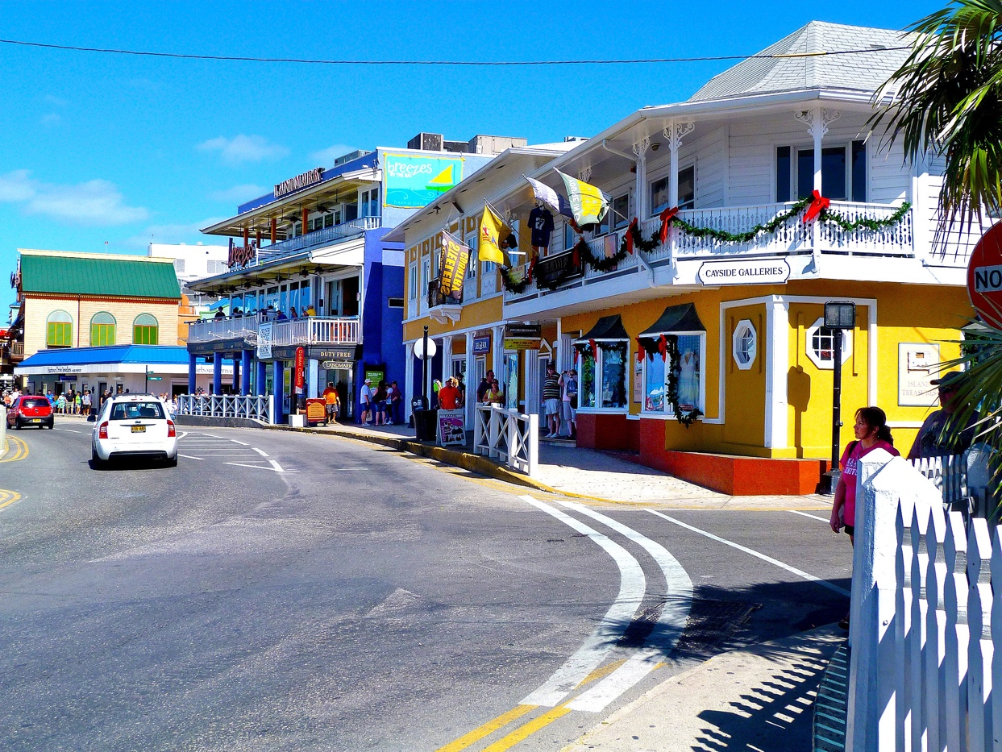




Slide 8
Introduction (telephonic and email)
Face –to – Face Undercover Operations
Create the Business
Move the Money - Venue
Execute the Arrest
Cooperation – Client List

Slide 9
Case Example
I will control the company in paper only
Technically the business is the client, not the U.S. citizen
You will be given a 5-digit code to check account balances so you don’t have to use your actual name
If you earn 8 percent you earn 8 percent, clean, no tax on gains
With the “clean” vs the “dirty” money, the fee structure would be cheaper for the more transparent money
UC: This first batch is very sensitive, very hot, from the stolen funds
Advisor: that’s OK, we just don’t want drug dealers or terrorist financing
It wouldn’t look good for the owners to be listed on the foundation
Send the money to my firms escrow account and not to the foundation so there is no link
The nominee company is very effective
Law firms can claim privilege and ignore MLAT’s
|

Slide 10
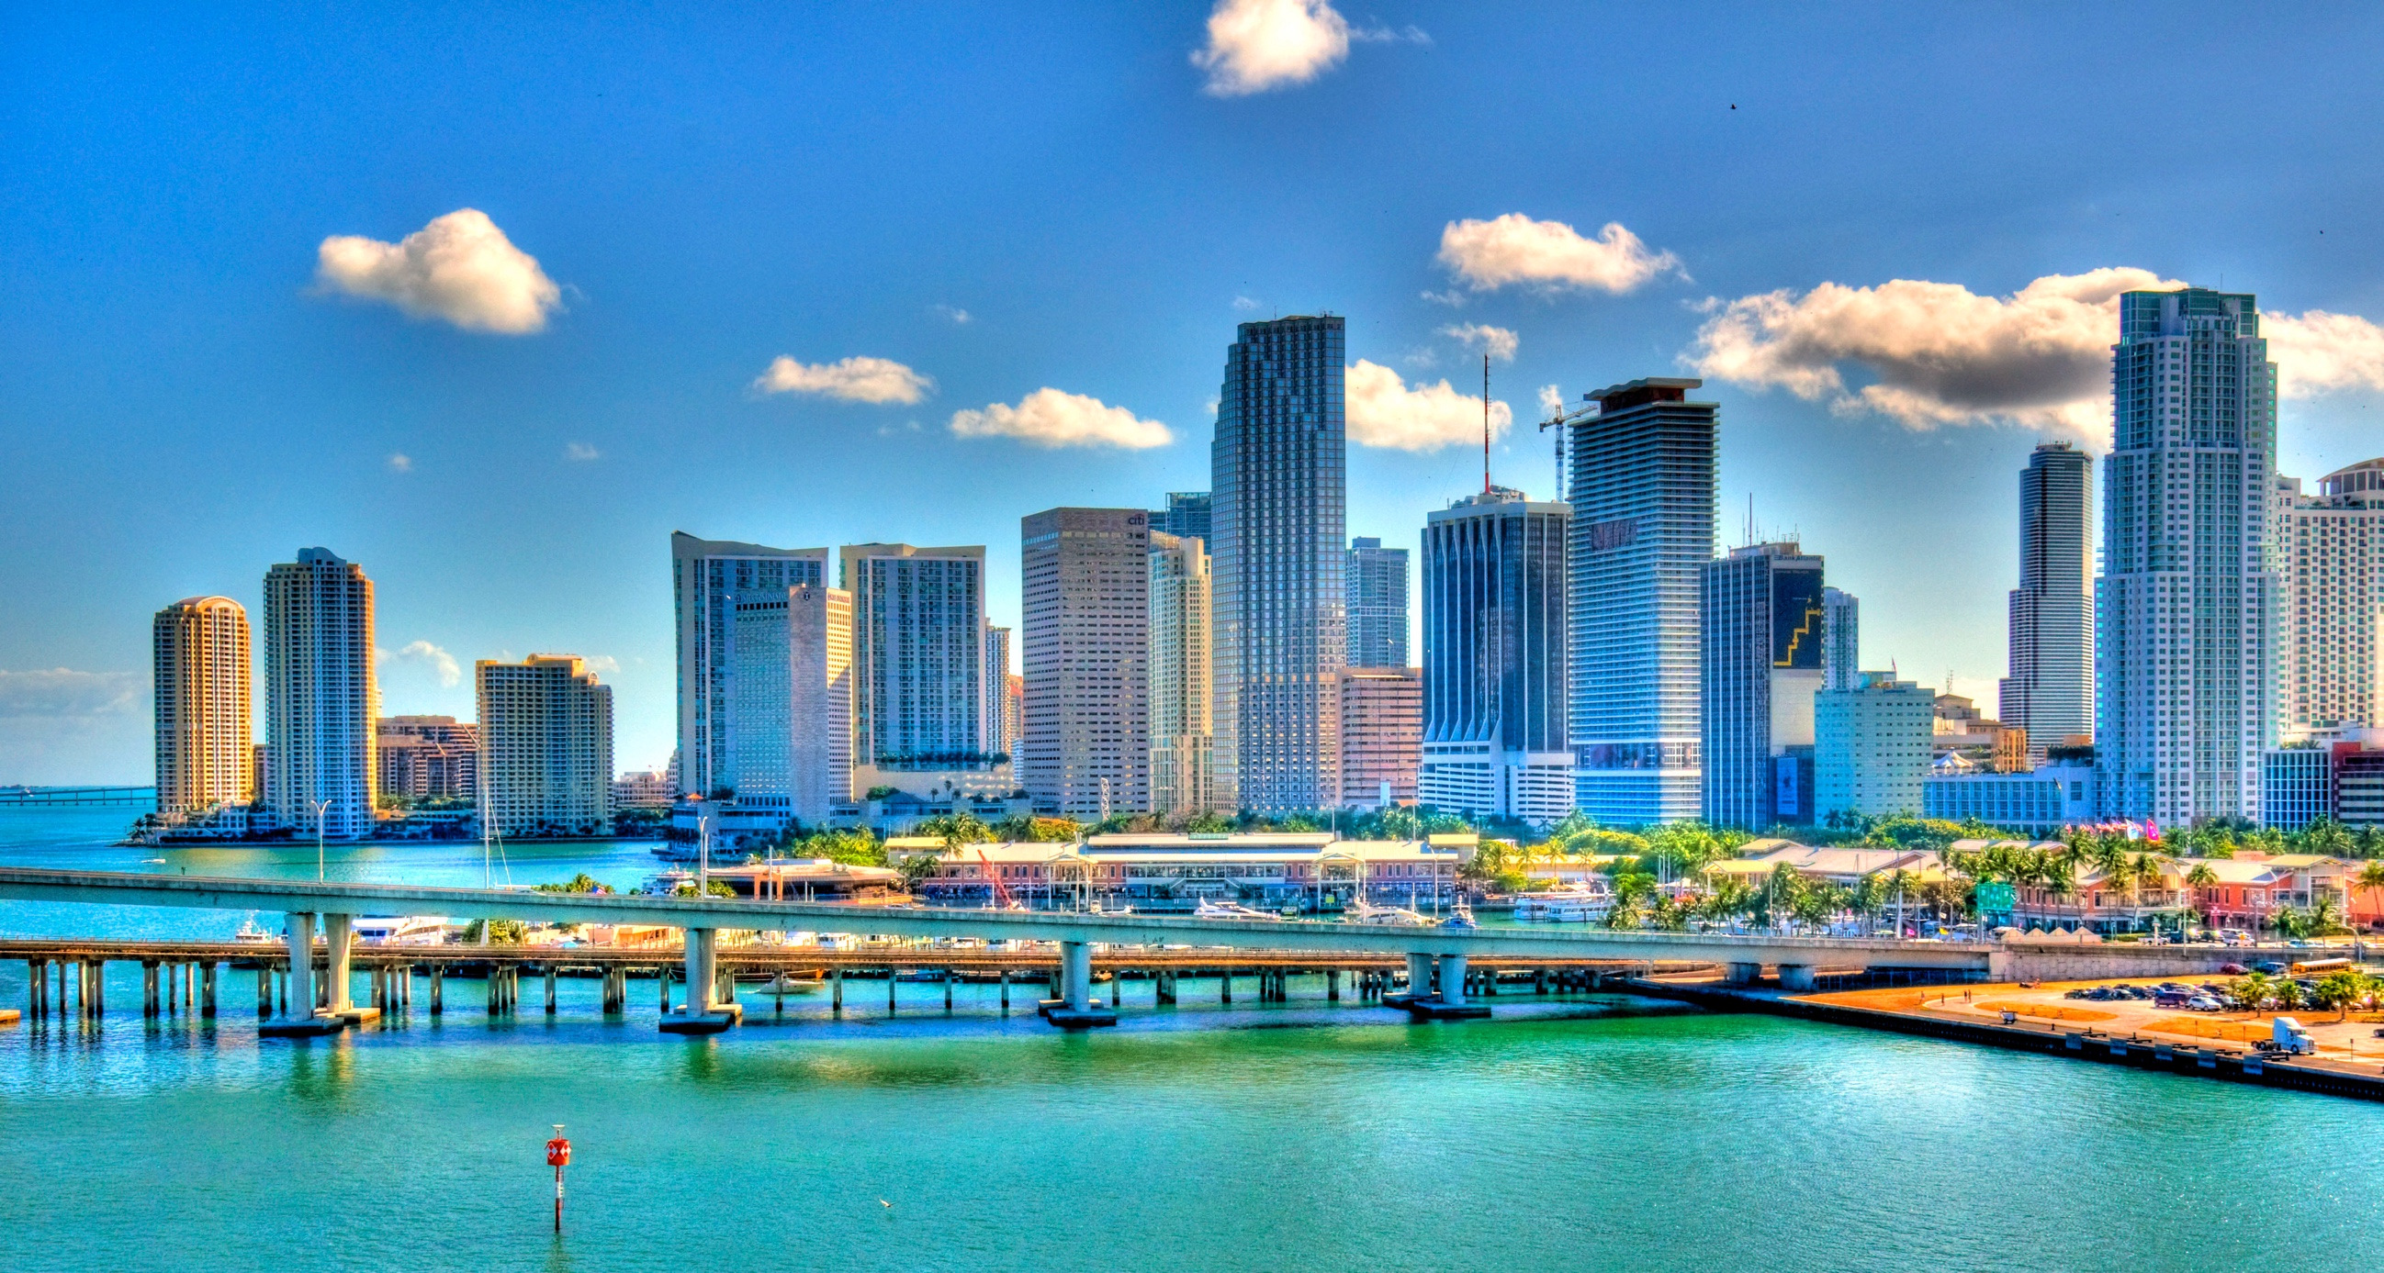
Miami, FL, USA
Our Prosecutors Get to Travel!

Slide 11
“There is no such thing as partial cooperation in a matter like this…” – Caryn Finley
Prison Sentences
Spin-off Cases
Challenges
Lessons Learned

