Slide 1

Whole of Government Approach to Combating
Professional Enablers of Financial Crimes

Slide 2
Ending the Shell Game
Legal gateways to share information (responding timely to foreign competent authorities)
Cross-training of agencies and jurisdictions (OECD Academy, Cyber Summits)
Identify a lead contact in agency to cooperate with other agencies and jurisdictions
Mechanisms for sharing feedback regarding shared information
Joint investigative teams – across agencies and jurisdictions – civil examinations
Secondments and co-location of personnel
Exchange of Information between tax authorities (spontaneous exchange)
J5, Joint International Taskforce on Shared Intelligence, CRS automatic exchange portal
|

Slide 3
Whole of Government Approach
How could a Barrister in Guernsey and a Special Agent from USA meet one another?
|

Slide 4
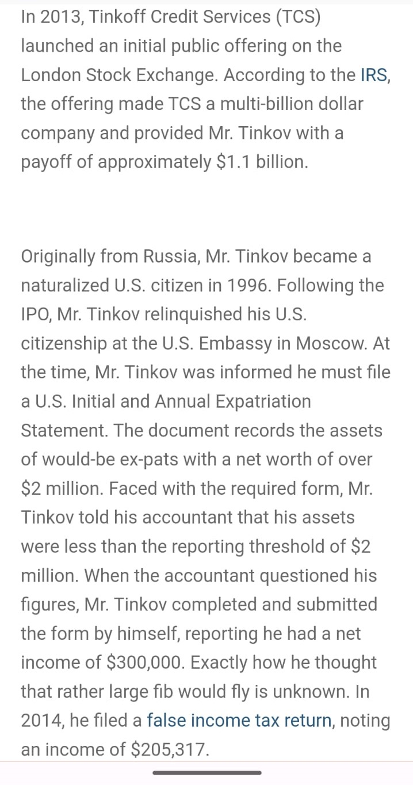
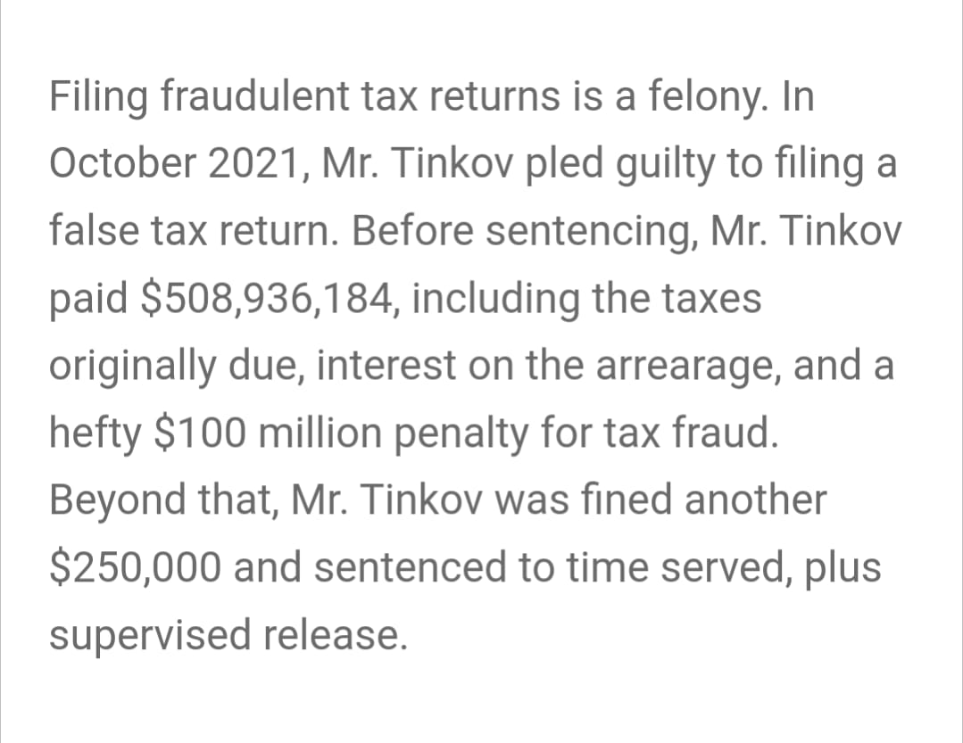
The Number isn’t a typo!
The Importance of the Oslo Dialogue
|

Slide 5
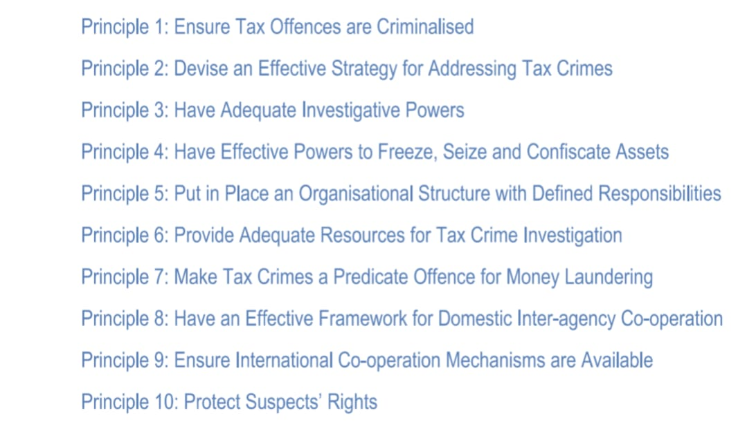
OECD Ten Global Principles
|

Slide 6
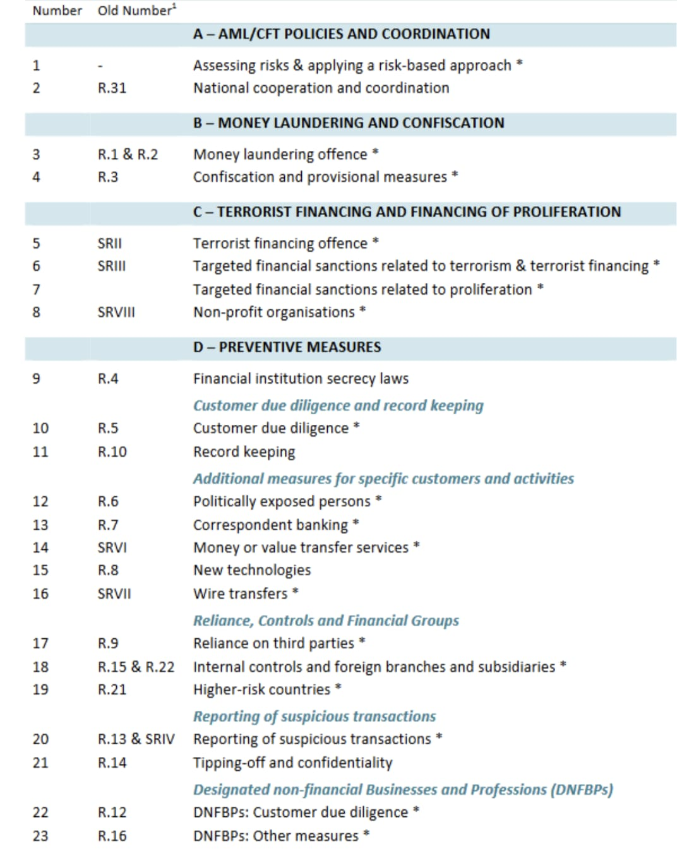
FATF 40 Recommendations
|

Slide 7
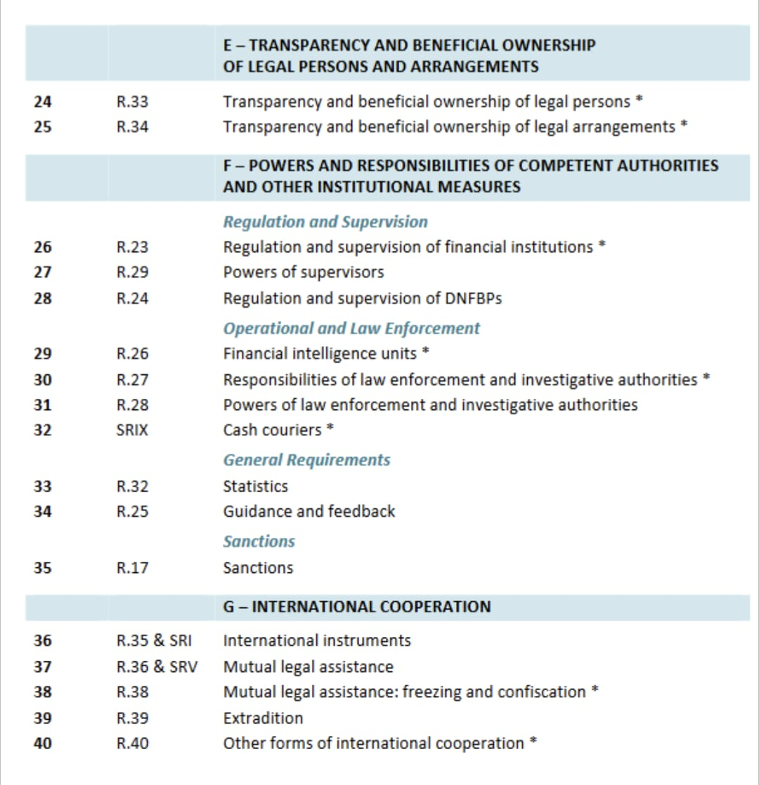
FATF 40 Recommendations
|

Slide 8
Financial Action Task Force
FATF was formed in 1989 at the G7 Summit in Paris to combat the growing problem of money laundering. The task force was charged with studying money laundering trends, monitoring legislative, financial and law enforcement activities taken at the national and international level, reporting on compliance, and issuing recommendations and standards to combat money laundering. In 2001, the mandate of FATF expanded to terrorist financing. FATF now also includes Virtual Asset Service Providers.
FATF Black List – since 2020 – deemed “uncooperative” in the global fight against money laundering and terrorist financing. Current blacklisted countries include Iran, North Korea, and Myanmar
Doesn’t respond to law enforcement requests, doesn’t capture information on ultimate beneficial ownership, doesn’t conduct due diligence, doesn’t verify account information or source of funds
FATF Grey List – Current list includes UAE, Panama, Cayman Islands, Gibraltar, Barbados and about 20 others.
What Grey Listing means, per FATF: Under increased monitoring to address strategic deficiencies in their jurisdictions to counter money laundering, terrorist financing, and proliferation financing.

Slide 9
Impacts of Grey List
Loss of Capital Flow
According to the IMF³, countries grey listed by the FATF typically suffer an average net loss of 7.68% of capital flow into their states relative to GDP.
The domestic financial cost of subsequent compliance can be significant – coupled with the fact that it often takes 2–5 years for a country to be removed from the grey list once the mandated requirements are duly satisfied and accepted by the FATF.
Grey listing discourages foreign investment and stands to suffer foreign direct investment shrinkage as a consequence.
Perceptual and Reputational Damage
Foreign banks and investors may become hesitant about doing business, choosing rather to operate within other jurisdictions that present healthier risk profiles.
Foreign companies may face increased bureaucratic hurdles, costs of operation and onerous levels of scrutiny.
Countries grey listed by the FATF are automatically considered high-risk jurisdictions by the European Union and the UK (in other words, they are considered jurisdictions with strategic deficiencies in their Anti-Money Laundering/Counter Terrorist Financing regimes that pose significant threats to the financial system).

Slide 10
EU Money Laundering Directives
The 5th AML Directive came into effect in2020 to mitigate criminal economic activity.
The focus was to establish public access to centralized public registers of companies and their beneficial owners. There will no longer be a requirement to demonstrate legitimate interest. Banks are obligated to report discrepancies between information contained on public registers and beneficial ownership obtained through customer due diligence.
Prepaid cards will be subject to further customer due diligence. The threshold at which prepaid cards will be subject to due diligence decreases from 250 to 150 euros.
Cryptocurrency exchanges now obligated to perform the same AML checks as traditional financial institutions.
EU Issuing list, subject to ongoing monitoring, of Politically Exposed Persons, as there may be higher risk.
Traders of high value goods, like art, are now subject to enhanced due diligence, including intermediaries (AML identity verification checks required for transactions exceeding 10,000 euros).
|

Slide 11
The Wolfsburg Group
            An association of 13 global banks which aims to develop frameworks and guidance for the management of financial crime risks, particularly involving Know Your Customer, AML, and Counter Terrorist Financing.
            The group came together in 2000 to work on drafting AML Guidelines for Private Banking.
            Some principles and standards they have published include guidance on:
              Correspondent Banking
              Risk-Based Approaches to implementing the principles
              Due Diligence
              Enhanced due Diligence for Politically Exposed Persons
              Transaction monitoring
              Understanding ownership of management structures prior to onboarding
|

Slide 12
Whole of Government Approach
  Attaché offices and Overseas Liaison Officers (Jason Bell)
  Foreign Law Enforcement Communities and HQ General Email Addresses (informal)
  International organizations – like the OECD, UN, World Bank, FATF
  Formal and Informal (MLAT, Tax Treaty, EGMONT and informal intelligence – police to police)
  Diplomacy
    Two-way street
    90 percent internal
    Police to police generally positive
  International Relations and Geopolitical Issues are a factor
  Working relationships between criminal and civil offices within our tax administrations
  Working relationships between all levels of government (depending on jurisdiction – federal and state)
  Working relationships between other agencies that investigate other crimes (finance usually always a factor)
  Working relationship with private sector

Slide 13
Nothing New but an Ongoing Matter (not illegal)
INVESTING THROUGH CITIZENSHIP – OECD area of concern
  Citizenship by Investment to evade legal and non-legal income, laundering funds, and potentially conceal foreign financial bank accounts (possibly as a way to avoid FATCA).
  St. Kitts and Nevis Hurricane Relief Fund – a $150,000 donation would grant citizenship. The Sustainable Growth Fund – a $475,000 investment in real estate would grant citizenship. Property can be sold in five years. The application is completed online.
  Cyprus abolished its Golden Passport Scheme back in 2020, following a report provided by Al Jazeera named the Cyprus Papers, which brought into light the fact that persons involved in illegal acts also managed to acquire residency in Cyprus through this program.
  Portugal considering ending Golden Visa program, one reason being rising real estate prices in Lisbon and Porto is pricing out citizens, making it difficult for citizens to purchase homes.

Slide 14
International Collaboration
The movement of funds and virtual assets via mobile devices is secure, fast, and low-cost
Financial Investigators ‘Follow the Money’ – but formal requests take a long time and criminals move currencies, fiat and non-fiat, across borders and cryptocurrencies, through various exchanges, including tumblers, within seconds
Agreements in place for asset forfeiture and sharing of seized proceeds of criminality
Public Private Partnerships: Financial Institutions are often the first line of defense and specialized blockchain tracing companies have powerful tools to trace illicit funds
International Visitor Programs and Liaison Officers based overseas
OECD Finance and Tax Crime Academy
Professional organizations like ACAMS and ACFE – take the test!
|

Slide 15

IRS-Criminal Investigation
Global Operations
Consulate of the United States of America – Dubai Post
Regional Attaché
Anthony Cook
Anthony.Cook@ci.irs.gov
WhatsApp +1 202.494.3248
www.linkedin.com/com/in/anthonycooklondonpost

