Slide 1
Services Provided by Professional Enablers
Asia-Pacific Academy in Tokyo, Japan (Specialty programme) 2023
OECD Tax Crime Academy course leader
BRENDON NORMAN-ROSS
Notes:
We are going to cover, amongst other things:
1. Services provided by PE
2. Setting up companies - how easy it is
3. We will discuss offshore structures
4. Providing false documentation
5. Assisting insolvency, bankruptcy and liquidation
First, let's consider a really key point about the reason why money launderers prefer well regulated jurisdictions

Slide 2

Services Provided by Professional Enablers
One key fact
Money launderers have an innate preference to launder their funds
through highly regulated jurisdictions. They are not queuing up to deposit funds in badly regulated or highly corruption jurisdictions.
Notes:
Before we explore the primary services, what are the challenges

Slide 3
Common Services - Professional Enablers
The following illustrate the most common or problematic services provided by professional enablers as identified by the Tax Force on Tax Crime (TFTC). The mere provision of these services is not an indication that the service provider is a professional enabler and several of these services themselves are not only legal, but essential parts of the global financial system.
However, where it is combined with an intent that the service be a part of a scheme for committing a financial crime, or where the service provider is willfully blind or would reasonably be expected to know that their services were being sought for this purpose, they may be a professional enabler.

Slide 4
Common Services - Professional Enablers
Most countries contributing to the ‘Ending the Shell Game’ report highlighted the prevalence of the companies, trusts and other corporate entities and arrangements in tax fraud and financial crime cases. Corporate structures are attractive to criminals for two main reasons:
They provide an air of legitimacy.
They are separate from the individuals behind the corporate veil, they provide the ability to shield the identity of the beneficial owner.
Generally the most prevalent are Trust and Corporate Service Providers (TCSP’s)

Slide 5
Common Services - Professional Enablers
For example, criminal assets can be disguised within legitimate business transactions by merging legal and illegal profits, which can be transferred either to other business entities or to domestic or foreign bank accounts.
As such, professional services for the formation of such entities and arrangements, while itself an important and legal activity, can also be an area of interest for investigators where such vehicles are then used for illegal activities.

Slide 6
Common Services - Professional Enablers
While the types of illegal services provided by professional enablers vary in each jurisdiction, common trends emerge from comparative experience. Some examples include:
  Hiding income or disguising the character and source of profits, for the purpose, for example, tax evasion;
  Obscuring beneficial ownership of assets, often through complex legal structures involving several jurisdictions, with the purpose of avoiding investigative scrutiny; or
  Offering advice on how to evade tax obligations using falsified transactions, documents or filings.

Slide 7
two common financial services
Trust and Corporate Service Providers (TCSP)
The Funds Industry
Notes:
What are TCSP's?

Slide 8
Trust and Corporate Service Providers (TCSP’s)

Slide 9
Trust and Corporate Service Providers
A Trust involves the separation of the legal title, or ownership, of property from the right to benefit from that property. It involves a person (the Settlor) transferring property (the trust fund) to another (the trustee) to hold for the benefit of another person (a beneficiary) or purpose.
Key UK Trusts:
Discretionary - when no one beneficiary has a defined interest. Probably the most widely used type of offshore trust. The trustees are under a duty to use their "discretion" to apply the income and capital of the trust assets for the benefit of a class of beneficiaries.
Fixed Interest – the benefit is defined in the Trust Deed.
Reserved Powers – certain individuals retain defined powers.
Charitable – specifically designed to benefit Charitable Organisations (Tax benefits).
Purpose – to fulfil a specific role e.g. hold assets until the fulfilment of an event.
The above are distinct from Foundations.

Slide 10
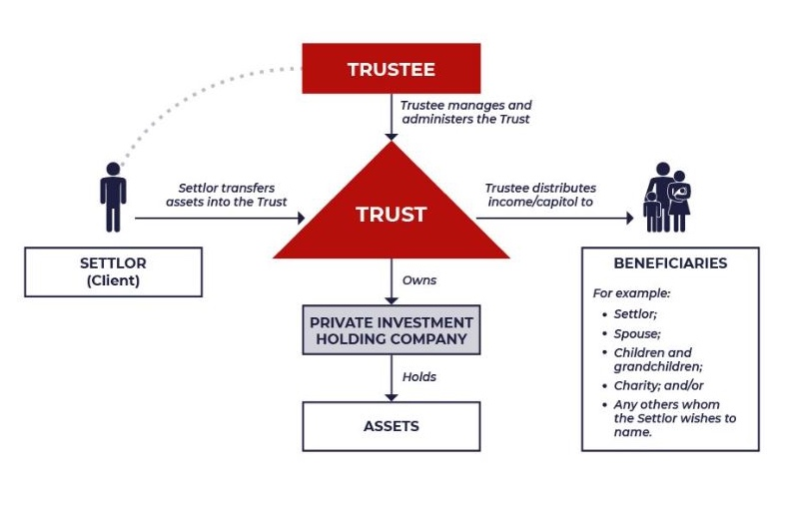
Trust and Corporate Service Providers

Slide 11

Trust and Corporate Service Providers
TCSP’s assist with company administration, from
entities established for a specific use to complex
cross-border structures that may have a number of different purposes in a variety of countries.
The jurisdictions of companies TCSP’s can administer is
not limited by the location of their offices; TCSP’s
offer company formation and administration in a
variety of jurisdictions.
TCSP’s provide a suite of corporate services; providing
the board of directors, both corporate and personal,
to registered office and supporting services;
bookkeeping, accounting and company secretarial.

Slide 12
the funds industry

Slide 13
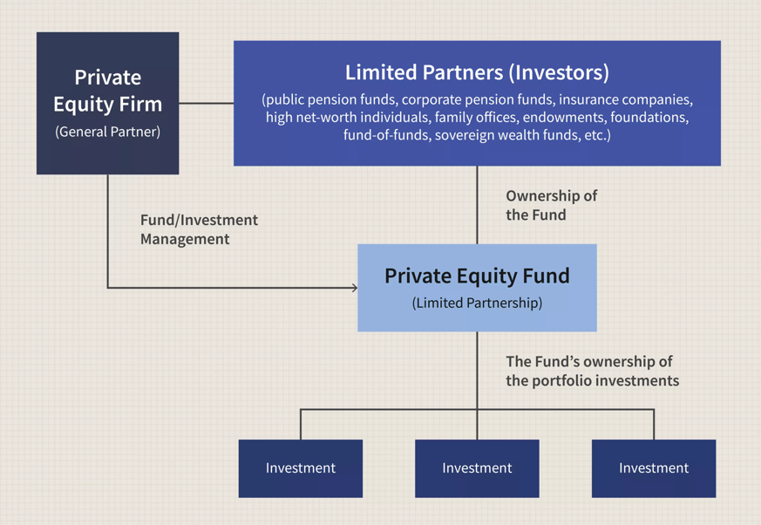
Advantages investing into funds?
A Typical Fund Structure
1. The management company, or private equity firm, is essentially an operating entity that employs General Partners and their investment teams. General Partners (GPs), or fund managers, are employed by and represent the private equity firm or management company.
2. Limited Partners (LPs), or simply Investors, are institutions and wealthy individuals responsible for providing the capital for the private equity fund.
3. Most private equity funds are established as a Limited Liability Company (LLC) or a Limited Partnership (LP). Limited Partnership Agreements (LPAs) are the investment terms that are agreed upon between General Partners or Private Equity Firms and Limited Partners.
Think of it as ‘flipping’ a property.
1
2
1
3
2
3

Slide 14
Largest private equity company in the world?
BlackRock - AUM: $7.5 trillion
Alternatives to PE are:
          Private Debt.
          Hedge Funds.
          Real Estate.
          Commodities.
          Collectibles.
          Structured Products, etc.

Slide 15
Advantages investing into funds?
Advantages of Using Fund Industry for Money Laundering – Stage One
Let us suppose an investment fund is formed in a jurisdiction with relatively lax regulatory standards. The fund is approached by the financial adviser of a “wealthy individual” who is seeking a high return on an investment. The money transferred into the investment fund on behalf of the “wealthy individual” comes from a bank account in Cyprus in the name of a company called “John Doe Investments LLC”.
The managers of the fund are informed that this is the “investment company” of the “wealthy individual”, and, because of the relatively lax regulatory regime coupled with the fact that the fund is in need of investors, thorough due diligence is not conducted.
John Doe Investments LLC is in fact controlled by a criminal organisation and the source of the money held in the bank account in Cyprus is the proceeds of internet fraud, drug trafficking, and arms dealing.

Slide 16
Advantages investing into funds?
Advantages of investing into funds – Stage Two
The investment fund makes a profit and, on the instructions of the “wealthy in individual”, money is periodically withdrawn from the fund and transferred to a bank account in Monaco. That bank account is controlled by the wife of one of the leaders of the criminal organisation. The income of the husband and wife can now be plausibly attributed to “foreign investment income”.
After several years, the criminal organisation behind “John Doe Investments LLC” wishes to use the shares held in the investment fund to pay off a debt incurred in the course of a major international illegal arms deal. The administrators of the fund are instructed to re- register the shares of the “wealthy individual” into the name of a corporate investment vehicle, “Investment One LLC”, for “tax planning purposes”. Investment One LLC is in fact controlled by the American mafia.
Notes:
Types of common fund structures - Open and Closed ended funds

Slide 17
Why not the funds industry?
Investing into Closed Ended (hedge) Funds
Pros
Less diversified portfolio.
Professional management.
Transparent pricing.
Potential for higher yields.
Cons
Subject to volatility.
Less liquid than open-end funds.
You cannot redeem prior to maturity.
Not particularly complex
Investing into Open Ended Funds
Pros
Hold diversified portfolios, lessening risk
Professional money management.
Are highly liquid.
Cons / Risk
The assets in which the fund invests cannot be liquidated within a day without material loss.
Exposed to price volatility, lower total returns.
Not particularly complex
Generally, not attractive to Money Launderers
Notes:
Generally, data found that TCSP were more attractive to Money Launderers, complex to disguise assets but simple enough to collapse

Slide 18
Trust and corporate service Providers
OECD analysis (Ending the Shell Game) - Most countries highlighted the prevalence of the companies, trusts and other corporate entities and arrangements in tax fraud and financial crime cases.
Corporate structures are attractive to criminals for two main reasons: a) they provide an air of legitimacy; and, b) they are separate from the individuals behind the corporate veil, they provide the ability to shield the identity of the beneficial owner.
Criminal funds can be disguised within legitimate business transactions by merging legal and illegal profits, which can be transferred either to other business entities or to domestic or foreign bank accounts. Professional services for the formation of such arrangements, while an important and legal activity, can also be an area of interest for investigators.
Use of business structures for illegal purposes is facilitated by an environment where quick, low-cost and easy incorporation is available. While the speed of incorporation is often designed to reduce the compliance burden on legitimate business owners and to encourage national economic growth, this can also create vulnerabilities to abuse by criminals.

Slide 19
Setting up companies, trusts and other business structures
Easy availability or formation of new companies negates the need for criminals to infiltrate established businesses. In many cases, fraudsters make use of corporate structures spanning multiple jurisdictions in order to hinder and disrupt investigations and to best present a legitimate front.
For example, an onshore jurisdiction can be used when setting up the “front” company, whereas accounts and assets are then located in offshore jurisdictions. Furthermore, the choice of the type of legal entity can be deliberate, in order to exploit legal arrangements where the separation of legal ownership and beneficial ownership of assets is designed to pose an impediment to investigators identifying, or recovering assets from, the owner.

Slide 20
Professional facilitators & shell companies - UK
Why Money Launders Like The UK:
https://www.youtube.com/watch?v=2ZcdxbzXtv0
Notes:
How does this relate in reality?

Slide 21


shell companies – A Practical example
Flat above a West Country takeaway that is home to 761 international firms.
Flat within South Bank tower has 1500 registered companies
Of 11,000 companies registered in the UK in 2020, most registered to 18 addresses (circa 4.4m registered companies)
‘The soft-touch system for registering companies in the UK is a fraudster’s paradise.’

Slide 22
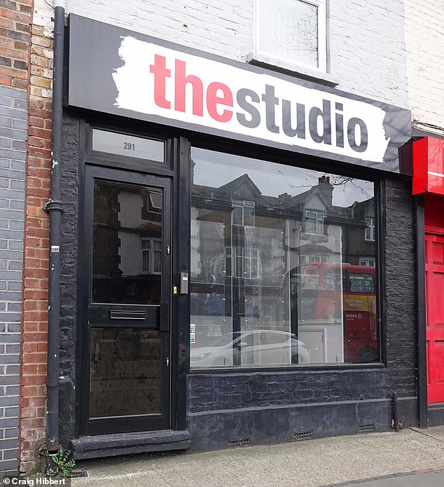
Professional facilitators & shell companies - UK
According to the National Crime Agency, these types of shell companies – which have no staff and do not trade but move assets on behalf of individuals or other businesses – are being used to launder £100 billion of stolen and illicit money through Britain each year.
While it can take weeks of form filling to get the bogus company removed, it takes less than 15 minutes and costs just £12 to register the company and needs neither proof of address, passport nor driving licence.

Slide 23
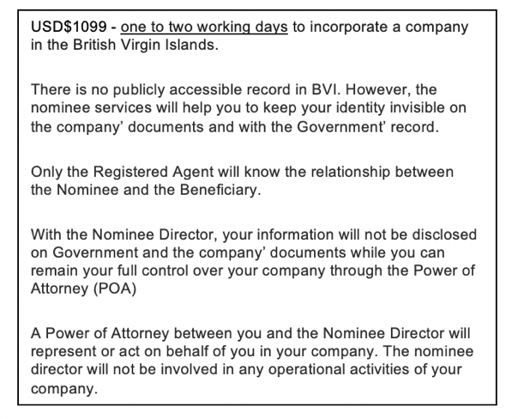
shell companies - BVI
The challenge is global. For example the BVI:
Commentary from a
BVI TCSP website offering services

Slide 24
Why do money launderers prefer trust structures?
Because they can be structured to be incredibly
complex and thus opaque.

Slide 25
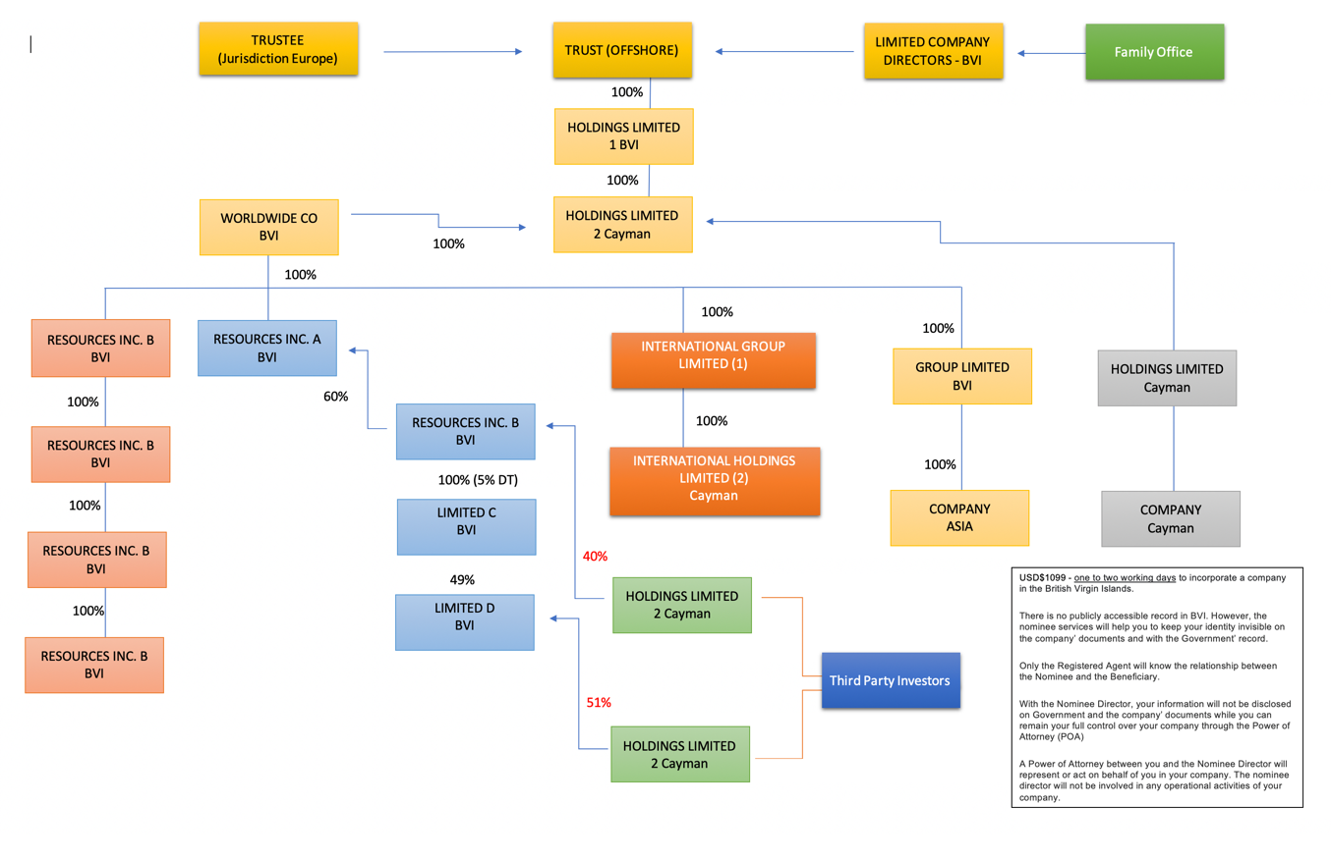
complex structures –Investigations / timing
?
40%

Slide 26
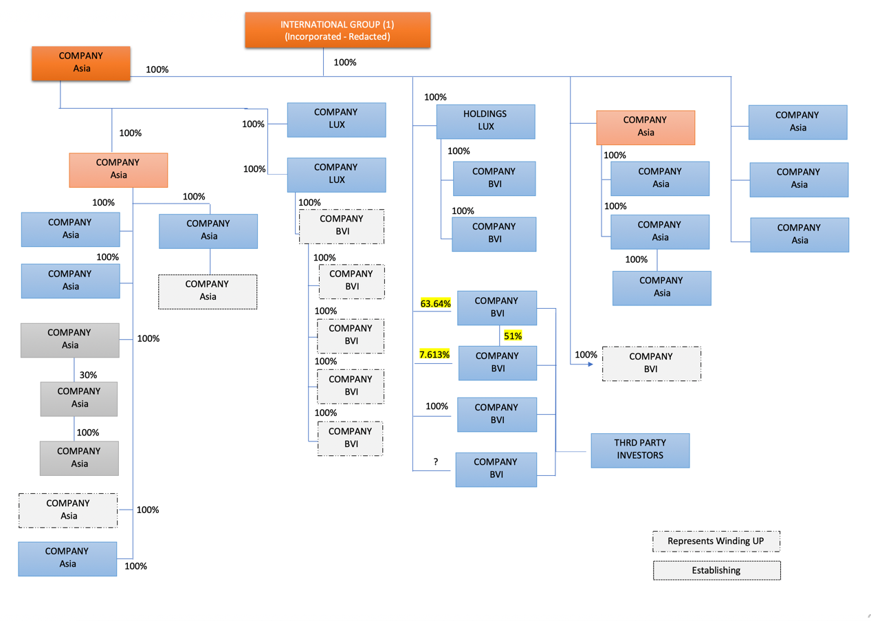
complex structures –Investigations / timing

Slide 27
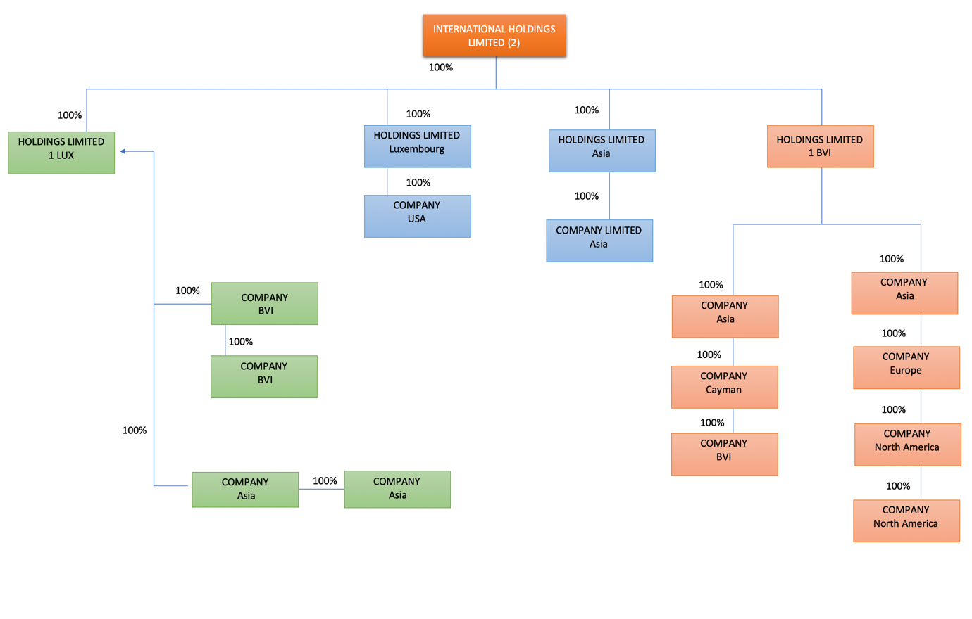
complex structures –Investigations / timing

Slide 28
Services Provided by Professional Enablers
Jersey – Population circa 103,000. Finance industry, employs 13,600
people. Value of the financial services sector - £1.8+ billion (2018).
Registered companies, 34,523.
ML prosecutions - minimal. Prosecutions for failing to report SAR’s – none.
Guernsey - Population circa 63,000. Finance industry, employs 2,455
people. Value of finance industry £1.2 billion. Registered entities, 19,140.
ML prosecutions – minimal. Prosecutions for failing to report SAR’s – none.

Slide 29
Controlling Professional Enablers
Legislative initiatives – Tighter Controls and Penalties
Jersey – Following the introduction of the Failing to Prevent Tax Evasion
Offence, 2022, Jersey introduced the new offence under
Article 35A of the POCL 1999 of ‘Failing to Prevent’ Money laundering.
Defence - Must demonstrate effective AML/CFT controls
UK - The Criminal Finances Act 2017 creates two new corporate criminal offences of failure to prevent the facilitation of tax evasion. ‘It is a criminal offence in the UK if a business fails to prevent its employees or any person associated with it from facilitating tax evasion.’

Slide 30
Controlling Professional Enablers
UK - Criminal Finances Act 2017 - Territorial
In relation to the UK tax offence, the offence will apply to any company or partnership, wherever it is formed or operates.
Where non-UK tax is evaded a business will commit an offence if there is a "connection" to the UK. Broadly, there will be a UK connection if the facilitation involves a UK company or partnership, any company or partnership with a place of business in the UK, including a branch, or if any part of the facilitation takes place in the UK. In addition, the foreign tax evasion and facilitation must amount to an offence in the local jurisdiction and involve conduct which a UK court would consider to be dishonest.

Slide 31
So how do you gain the advantage?
Points for consideration?
The less intelligence the more complex the investigation. So consider data mining professional enablers.
You are at an distinct disadvantage if you fail to cultivate international relations with fellow law enforcement departments. Consider why senior financial service sector professionals are exceptionally good at their respective professions – networking, networking, networking. You need to start thinking and acting like the business sector because that’s where the proceeds of crime are processed.
Importantly, you need to understand the finance sector on a granular level.

Slide 32

Gaining the advantage?

Slide 33

Gaining the advantage?
Speed

Slide 34

Gaining the advantage?
Speed
Speed

Slide 35
Gaining the advantage?
Speed
expeditious
Speed

Slide 36
So how do we gain the advantage?
5 / 10 minutes
Consider some ideas on how law enforcement and/or the judiciary
can consider altering the balance by expediting investagations.

Slide 37
Challenges and advantages
Challenge:
Financial services firms have embraced the opportunities offered by innovation and further integrate disruptive technologies, such as artificial intelligence (AI), advanced analytics, robotics, the cloud and blockchain, to enable new services and capabilities. Automation = speed.
Performance related incentives. Employees more willing to ‘turn a blind eye.’ Very aggressive working environment, substantial pressure to hit targets which are reset on 1 January.
Skillset – companies invest heavily in academia/qualifications specifically related to subject matter.
Professional enablers are committed to the provision of a high service facility to clients. Speed and a ‘can do’ attitude. Employees are heavily incentivised.
Investment into financial services infrastructure – IT etc.

Slide 38
However, you are afforded advantages
Advantages:
Local and global intelligence gathering network.
Legislative framework / coercive orders.
International MLAT function.
A true commitment to public service and the enforcement of criminal legislation.
Ability to adapt legislation to changing landscape.
Support from the public sector.

Slide 39
How does this translate?
UK Initiatives:
Corporate Directors – UK Proposal - ‘Businesses will only be able to operate as corporate directors on the boards of other companies in the UK if all of their directors are real people whose identity has been verified by Companies House. Evidence suggests that the use of corporate directors can muddy the waters around ownership and provide a screen behind which to conduct illicit activity,"
Beneficial Ownership Register - The UK beneficial ownership registry has more than 5.1 million names of people with significant control over UK registered companies. The Beneficial Ownership of Legal Persons (Guernsey) Law, 2017, effective; 15 August 2017.
More than 25% of shares in the company
More than 25% of voting rights in the company
The right to appoint or remove the majority of the board of directors

Slide 40
How can we improve?
Embrace Data Mining

Slide 41
“Leadership is influence, nothing more, nothing less.”
Everyone has some level of influence, which is why everyone is a leader.
(Anon)

